Slide 1

Cell Communication

Slide 2
Multicellular Organisms
Many multicellular organisms have trillions of cells which must communicate with one another.
Such communication enables the creature to coordinate cellular activities ensuring the vitality of the organism.

Slide 3
Signal Transduction Pathways
There are three main stages to a signal transduction pathway:
1. Reception—a surface protein in the cell membrane receives a signal on its surface.
2. Transduction—the change in the protein stimulates a series of events that leads to changes in the cell.
3. Response—nearly all cellular activity changes in one way or another.

Slide 4
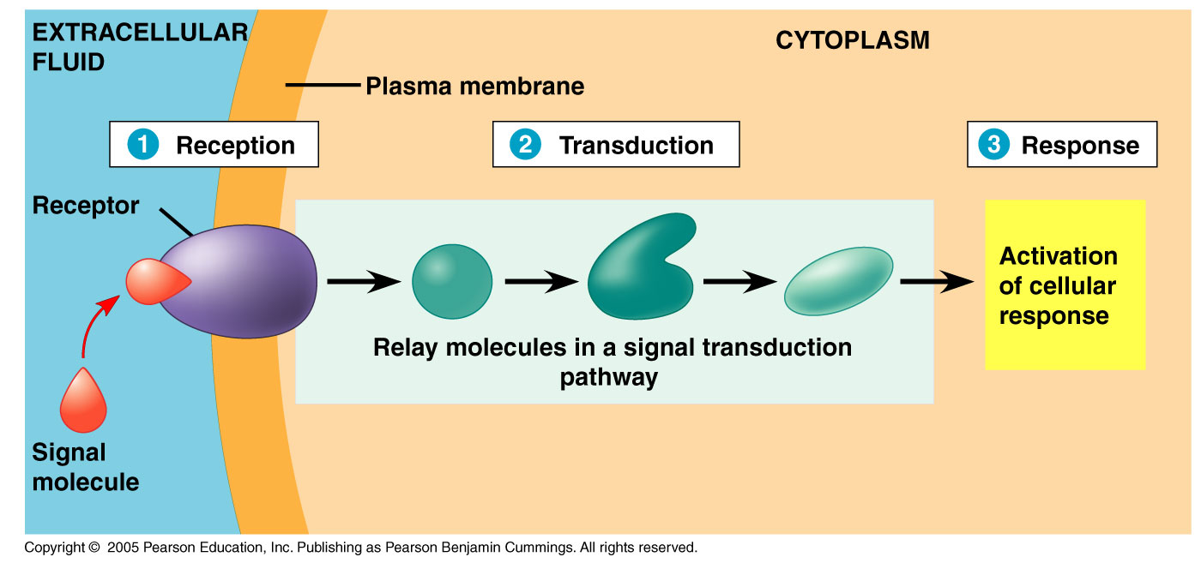
Cell Signaling in Yeast
So, how do cell signals elicit changes?
This process is called a signal transduction pathway, and is a series of steps whereby the signal received by the surface of the cell is passed through a series of steps in the cell bringing about changes in transcription and translation.

Slide 5
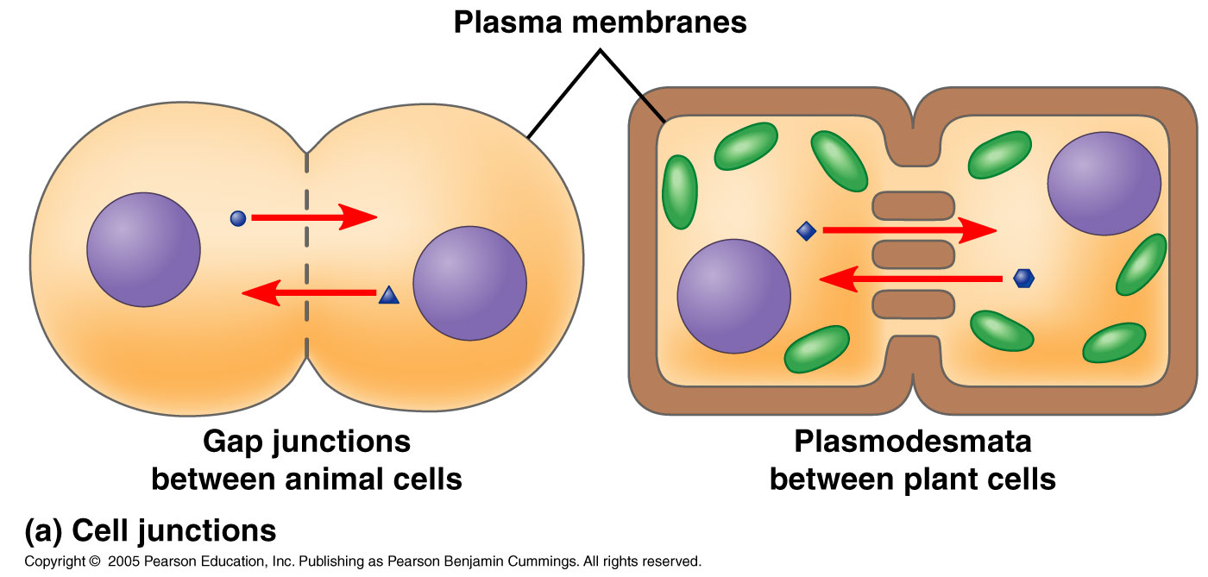
Local Signaling
Plants and animals have cellular junctions that connect the cytoplasms of adjacent cells.
Cytosolic substances can pass freely from cell to cell.

Slide 6
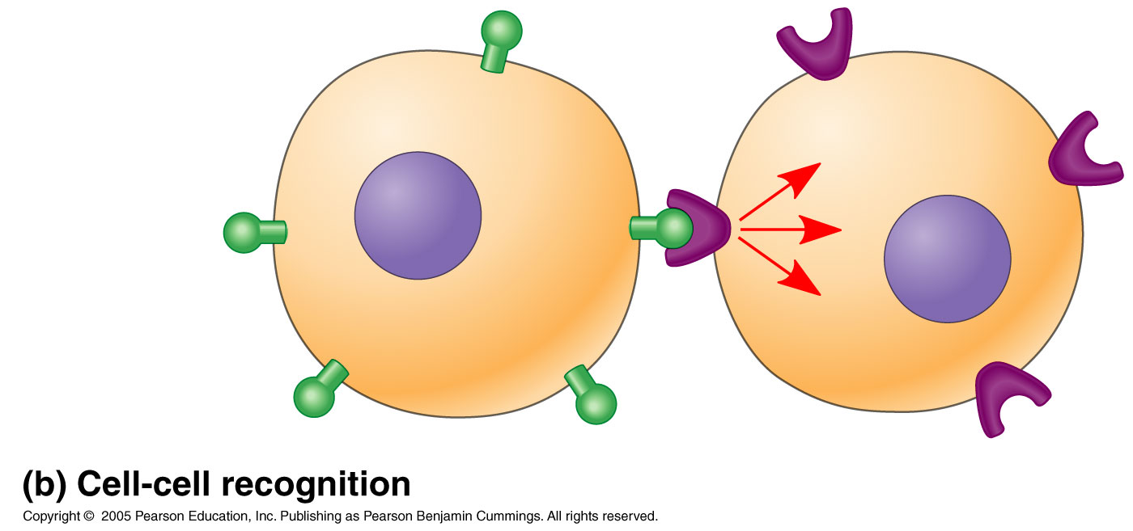
Local Signaling
Additionally, animal cells can also communicate via direct contact of membrane-bound cell-surface molecules in a process called cell-cell recognition.

Slide 7
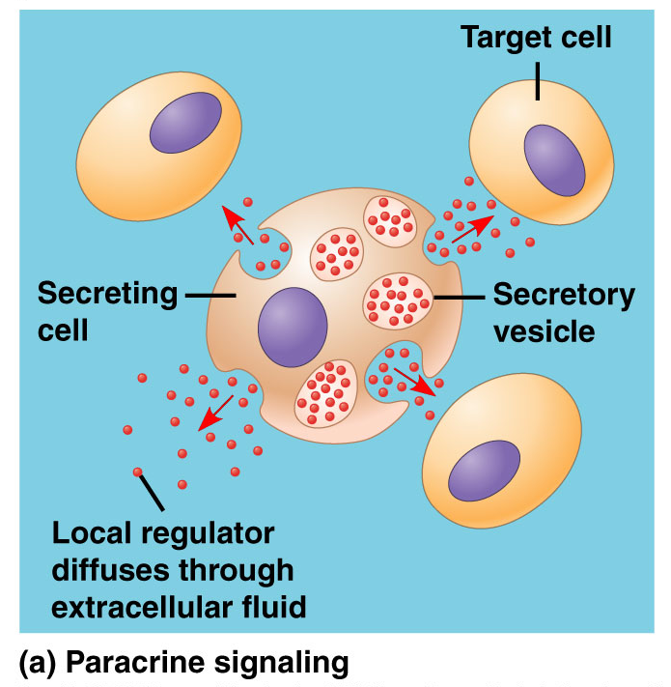
Local Signaling
Local regulators travel short distances and influence cells in the immediate vicinity.
This type of local signaling is called paracrine signaling.

Slide 8
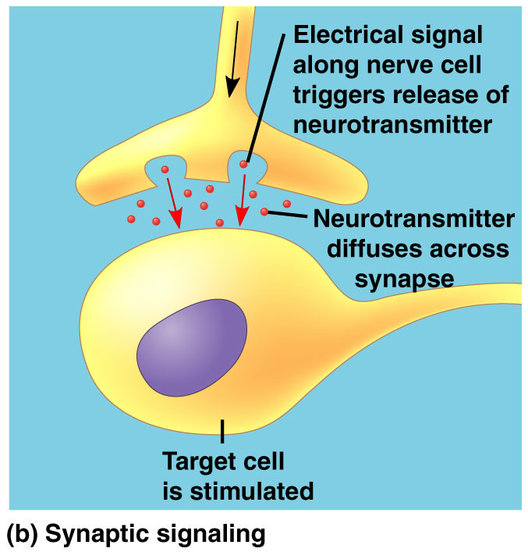
Local Signaling
Another type of local signaling is called synaptic signaling. This occurs in an animal’s nervous system and involves the release of a chemical signal in response to an electrical signal from the nervous system.
These neurotransmitters diffuse across the synapse and elicit a change in the target cell.

Slide 9
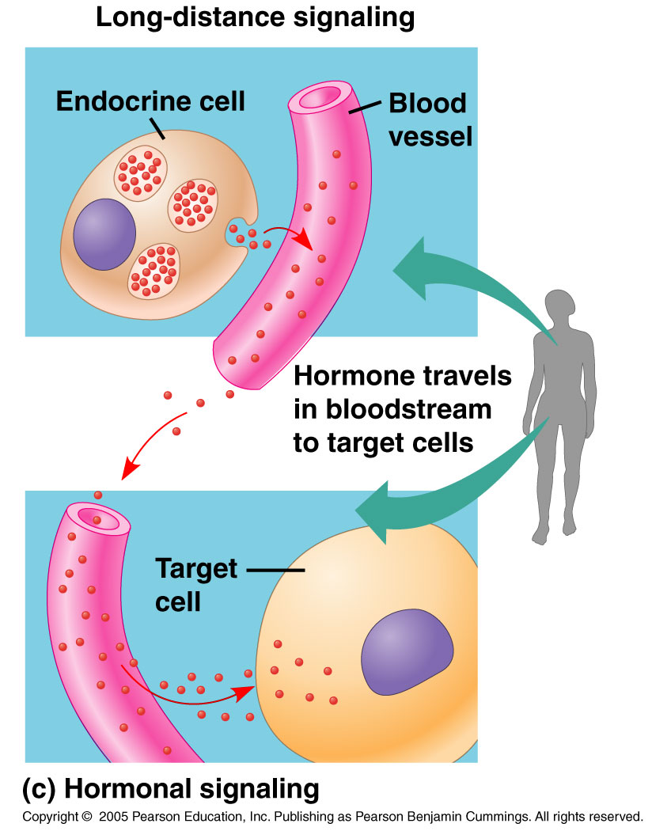
Long-Distance Signaling
Plants and animals use hormones for long-distance signaling.
This type of signaling is also called endocrine signaling, and involves specialized cells releasing hormones into vessels of the circulatory system. When these hormones reach the target cells, they elicit a change.

Slide 10
So, Now What Happens?
1. A receptor molecule on the surface of a cell must recognize the chemical signal and the information it carries.
2. The transduction of the signal must occur before the cell can respond.
3. The cell must then respond.

Slide 11
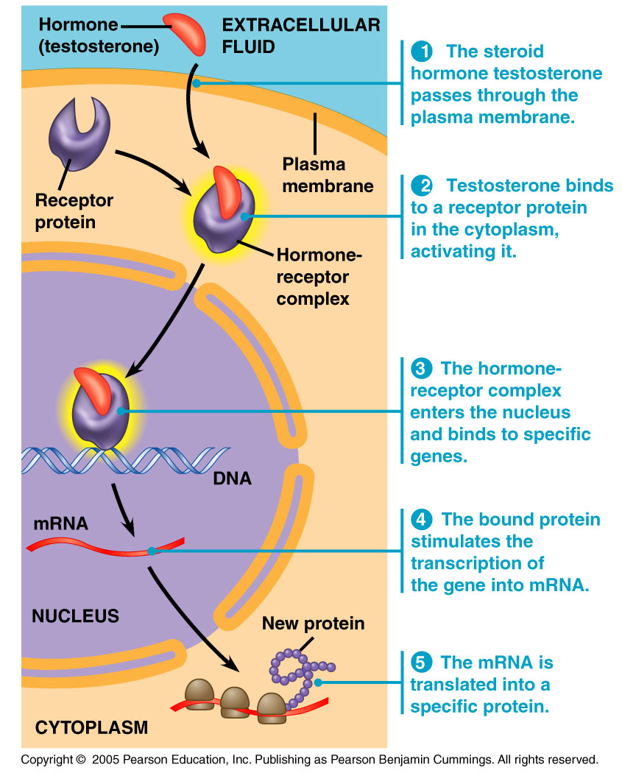
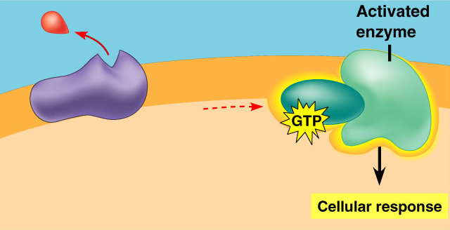
3 Stages of Cell Signaling
1. Reception. This is the process by which the target cell detects the outside signal.
  Detection occurs when a signal molecule binds to a receptor protein on the surface or inside the cell.

Slide 12
3 Stages of Cell Signaling
2. Transduction. When the signaling molecule changes the receptor protein in some way, transduction is initiated. This is the stage where the signal is converted into a form bringing about a specific cellular response.

Slide 13
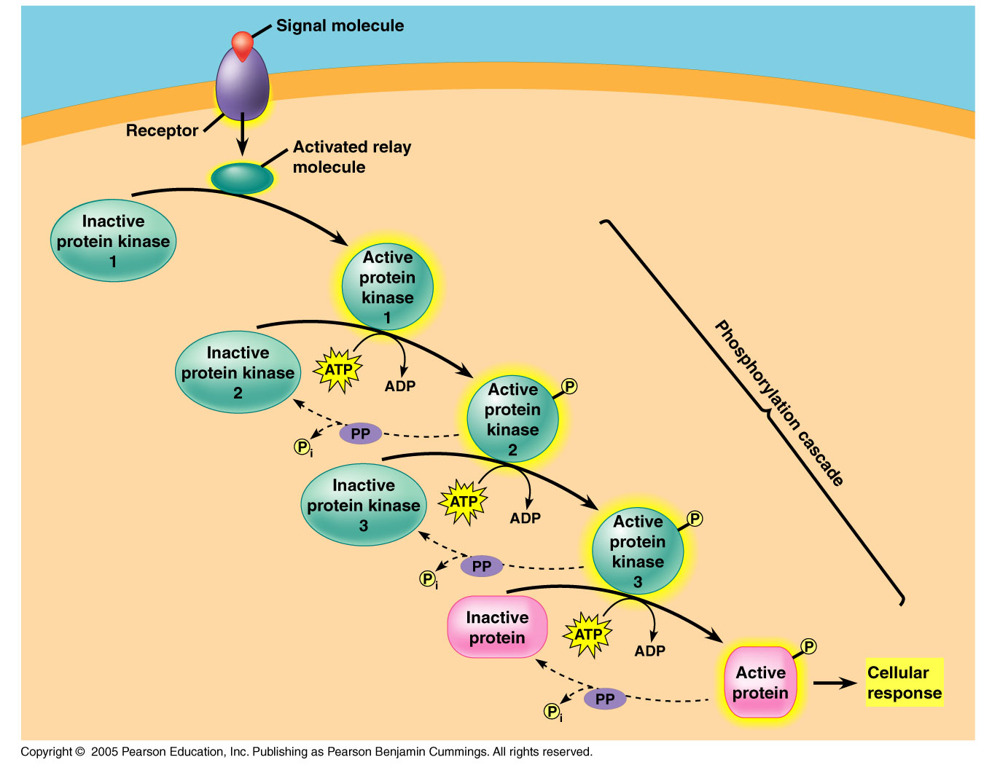
3 Stages of Cell Signaling
Transduction can occur in one step, but often involves many steps.

Slide 14
3 Stages of Cell Signaling
3. Response. The response occurs when the transduced signal triggers a specific cellular response.

Slide 15
1. Reception
The signal created is received by a receptor protein on or in the target cell.
The signal-receptor interaction is similar to the enzyme-substrate reaction.
The signal behaves as a ligand—a molecule that binds specifically to another molecule.
This binding generally causes a shape change that allows for further events to occur inside the cell.

Slide 16
1. Reception
Thus, the ligand binding acts similarly to the binding of an allosteric regulator onto that of an enzyme.

Slide 17
Plasma Membrane Receptors
Most water-soluble signaling molecules bind to sites on receptor proteins embedded in the cell’s plasma membrane.
The signal is then transmitted to the inside of the cell.

Slide 18
Plasma Membrane Receptors
There are three major types of membrane receptors:
  A. G protein-coupled receptors
  B. Receptor tyrosine kinases
  C. Ion channel receptors

Slide 19
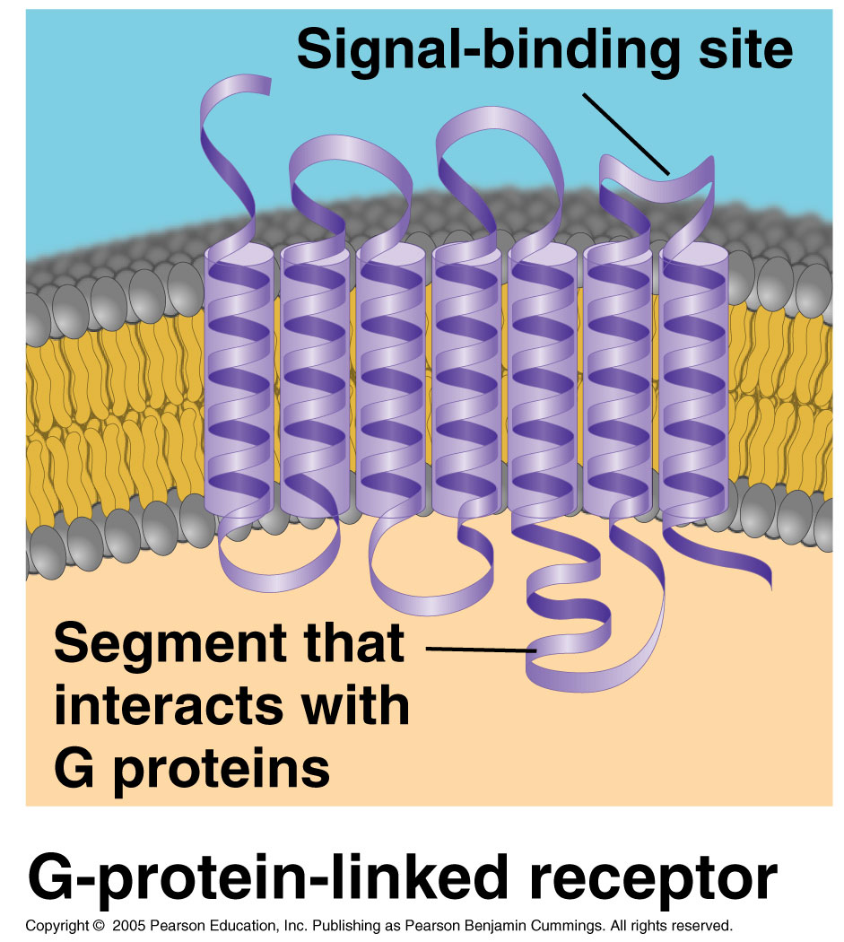
A. G Protein-Coupled Receptors
These receptors are embedded in the plasma membrane and work with the help of a G-protein.
G-proteins are proteins that bind energy rich GTP molecules.
They are all similar in structure and have seven α helicies which span the membrane.

Slide 20
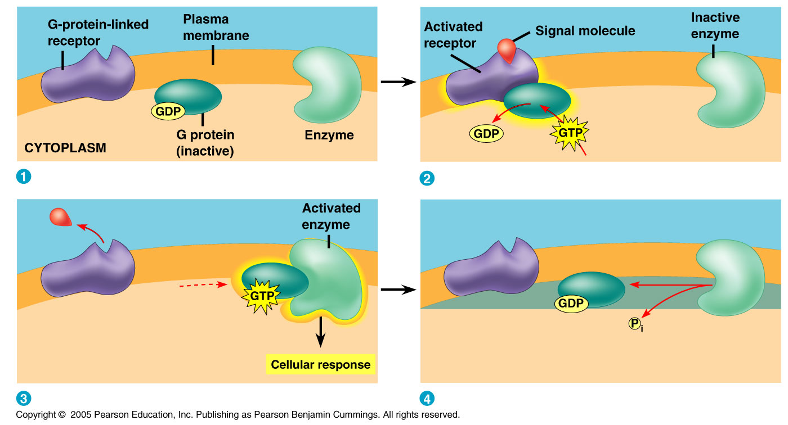
A. G Protein-Coupled Receptors
G-protein receptors are embedded in the plasma membrane. When they receive the signal, they activate the associated G-protein which, in turn, activates an enzyme starting the signal cascade.

Slide 21
A. G Protein-Coupled Receptors
These protein receptors are very widespread and diverse in their functions.
They are involved in embryonic development and sensory reception such as vision and smell, as well as many other functions.
They bind:
  Odors
  Pheromones
  Hormones
  Neurotransmitters

Slide 22
A. G Protein-Coupled Receptors
G-protein systems are involved in numerous human diseases.
Cholera, pertussis, and botulism are common bacteria-induced illnesses that produce toxins which interfere with G-protein function.
  This interference causes the symptoms associated with the illnesses-massive diarrhea, muscle contraction, coughing attacks, etc.

Slide 23
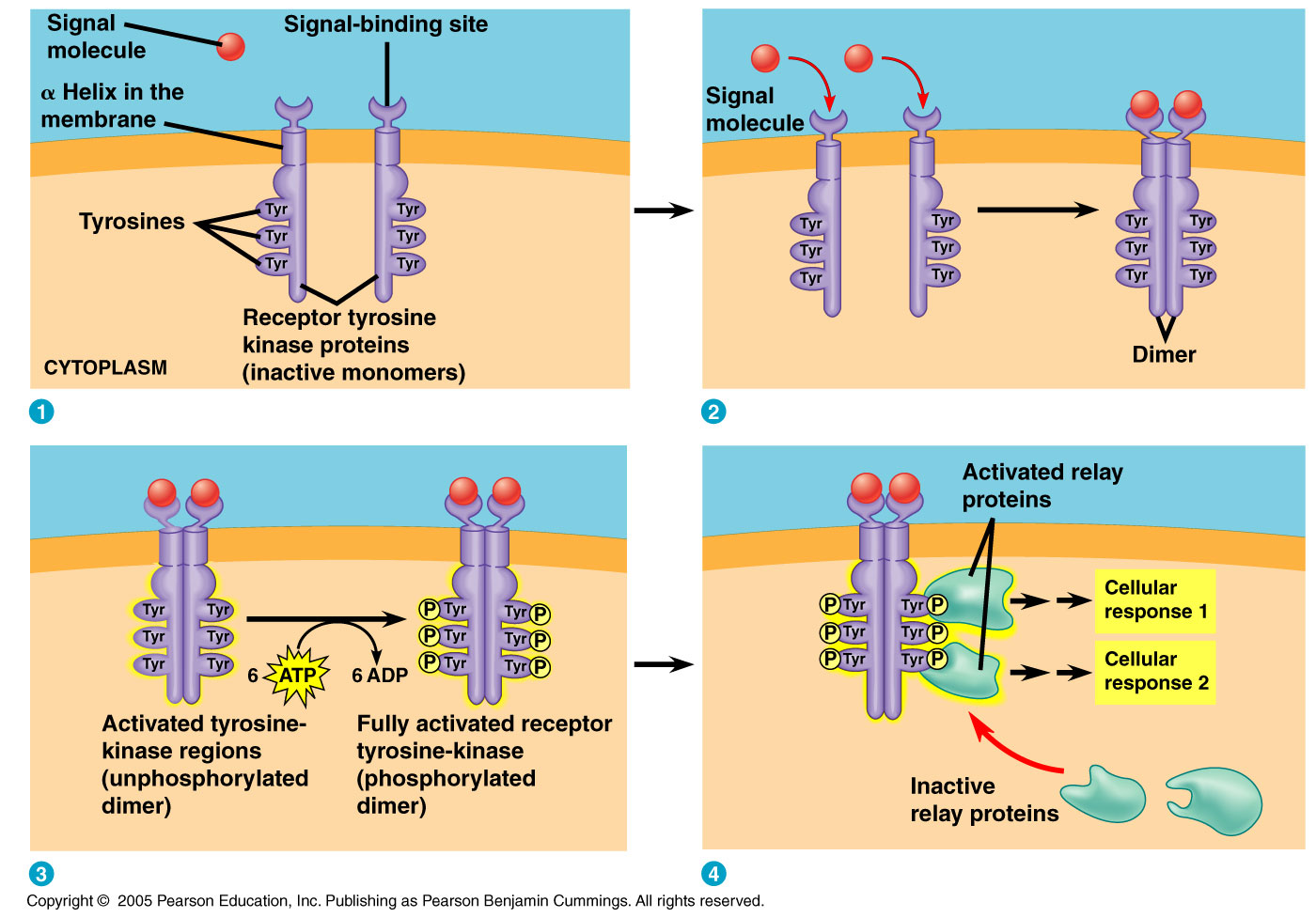
B. Receptor Tyrosine Kinases
Receptor tyrosine kinases belong to a major class of plasma membrane receptors which have enzymatic activity.

Slide 24
B. Receptor Tyrosine Kinases
The part of the receptor protein which extends into the cytoplasm acts as the tyrosine kinase—the enzyme that catalyzes the transfer of the phosphate from ATP to the amino acid tyrosine on the substrate protein.

Slide 25
B. Receptor Tyrosine Kinases
One receptor tyrosine kinase can activate a number of different transduction pathways.
The ability of these receptors to trigger so many pathways is a key difference between receptor tyrosine kinases and G-protein coupled receptors.

Slide 26
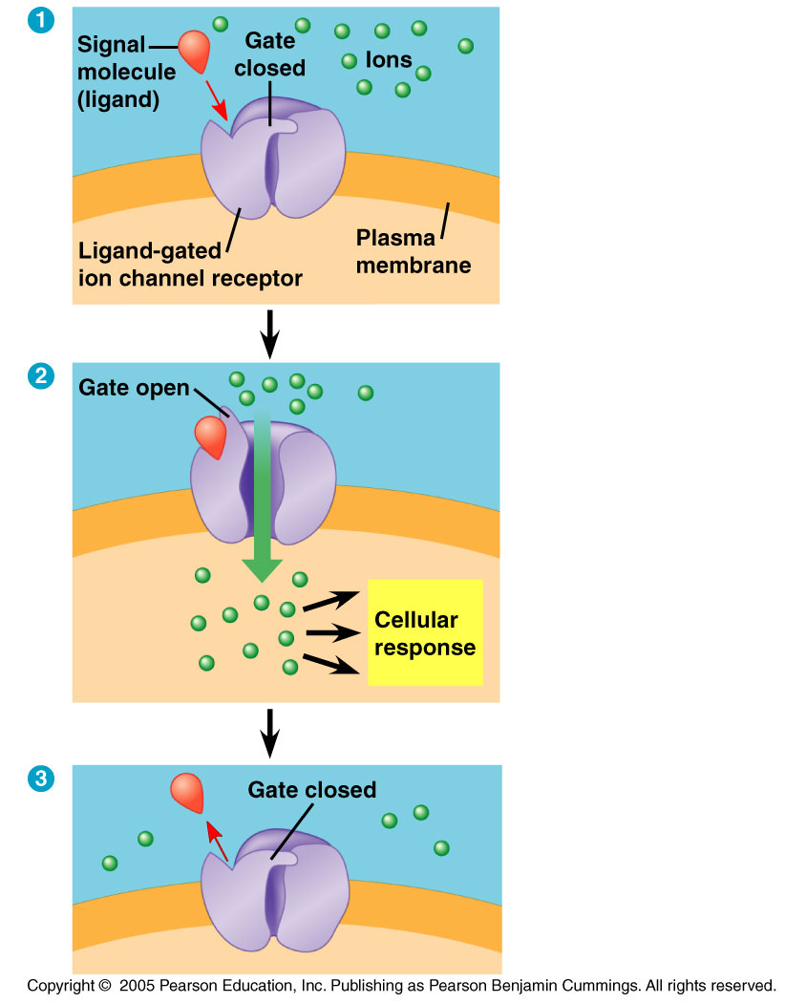
C. Ion Channel Receptors
Ligand-gated ion channels are a type of membrane receptor with a region that acts as a gate.

Slide 27
C. Ion Channel Receptors
When a signaling molecule binds to the receptor, a conformational change occurs and a gate opens or closes.
This opening or closing allows for the flow or blockage of specific ions—eg. Ca²⁺, Na⁺, etc.

Slide 28

C. Ion Channel Receptors
These channels are very important to the nervous system.
When a neurotransmitter molecule is released at the synapse, it acts as a ligand and binds to the ion channel on the receiving cell.

Slide 29
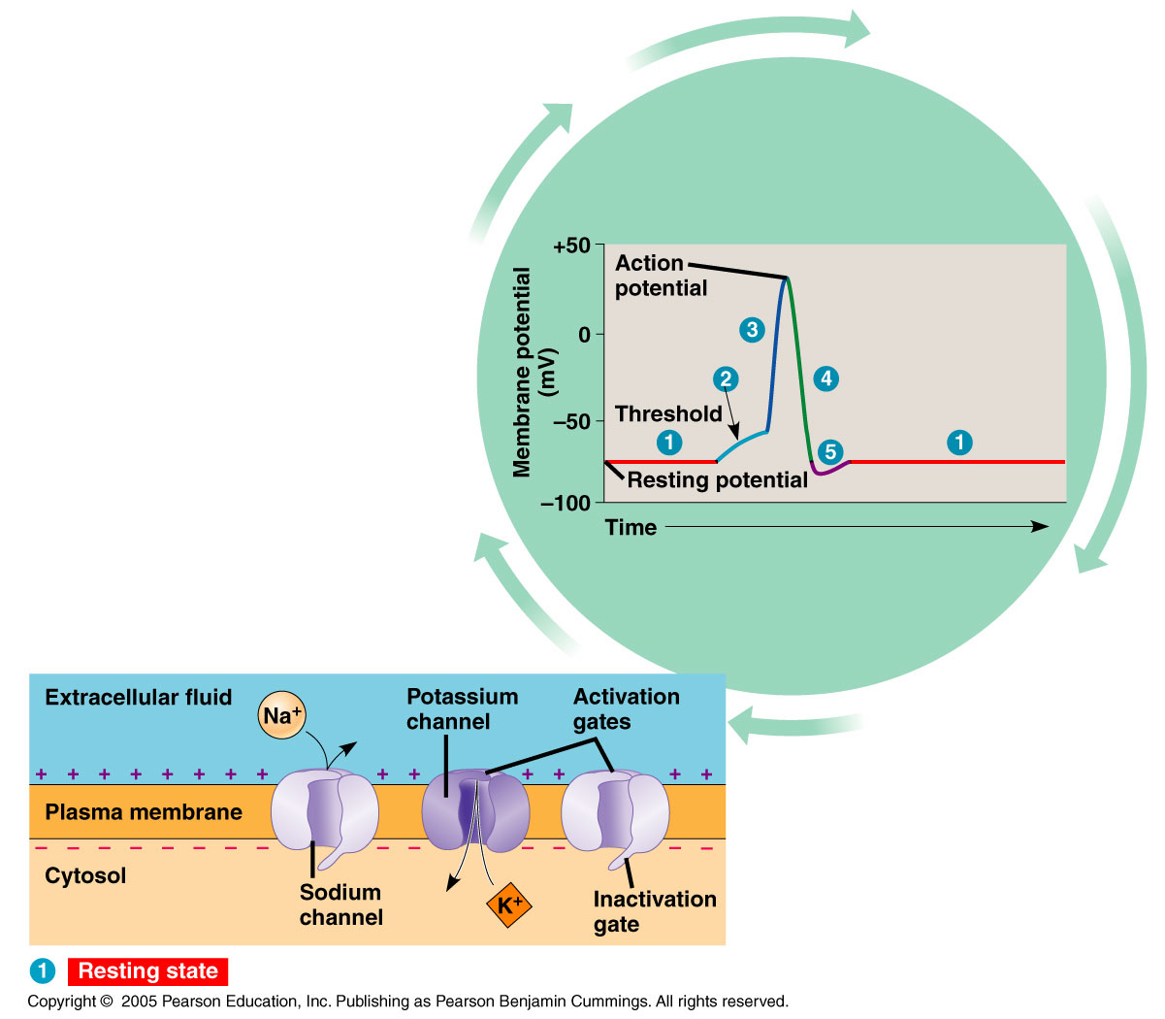
C. Ion Channel Receptors
Binding, in turn, causes the channel to open and ions flow through the gate triggering an electrical signal that rapidly moves along the length of the receiving cell.

Slide 30
Intracellular Receptors
Intracellular receptor proteins can also be found in the nucleus or the cytoplasm of target cells.
In order to reach these receptors, the chemical messenger must pass through the plasma membrane.
Steroid hormones, thyroid hormones, and nitric oxide are common messengers that pass through the plasma membrane.

Slide 31
Intracellular Receptors
Once they pass through the membrane, the signals activate a receptor protein which then enters the nucleus and turns on transcription and translation.

Slide 32
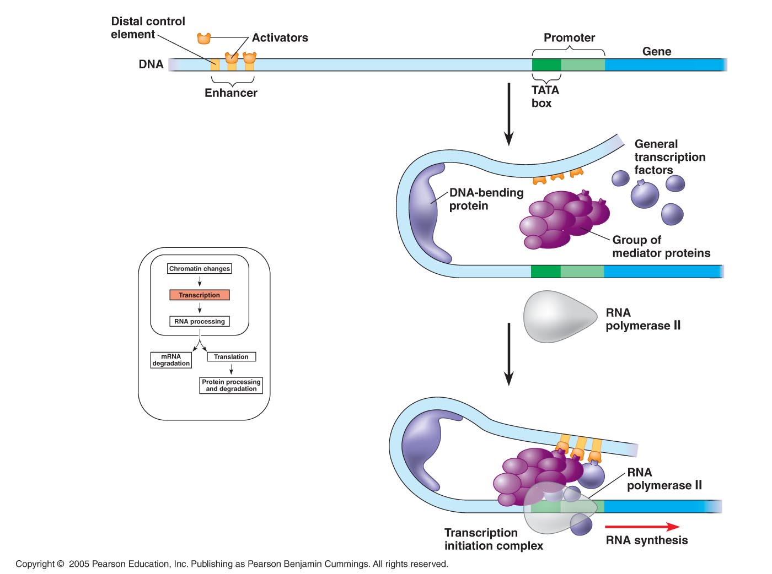
Intracellular Receptors
How does this happen?
These activated receptor proteins act as transcription factors which control the transcription of genes into mRNA, and ultimately the production of protein.

Slide 33
2. Signal Transduction
Cell signaling is usually a multistep pathway.
These steps can include:
  The addition of phosphate groups.
  The removal of phosphate groups.
  Release of small molecules or ions which act as messengers.

Slide 34
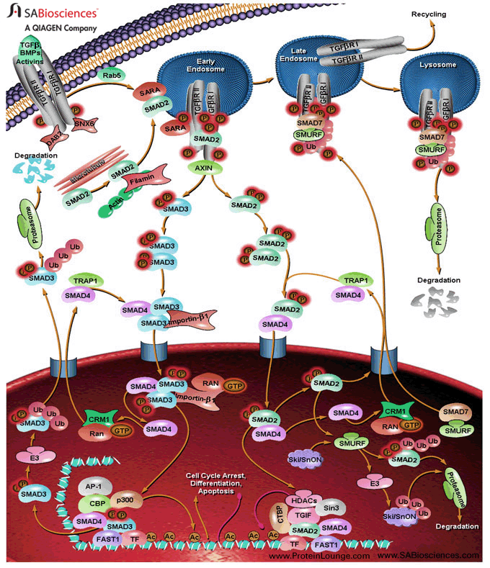
2. Signal Transduction
By this method, the signal is often amplified as a small number of initial molecules interact with a larger number of molecules in the next step of the pathway.
http://sabiosciences.com/pathway.php?sn=SMAD_Signaling_Network

Slide 35
Signal Transduction Pathway
The first step in the pathway is the attachment of the signaling molecule to the receptor protein.
From here, the relay molecules (mostly proteins) transmit the signal to the next step—usually resulting in a change in protein conformation.
These pathways can regulate both the activity of the proteins, or the synthesis of them.

Slide 36
Protein Kinases
The phosphorylation and dephosphorylation of proteins is a common cellular mechanism for regulating protein activity.
  Protein kinases are enzymes that transfer a phosphate group from ATP to a protein.
    These are very important—at least 2% of our genes code for protein kinases.
Each cell may have more than 100 different kinds of protein kinases.

Slide 37
Protein Kinases

Slide 38
Protein Kinases
Many relay molecules in a signal transduction pathway are protein kinases; these often act on other protein kinases in the pathway.

Slide 39
Phosphorylation Cascade
In such a cascade, a series of different molecules in the pathway are phosphorylated, and in turn, each molecule adds a phosphate group to the next one in the series.

Slide 40
Phosphorylation Cascade
Generally speaking, phosphorylation activates each molecule, and dephosphorylation returns it to its inactive form; each often results in a change in molecular shape.

Slide 41
Protein Phosphatases
As we said, phosphorylation and dephosphorylation of proteins are common cellular mechanisms for regulating protein activity.
  Phosphatases rapidly remove phosphate groups from proteins in a process called dephosphorylation.
  They act as off switches in the signal pathway, and they make the protein kinases available for reuse.

Slide 42
Protein Phosphatases

Slide 43
Second Messengers
Some components of the signal transduction pathways are NOT proteins.
Many of these pathways involve second messengers, which are often small, water soluble molecules or ions. Additionally, they can easily diffuse through the cytoplasm.
Second messengers participate in signal transduction pathways initiated by both G protein-coupled receptors and receptor tyrosine kinases.
  cAMP and Ca²⁺ are the two most commonly used second messengers.

Slide 44
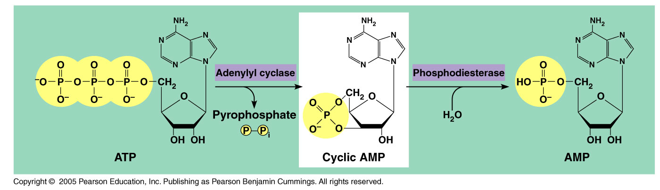
Cyclic AMP
Embedded within the membrane is an enzyme called adenylyl cyclase which converts ATP to cAMP in response to the extracellular signal.

Slide 45
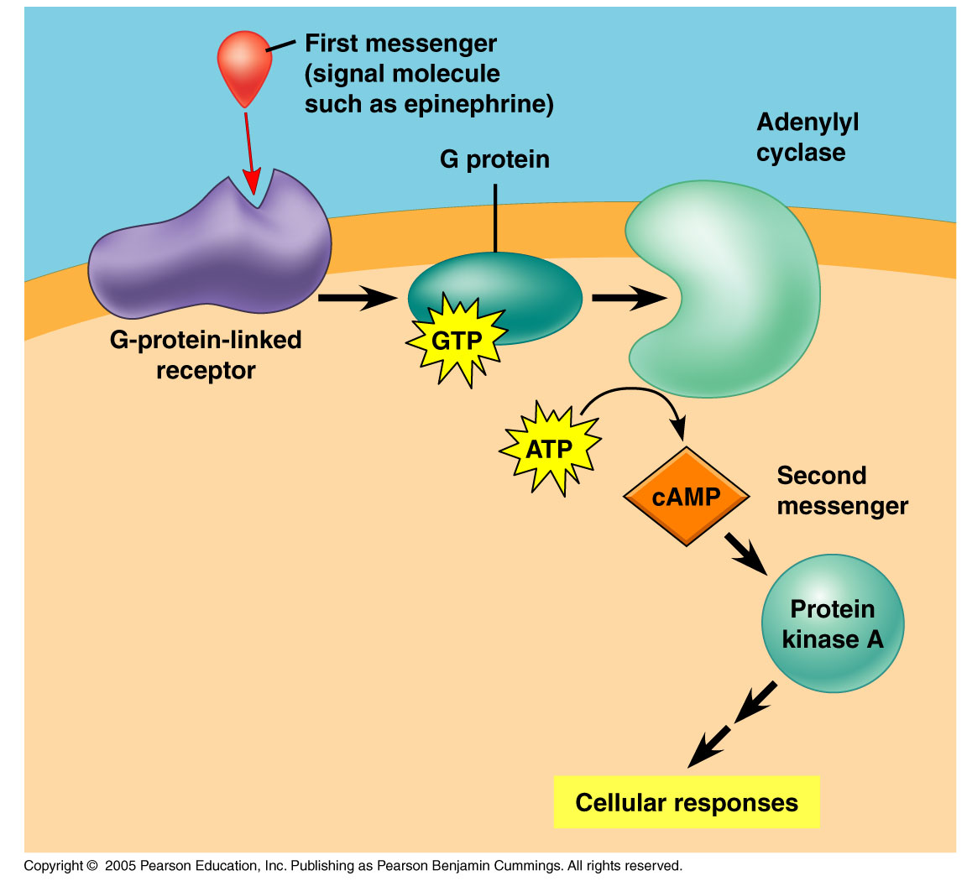
Cyclic AMP
In response to the external signal, a receptor protein activates adenylyl cyclase, catalyzing the synthesis of many molecules of cAMP.
Thus, in a matter of seconds, the amount of cAMP can be dramatically increased.

Slide 46
Cyclic AMP
Not long after cAMP is created, phosphodiesterase converts it to AMP and the pathway shuts down.
  The immediate effect of cAMP is usually the activation of a serine/threonine kinase called protein kinase A.
  This leads to further transmission of the signal.

Slide 47
Cyclic AMP
Cell metabolism can be further regulated by other G-protein systems that inhibit adenylyl cyclase.
In such cases, a different signaling molecule activates different receptors which, in turn, activate inhibitory G-proteins.

Slide 48
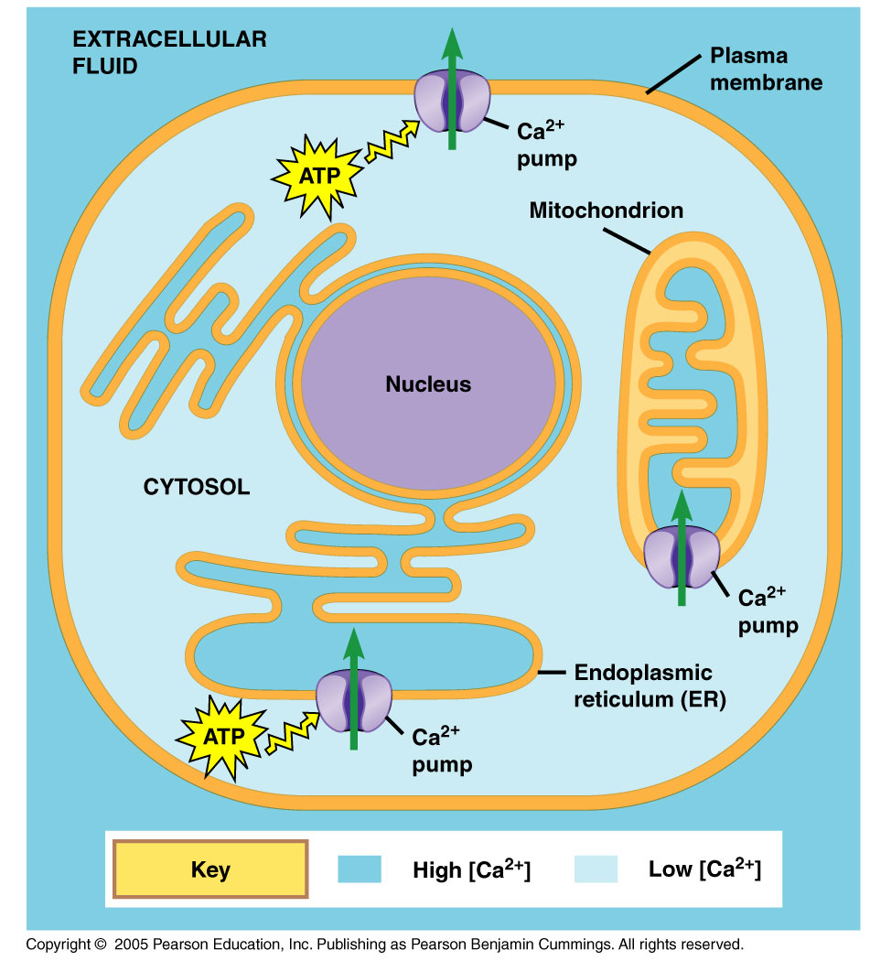
Ca²⁺ and IP₃
Many signaling molecules induce responses in their target cells by signal transduction pathways.
These pathways increase the cytosolic concentration of Ca²⁺ ions.

Slide 49
Ca²⁺ and IP₃
Calcium is actively pumped out of the cell and thus the concentration of Ca²⁺ is about 10,000x lower in the cytoplasm of the cell.

Slide 50
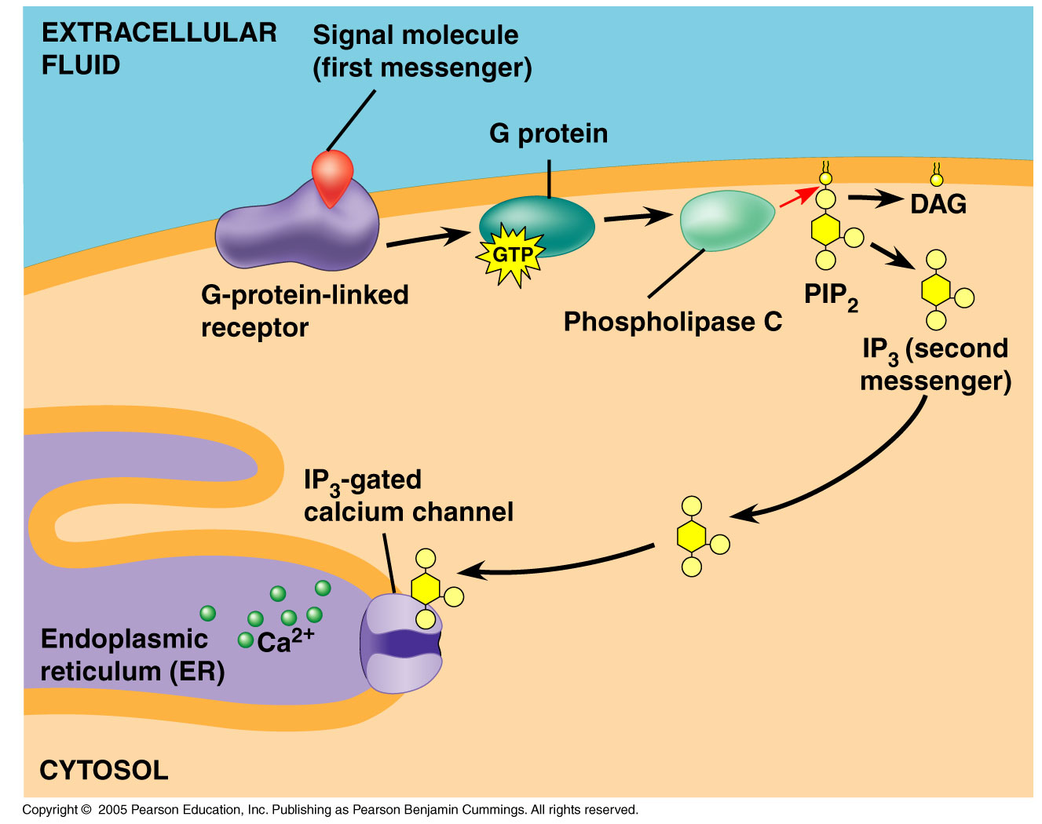
Ca²⁺ and IP₃
When an appropriate signal is received, a variety of second messengers get involved resulting in an increase in cytoplasmic calcium concentration.

Slide 51
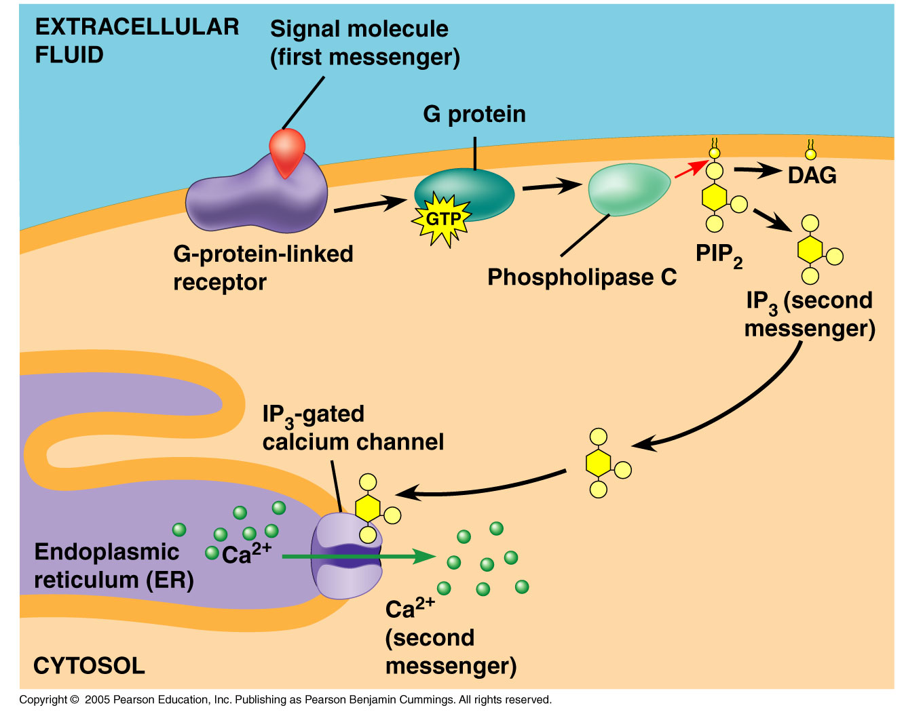
Ca²⁺ and IP₃
IP₃ and diacylglycerol are two messengers produced by the alteration of a phospholipid in the plasma membrane.
This leads to the increase in the Ca²⁺ concentration within the cytoplasm.

Slide 52
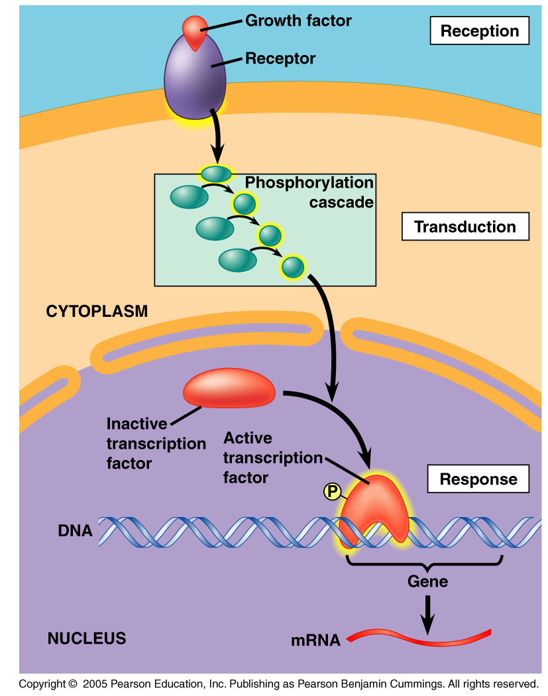
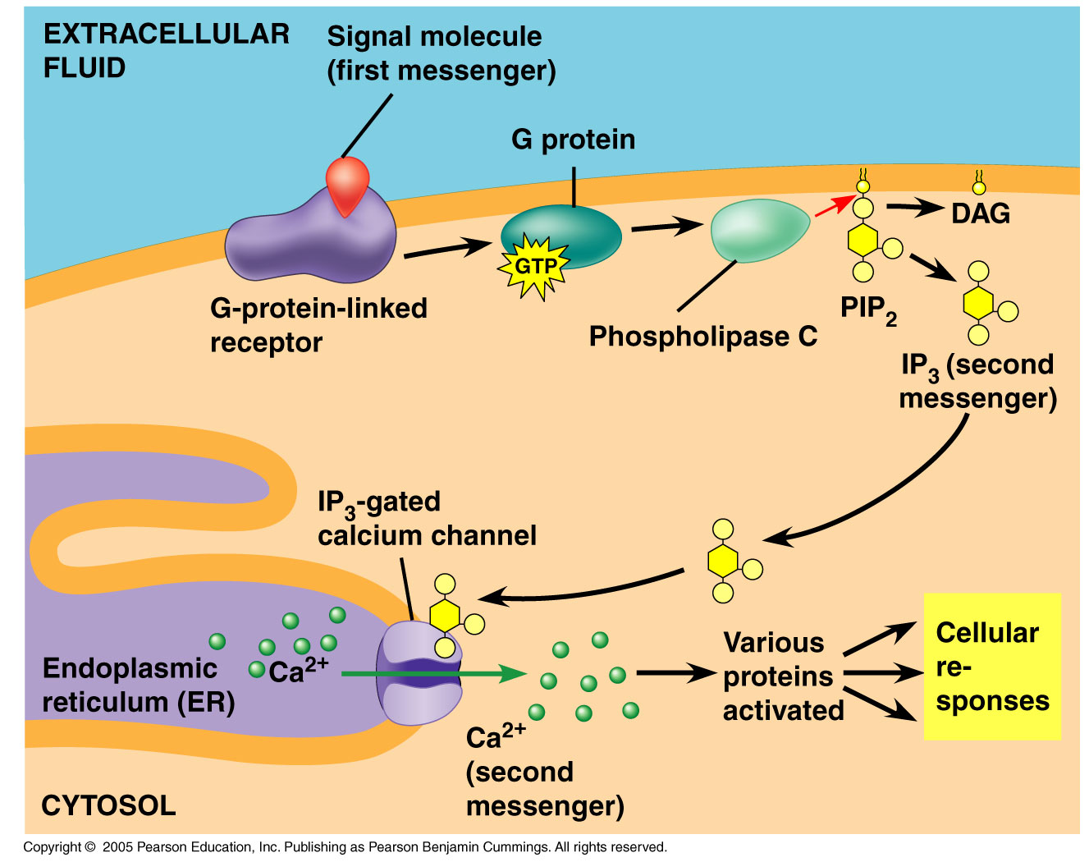
3. Cellular Responses
Many signaling pathways ultimately regulate protein synthesis, usually by turning specific genes on and off.

Slide 53
Fine Tuning Cellular Response
There are many benefits to having multiple events in a signal transduction pathway.
Two important benefits:
  1. They easily amplify the signal.
  2. They provide different points where the response can be regulated.

Slide 54
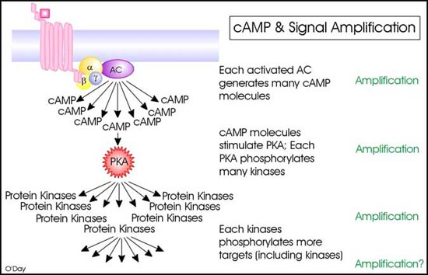
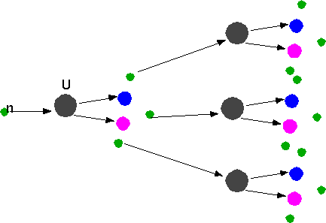
1. Signal Amplification
Elaborate enzyme cascades amplify a cell’s response to an external signal.
  Such cascades serve to activate many more products in the following stage—in much the same way as occurs during a nuclear chain reaction.
http://www.utm.utoronto.ca/~w3bio315/lecture10.htm
http://www.physics.carleton.ca/~watson/Physics/1000_level/1008_Modern_Physics/1008_Nuclear_Physics_app.html

Slide 55
1. Signal Amplification
The reason this occurs is because the activated proteins remain in the cytoplasm long enough to process numerous molecules of substrate before they become deactivated.

Slide 56
2. Different Regulation Points
When there are many steps involved, different substances can bind to different proteins, inactivating them, and ultimately controlling the pathway and hence the response.

Slide 57
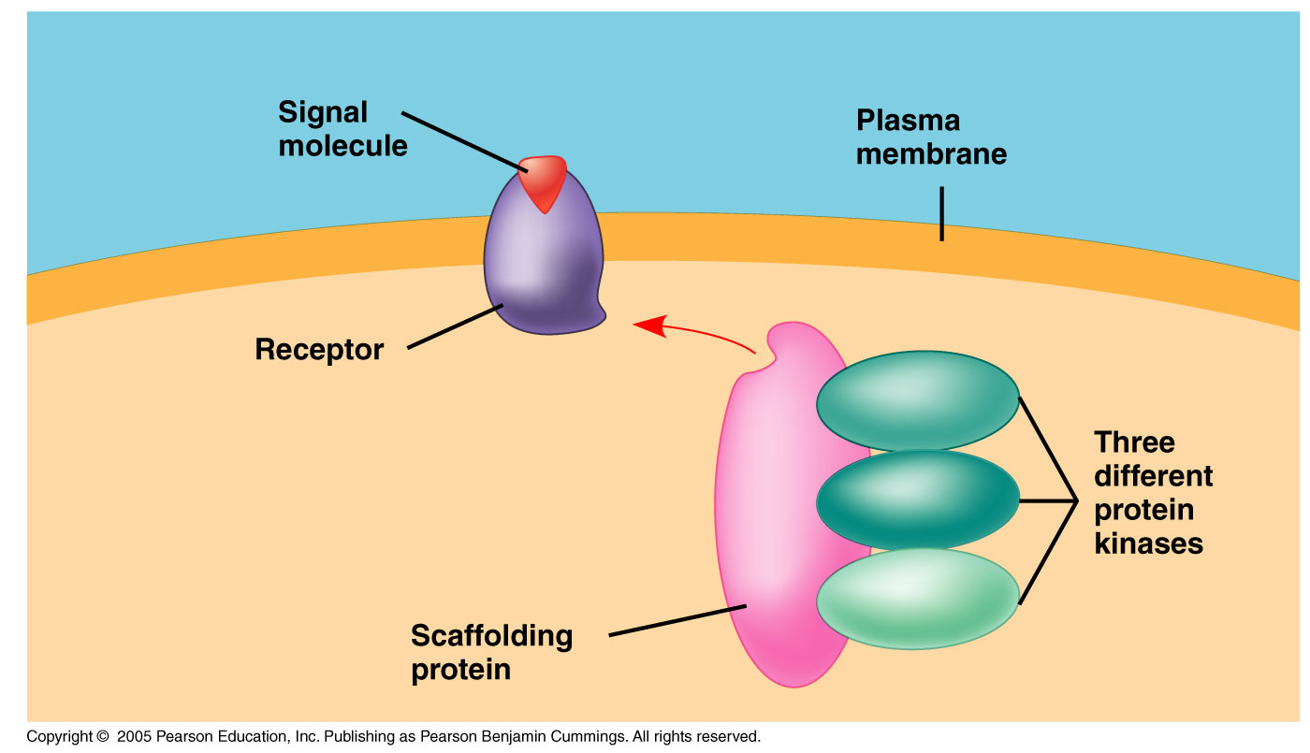
Signal Efficiency
There are many large relay proteins that assist in increasing the efficiency of the signal transduction.
They are necessary because the signal alone cannot simply diffuse through the cytosol.

Slide 58
Signal Termination
Cells must remain continually receptive to signaling so the organism can sense the surrounding stimuli.

Slide 59
Signal Termination
This occurs because of the reversibility of the changes the signals produce.
The receptor reverts to its inactive form as do the relay molecules and the cell is now ready to respond to fresh stimuli.

Slide 60
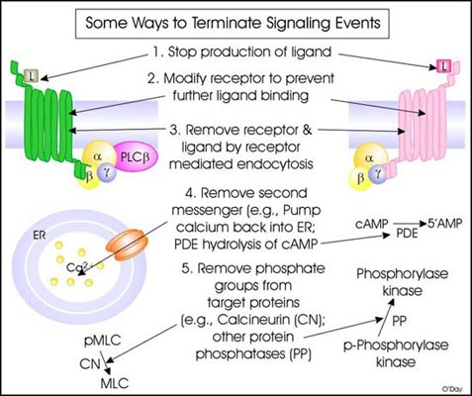
Signal Termination
Eventually, the signal needs to be terminated so that the cell doesn’t unnecessarily make too much product or waste energy.
Below are some ways in which signal termination occurs:
http://www.utm.utoronto.ca/~w3bio315/lecture10.htm#section10

