Slide 1
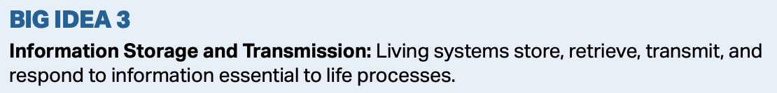
Chapter 12
The Cell cycle
Essential Idea: cell division is essential, but must be controlled.

Slide 2
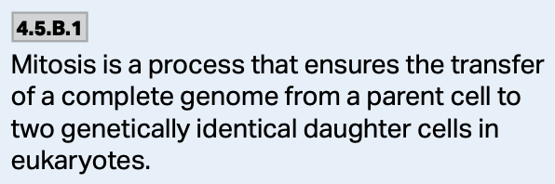

Mitosis
Mitosis is the division of the nucleus into two genetically identical daughter nuclei.
The result is two cells that are exactly alike—clones of one another.
Mitosis plays a role in growth, repair, and asexual reproduction.
https://moseseducom.wordpress.com/2017/01/02/mitosis-and-meiosis-by-doctor-moses-omang/

Slide 3
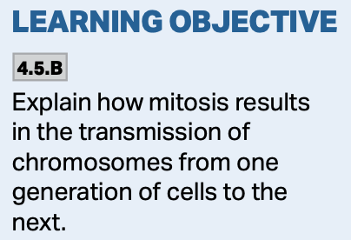
Mitosis
During mitosis, the sister chromatids separate, the nucleus divides, and cytokinesis separates the cytoplasm of the cell.
Each new cell now contains one copy of DNA from the parent cell and the cycle repeats.

Slide 4
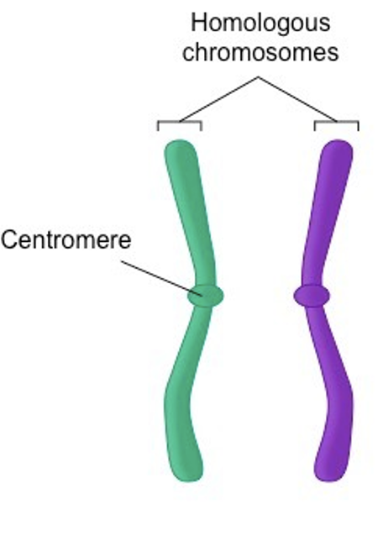
Mitosis
During mitosis, the genetic material is duplicated and then division occurs, producing two identical daughter cells..
When the chromosome has duplicated and the two pieces are attached at the centromere, they are referred to as sister chromatids. Sister chromatids = a duplicated chromosome.
https://ib.bioninja.com.au/standard-level/topic-3-genetics/33-meiosis/sister-chromatids.html

Slide 5
Mitosis
After anaphase, when the sister chromatids have separated, the structures are now referred to as chromosomes.
  Summary: chromosomes, sister chromatids, chromosomes.
https://www.quora.com/What-is-the-difference-between-a-chromosome-and-chromatid

Slide 6
The genome
The genome is all of the genetic material contained within the DNA of an organism.
Most prokaryotes contain a single strand of circular DNA (and usually some plasmids).
Most eukaryotes have multiple linear strands of DNA.

Slide 7
Chromosomes
Chromosomes are the structures that make DNA replication and distribution manageable.
The name, “chromosome” means “colored body,” comes from their ability to take up dye when being prepared for microscopy.
All eukaryotes have a characteristic number of chromosomes contained withing the nucleus of the cell.
https://labmedicineblog.com/2016/01/04/chromosome-structure-staining-and-naming/

Slide 8
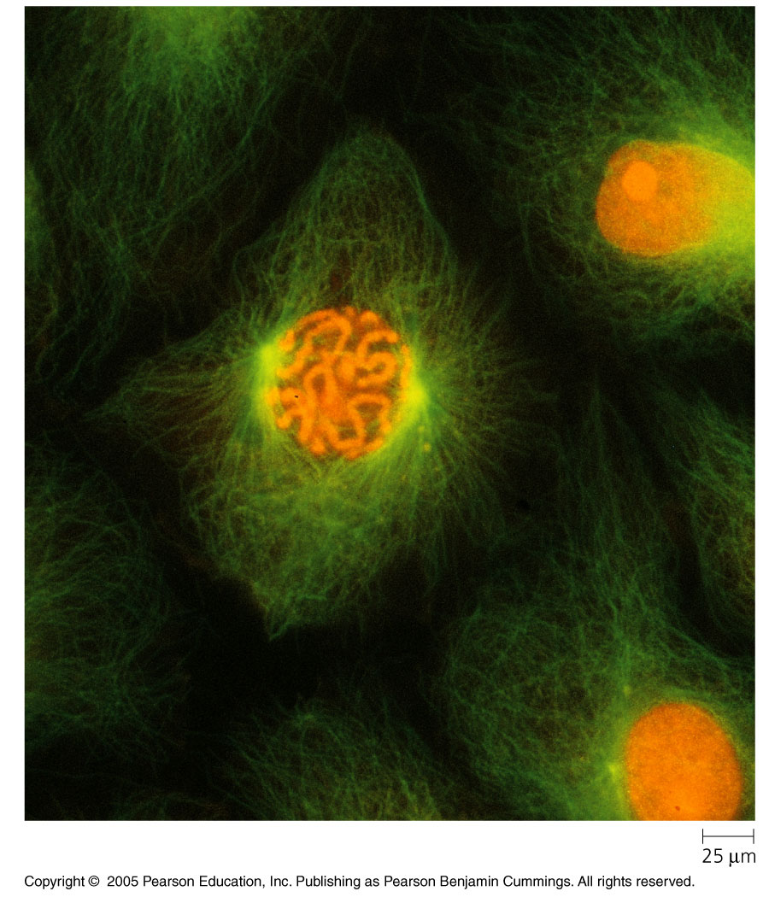
Chromatin and eukaryotic cells
The chromosomes of eukaryotic cells are made up of chromatin.
Chromatin is composed of DNA and associated proteins.

Slide 9
Chromatin and eukaryotic cells
The DNA found on each chromosome contains a few hundred to a few thousand genes specifying an organism’s traits.
The associated proteins help to maintain the structure of the chromosome and control the activity of the genes.

Slide 10
mitosis
There are essentially two types of cells as well as two states a cell can be in when it comes to mitosis:
  1. Non-dividing
  2. Dividing

Slide 11
1. non-dividing cells
During this time, the chromatin of each chromosome is in a long, thin configuration distributed throughout the cell.
  1. The cell is doing its job.
  2. The cell is preparing to divide.

Slide 12
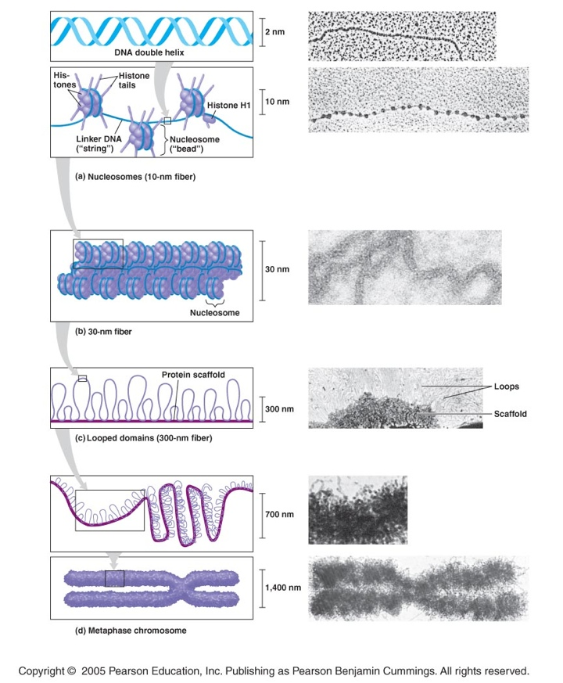
1. non-dividing cells
During interphase, DNA is duplicated in preparation for cell division, and when finished, the chromatin begins to condense—or become supercoiled.

Slide 13
2. dividing cells
Once the chromosomes have been duplicated, there are now 2 sister chromatids which contain identical DNA molecules, and are attached by cohesin proteins along their lengths.
The region where the sister chromatids appear to be pinched together is called the centromere.

Slide 14
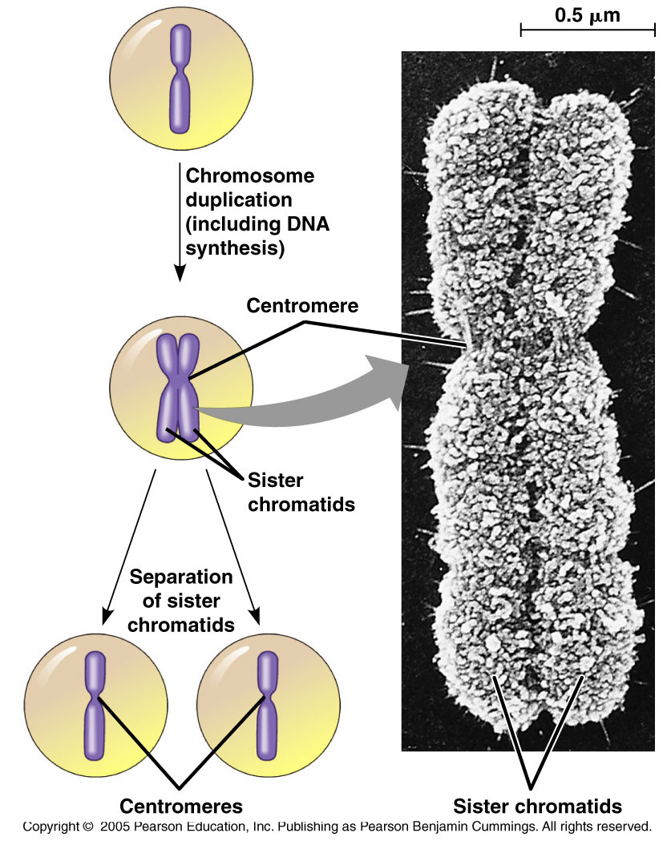

Slide 15
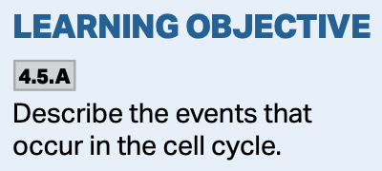
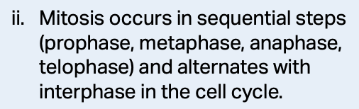
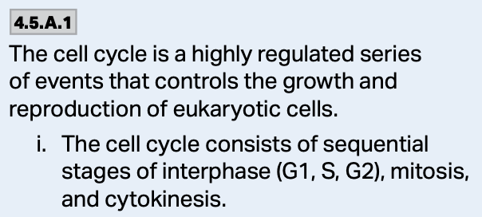
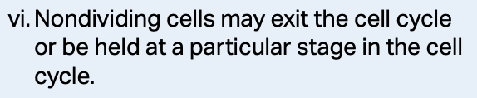
2 main phases of the cell cycle
Interphase, which is broken into:
  G₁
  S
  G₂
Mitosis (M-phase), which is broken into:
  Prophase
  Metaphase
  Anaphase
  Telophase
  Cytokinesis

Slide 16
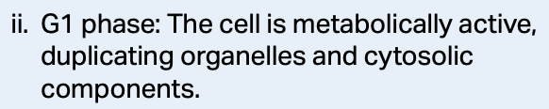
Interphase
During G₁, a lot of genes are turned on in order to make proteins necessary to run the metabolism of the cell.
  This includes generating enzymes to break down carbohydrates, lipids, proteins, etc.
  Most of the cell growth occurs during this stage.
  It checks its DNA for damage at the cell growth checkpoint, and makes sure it’s ready to enter the S-phase.

Slide 17
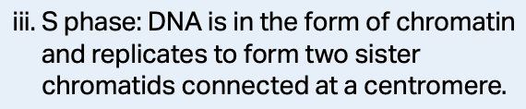
Interphase
During the S-phase, the DNA is copied while growth and metabolic activity continue.
  During this phase, the DNA is constantly being checked to make sure that no copying errors have occurred.
  In animal cells, the centrosomes duplicate.

Slide 18
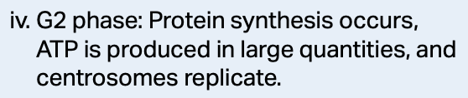
Interphase
During G₂, cell growth and metabolic activity continues as the cell finalizes preparation for division.
  α and β tubulins proteins are made that will assemble into the microtubule spindle fibers.
  Organelles grow and divide and increase in number so each cell ends up with what it needs to continue.
  Towards the end of G₂, things slow down as the cell readies for division.
  In the G₂ checkpoint, the cell makes one last check to ensure that everything needed for division is there.

Slide 19
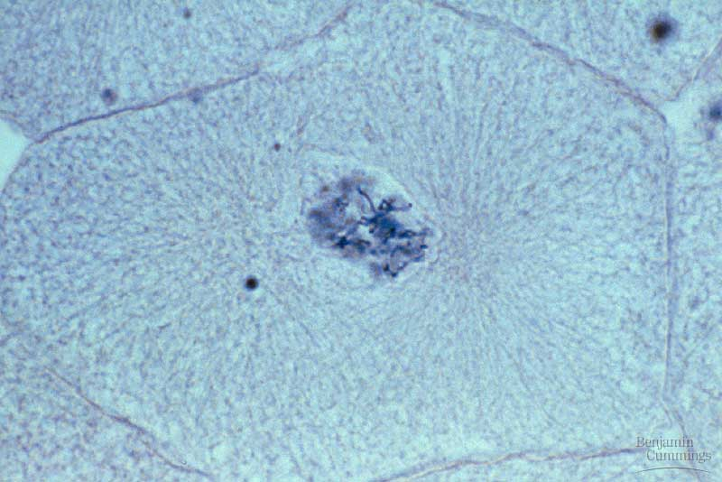
Mitosis—prophase
During prophase, the chromatin begins to condense and are visible with a light microscope.
  The nucleoli disappear.
  Chromosomes appear as identical sister chromatids.
  The mitotic spindle begins to form.
  In animal cells, the centrosomes migrate to opposite poles.

Slide 20
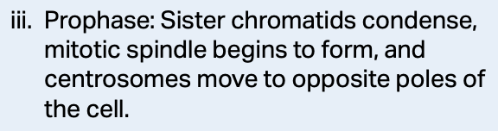
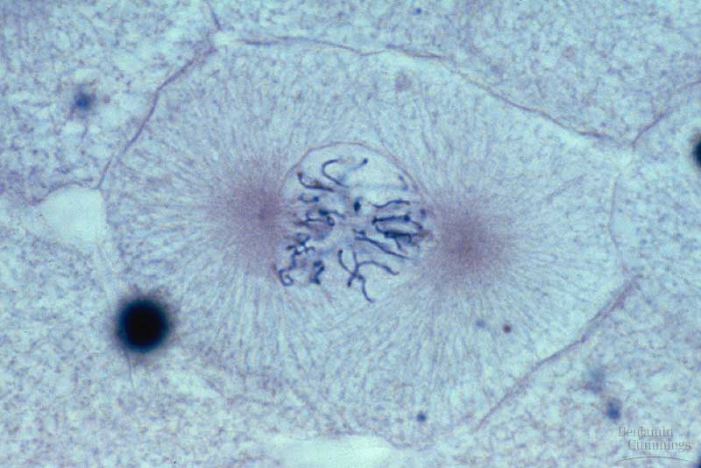
Mitosis—Prophase
During prophase, each chromosome becomes distinctly visible.
  The nuclear envelope breaks down.
  The kinetochore forms at the centromere of each chromatid.

Slide 21
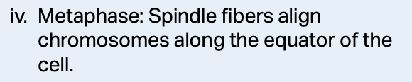
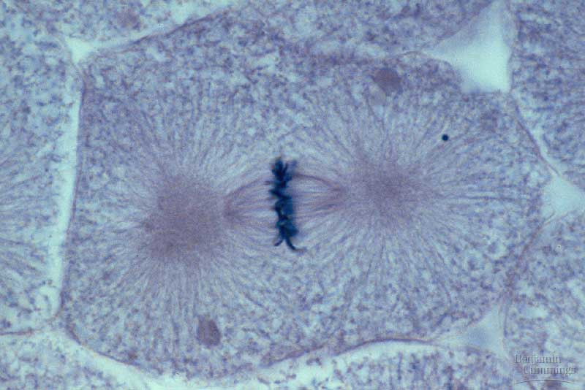
Mitosis—metaphase
During metaphase, the chromosomes align at the metaphase plate.

Slide 22
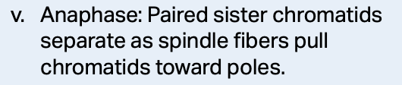
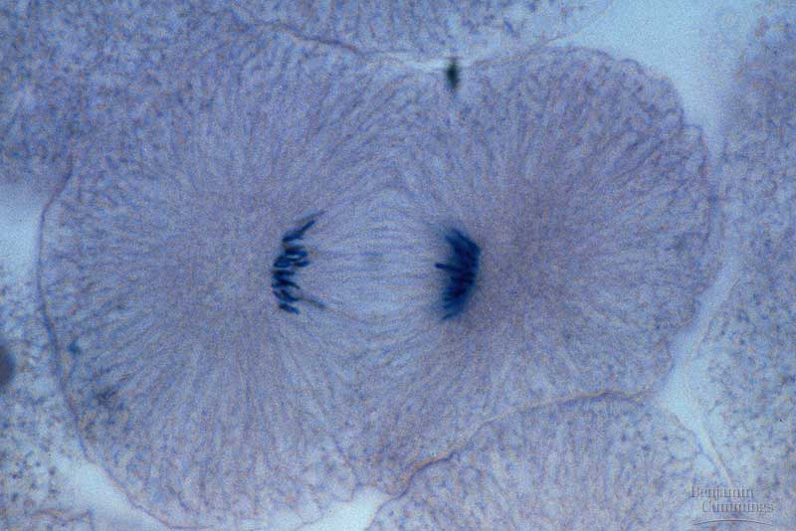
Mitosis—ANaphase
As the cohesin proteins which bind the sister chromatids together become inactivated, sister chromatids start to separate and begin moving to opposite ends of the cell.
Motor proteins move the chromatids to the poles of the cell.

Slide 23
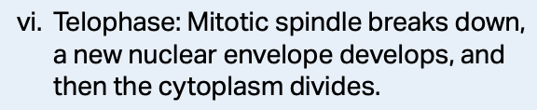
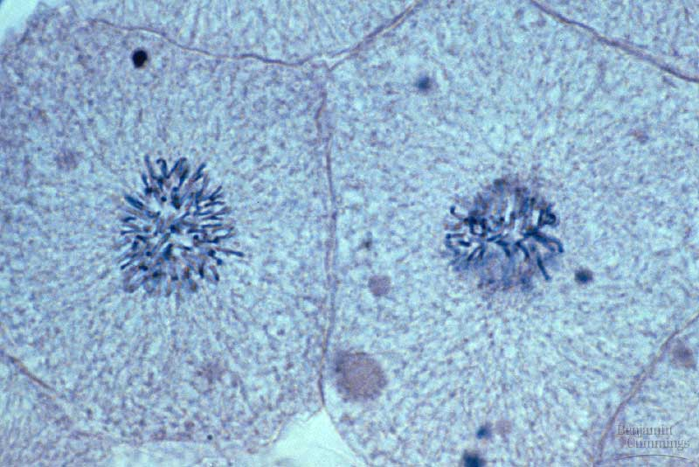
Mitosis—Telophase
Telophase occurs when the 2 daughter nuclei begin to form.
  The nuclear envelopes reform from fragments of the parent cell’s nuclear envelope.
  Nucleoli reappear.
  Chromatin relaxes.
  Mitotic spindle breaks down.

Slide 24
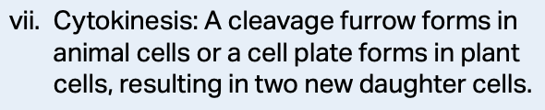
Mitosis—cytokinesis
Cytokinesis is when the cytoplasm is divided between the 2 daughter cells.
The process is different between plants and animals.
https://www.nicepng.com/ourpic/u2e6a9w7w7u2o0a9_plant-cytokinesis-images-cytokinesis-in-plant-cells-microscope/

Slide 25
Cytokinesis in Animal Cells
During cytokinesis in animal cells, a cleavage furrow forms between the 2 new cells.
The cleavage furrow forms as a contractile ring of microfilaments interacts with myosin molecules on the cytoplasmic side of the plasma membrane.
When this interaction occurs, the ring contracts and pinches the cell in two.
https://slideplayer.com/slide/9733128/

Slide 26
Cytokinesis in plants
In plant cells, cytokinesis is much different. Vesicles come from the endomembrane system, and migrate along microtubules.
The vesicles collect at the center of the cell and form a cell plate, which eventually becomes the cell wall, forming 2 cells.
https://slideplayer.com/slide/699033/

Slide 27
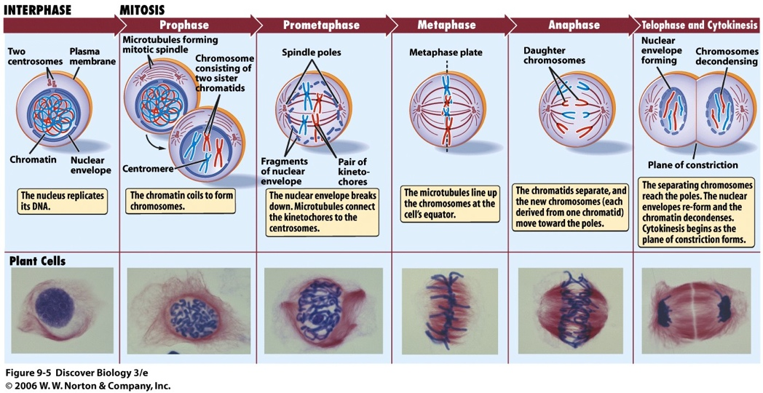

Slide 28
Centrioles and centrosomes
Plant cells do not have centrioles or centrosomes, but they still form mitotic spindles.
In animal cells, the centrosomes are non-membranous organelles which organize the microtubules.
During G₁ centrosomes separate, and in S-phase they begin to elongate centrosomes.
Sometimes the centrosomes are called the microtubule organizing center because in animal cells, they give rise to the mitotic spindle.

Slide 29
The Mitotic spindle
The mitotic spindle is an important part of mitosis because it is the organized array of microtubules that moves the chromosomes during cell division.
During division, the actual movement of chromatids is prevented because of the binding of the microtubules from the opposite end of the cell. This tug-of-war helps align the chromosomes at the metaphase plate.

Slide 30
Control of the cell cycle
The various stages of the cell cycle are determined by a variety of cytoplasmic signals.
  The evidence for this come from cell-fusion experiments performed in the early 1970s.
  It is often referred to as the Cell Cycle Control System.

Slide 31
Control of of the cell cycle
When this system is active, the cell replicates its DNA, elongates, and the plasma membrane grows inward dividing the cell in two.

Slide 32
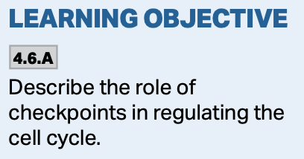
Control of the cell cycle
This system cyclically operates and controls the key events in the cell cycle.
Each of the phases of the cell cycle seem to be controlled by a checkpoint which is where critical stop-and-go signals regulate the cell cycle.
Cytoplasmic signals govern the Cell Cycle Control System.

Slide 33
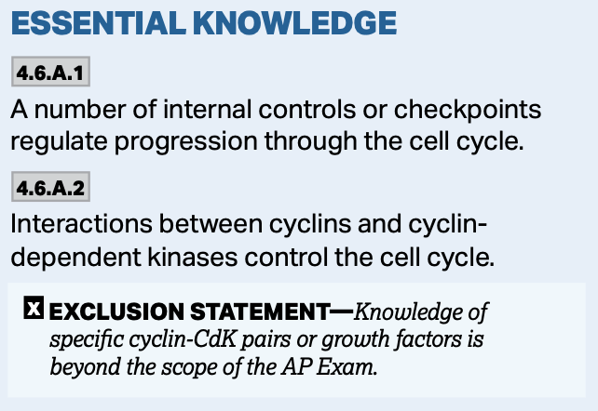
Control of the cell cycle
Cyclins and Kinases are the two main types of regulatory molecules (proteins) found in cells.
  They work together to regulate the activation of the signaling molecules involved in DNA synthesis and mitosis.
The levels of cyclins rise and fall throughout the cell cycle.
The levels of kinases remains the same during the cell cycle.

Slide 34
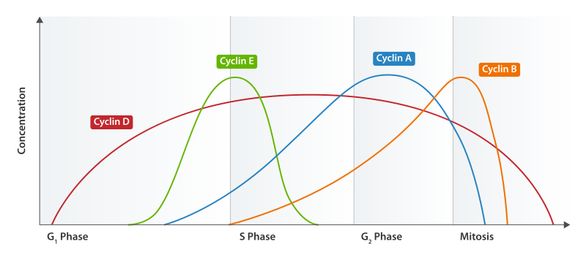

Slide 35
Cyclins
Cyclins are a family of proteins that interact with kinases to control the cell cycle.
They do so by activating cyclin-dependent kinase enzymes that, in turn, set off a series of signals resulting in a cellular response: DNA synthesis, protein synthesis, cell division, etc.

Slide 36
kinases
Kinases are enzymes that function by either activating or inactivating other proteins by phosphorylation.
These activated proteins carry out a variety of functions in addition to giving “go” signals at the G₁ and G₂ checkpoints.

Slide 37
kinases
Kinases are usually present in constant concentration within the cell, but are inactive.
  They become active when a particular cyclin protein binds to them.
  These kinases are called cyclin dependent kinases, or CdKs for short.
The cyclin-CdK complex activation is what triggers events in the cell cycle.

Slide 38
Cyclin-kinase interactions
When cyclins and kinases interact, they initiate a variety of conformational changes in the associated protein. These changes lead to an effect within the cell.

Slide 39
Cyclin-kinase interactions
For example, at the beginning of mitosis, CdK activity increases leading to the increased phosphorylation of proteins controlling chromosome condensation, nuclear envelope breakdown, and spindle assembly.

Slide 40
Cyclin-kinase interactions
When cyclins and kinases interact, they initiate a variety of conformational changes in the associated protein. These changes lead to an effect within the cell.

Slide 41
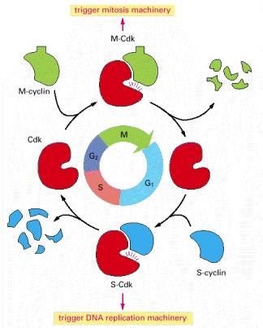
Cyclin-kinase interactions
CdK associates with different cyclins triggering different events of the cell cycle.
For simplicity, only the cyclins that act in the S-phase and M-phase are shown here.
http://www.ncbi.nlm.nih.gov/books/NBK26824/

Slide 42
Classes of Cyclins
There are four major classes of cyclins that push the cell through the cell cycle:
  G₁/S-cyclins: Bind CdKs at the end of G₁ and commit the cell to DNA replication.
  S-cyclins: bind CdKs during the S-phase and are required for DNA replication.
  M-cyclins: promote the events of mitosis.
  G₁-cyclins: promote passage through G₁.

Slide 43
Classes of Cyclins
The cyclin signals shut down certain aspects of the cell cycle while starting others once key cellular processes have been completed.
  The checkpoints are:
  G₁/S Checkpoint
  G₂/M Checkpoint
There are two intra-phase checkpoints:
  Intra-S-phase checkpoint
  Spindle assembly (M) checkpoint

Slide 44
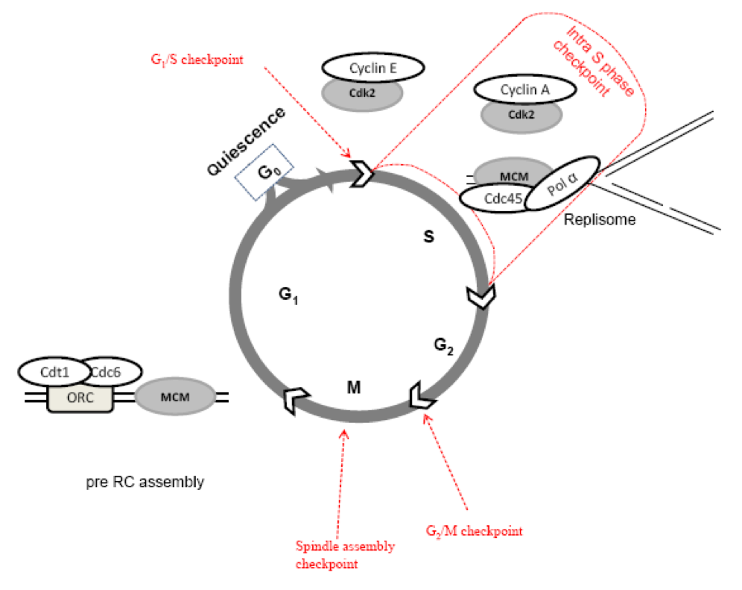

Slide 45
G₁/S Checkpoint
For many cells, G₁ is important because it is here where if cells receive a “go” signal, then they will usually go through S, G₂, and M.
  It is sometimes dubbed the “restriction point.”
  The cell checks for size, nutrients, molecular signals for division, and DNA integrity.
If no go signal is received, the cell enters G₀ which is a phase of non-division.

Slide 46
G₁/S Checkpoint
During G₁, there are a variety of cyclin-kinase reactions that result in the transcription of genes that make proteins which promote entry into the S-phase.
If damage to the DNA occurs, several mechanisms are in place which halt the cell cycle in G₁.
These mechanisms are associated with several gene products—proteins.

Slide 47
G₁/S Checkpoint
If DNA damage is detected, two signal transduction pathways work to arrest the cell in G₁—one initiates arrest, the other maintains it.
These pathways kickstart mechanisms to repair the DNA, including p53.

Slide 48
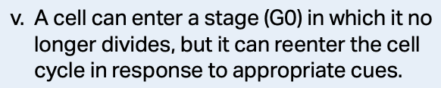
G₀ Quiescence
Most cells in the human body are in the G₀ phase and only very rarely divide (mature nerve and muscle cells).
Others are in G₀, but can be stimulated to divide when needed, such as after an injury (liver).

Slide 49
Intra-S-Phase Checkpoint
The intra-S-phase checkpoint acts as a surveillance camera.
During the S-phase, any problems with DNA replication trigger this checkpoint.
This checkpoint results in a cascade of signaling events that puts this and the next phase on hold until the problem is resolved.

Slide 50
Intra-S-Phase Checkpoint
When the replication fork encounters damaged DNA, protein kinase pathways are activated.
This prevents the formation of new replication forks stopping DNA synthesis and arresting mitosis.
The involved protein kinases also act to stabilize the replication fork while the DNA is being repaired.

Slide 51
Intra-S-Phase Checkpoint
If repairs cannot be made, either cell cycle arrest occurs, or apoptosis ensues.

Slide 52
G₂/M Checkpoint
This checkpoint is sometimes called the DNA Damage Checkpoint, and it ensures that the cell has successfully replicated its DNA.
If errors are detected, various cyclin-dependent kinase pathways will hold the cell in G₂ until the damage has been fixed.

Slide 53
G₂/M Checkpoint
During G₂, cells produce M-cyclin molecules that interact with various kinases and promote entry of the cell into the M-phase (mitosis).
The interaction of particular cyclins with kinases at G₂ will form MPF and stimulate entry into M-phase.

Slide 54
G₂/M Checkpoint
High levels of cyclins from G₂ associate with Cdk molecules resulting in an active MPF complex.
MPF promotes the breakdown of the nuclear envelope, chromosome condensation, and mitotic spindle formation.

Slide 55
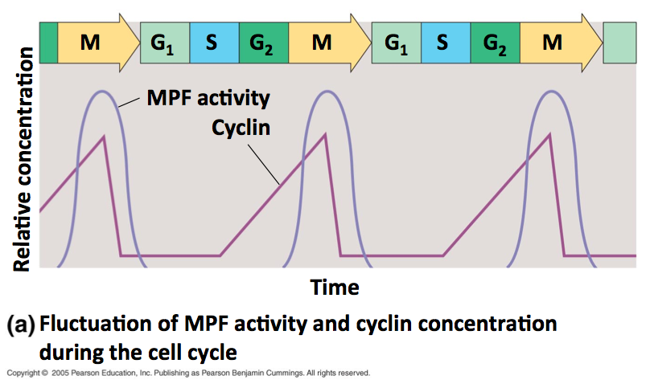

Slide 56
G₂/M Checkpoint
MPF is also involved in switching itself off.
It initiates a process that leads to the destruction of its own cyclin.
The Cdk will remain in the cell until it becomes a part of the MPF again during the next round of the cell cycle.

Slide 57
Spindle assembly (M) checkpoint
This checkpoint occurs during metaphase, and senses the tension caused by the attachment of the microtubules to the chromosomes.
When this tension is sensed, a variety of cyclin-kinase pathways are stimulated promoting the completion of mitosis and re-entry into G₁.

Slide 58
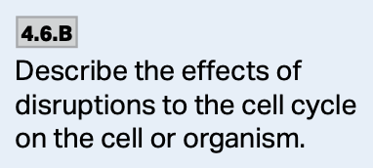
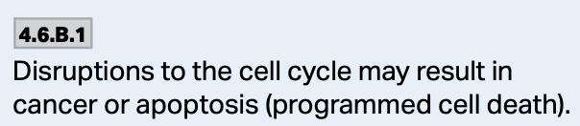
The effects of a faulty cell cycle
During the next discussion, you will learn what happens when the cell cycle doesn’t function properly.

