Slide 1
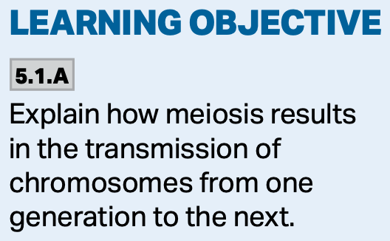
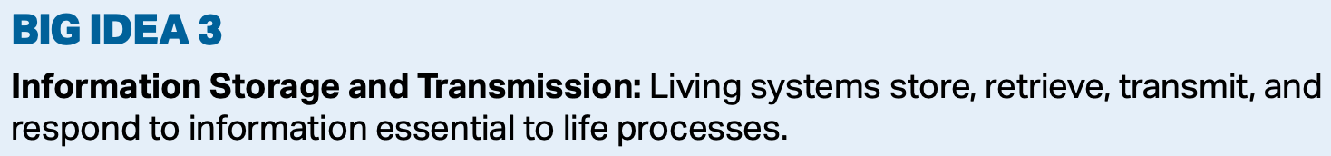
Chapter 13—Meiosis
The Process of Meiosis

Slide 2
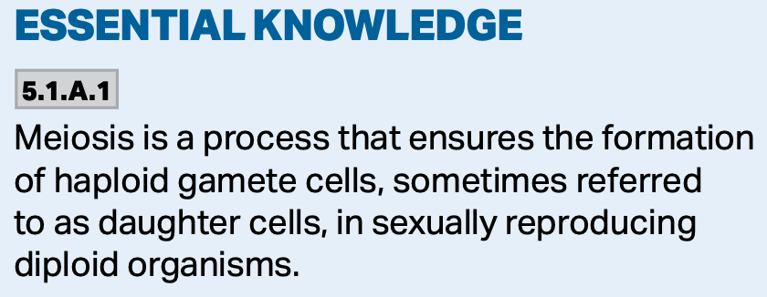
Sexual Maturity
As the organism reaches sexual maturity, its gonads will begin producing haploid cells through a process called meiosis.

Slide 3
Meiosis
Meiosis will allow the chromosome number to remain constant throughout the generations.

Slide 4
Meiosis and Fertilization
The process of meiosis and fertilization are common to sexually reproducing organisms.

Slide 5
Meiosis
Meiosis reduces the ploidy.
  We go from a diploid cell to a haploid cell.
It provides for genetic variation.
It keeps the chromosome number constant through the generations.
  2 haploid cells will combine during mating to give a diploid zygote.

Slide 6
Meiosis
Meiosis can be broken into two parts: Meiosis I and Meiosis II.
Meiosis I separates homologous chromosomes.
Meiosis II is essentially a mitotic division, and separates the sister chromatids.

Slide 7
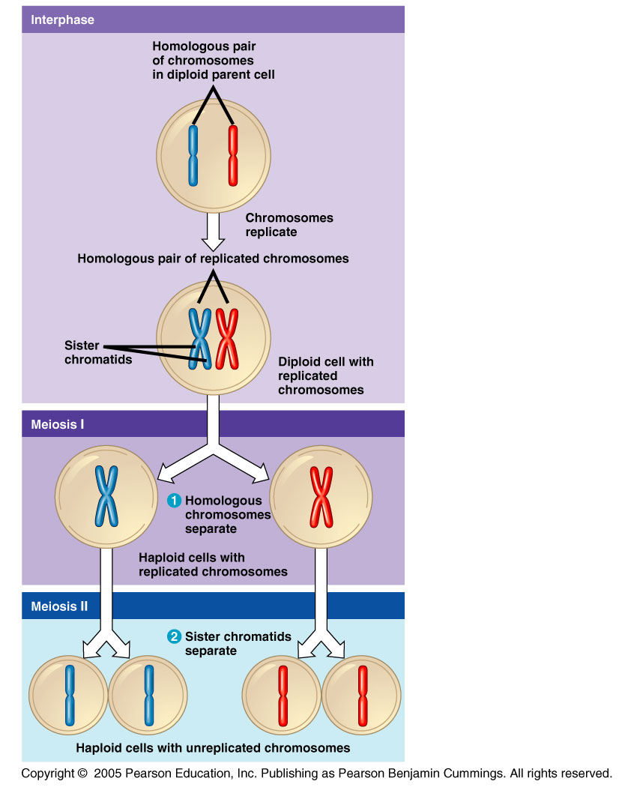
Meiosis
Meiosis halves the number of chromosomes.

Slide 8
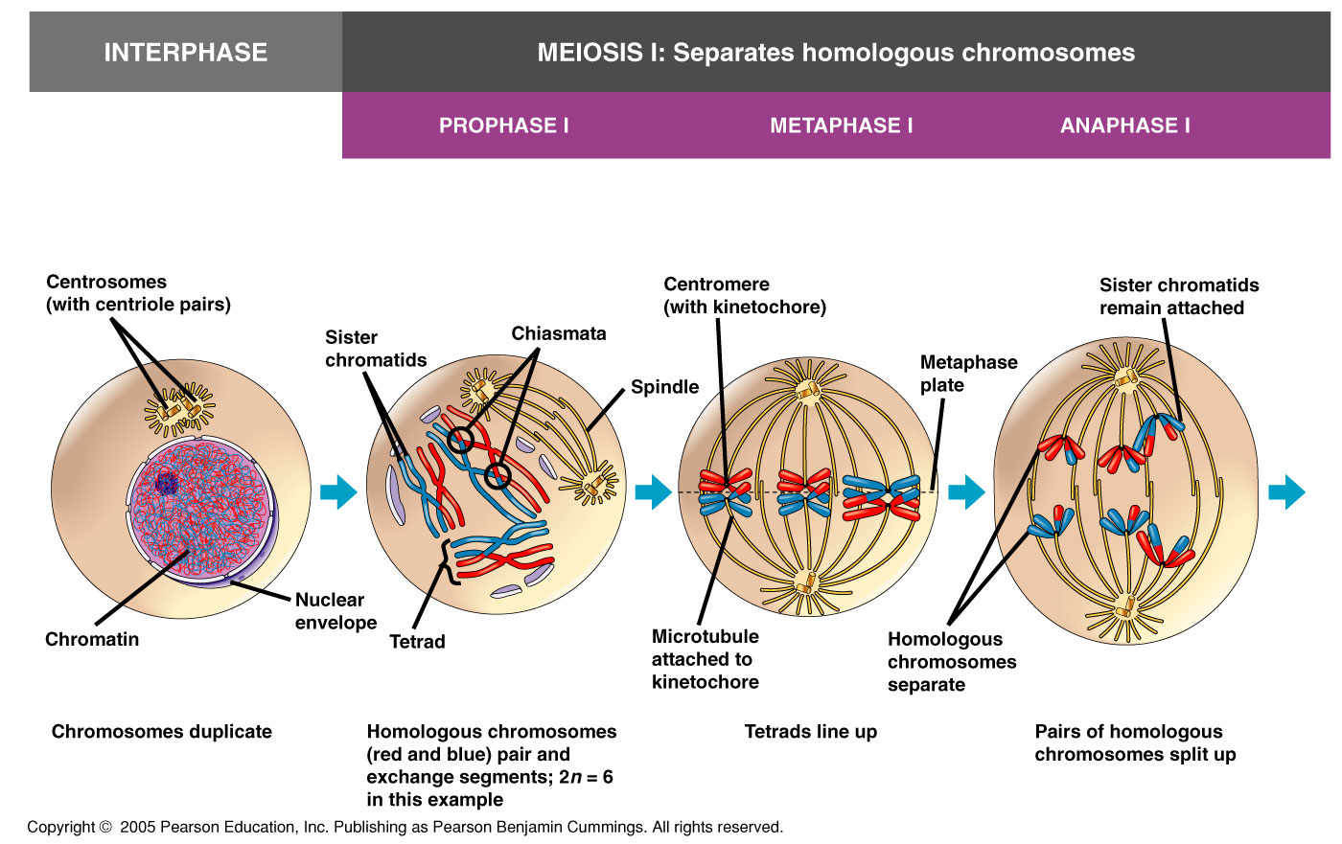

Slide 9
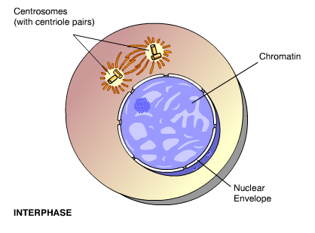
Interphase I
Much like mitosis, there is a G1-where the cell grows, an S-where the DNA is synthesized, and a G2-with further growth of the cell, and preparation for division.

Slide 10
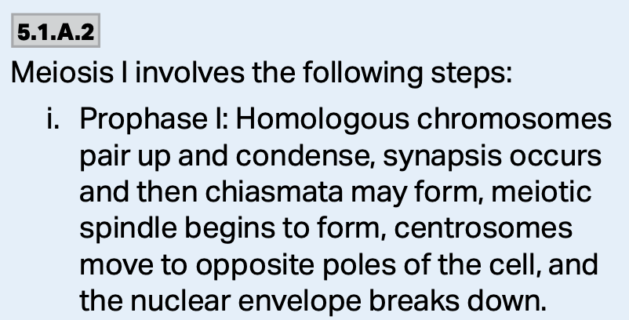
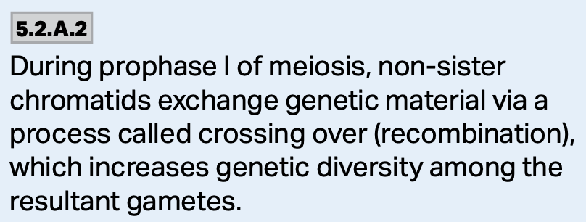
Meiosis I
Prophase I: Homologous chromosomes condense and pair up forming tetrads, crossing-over takes place, the nuclear envelope breaks down.
https://www.expii.com/t/meiosis-overview-stages-10164

Slide 11
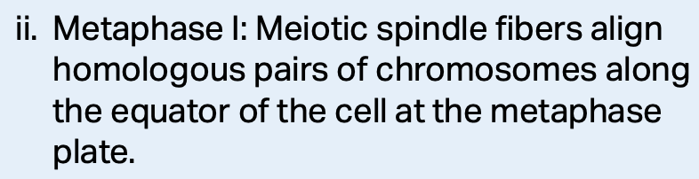
Meiosis I
Metaphase I: Homologous pairs of chromosomes randomly line up at the metaphase plate.
https://www.emaze.com/@AOFFZQOFL

Slide 12
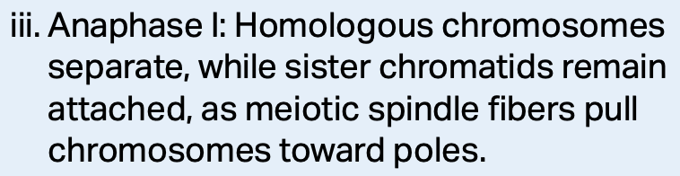
Meiosis I
Anaphase I: Each homologous pair of chromosomes separate and move to the opposite poles of the “cell.”
The sister chromatids, however, remain attached.
https://www.expii.com/t/meiosis-overview-stages-10164

Slide 13
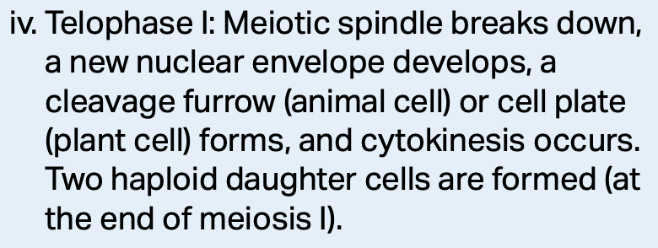
Meiosis I
Telophase I: Sister chromatids arrive at the spindle poles.
Cytokinesis: Cytoplasm divides producing 2 cells, each being haploid (1/2 the original number of chromosomes), but still having twice the amount of DNA.
https://teachmephysiology.com/biochemistry/cell-growth-death/meiosis/

Slide 14
Interkinesis
In some organisms, the chromosomes relax and the nuclear envelope reforms.
The is no DNA replication.
Other organism’s cells go directly to meiosis II.

Slide 15
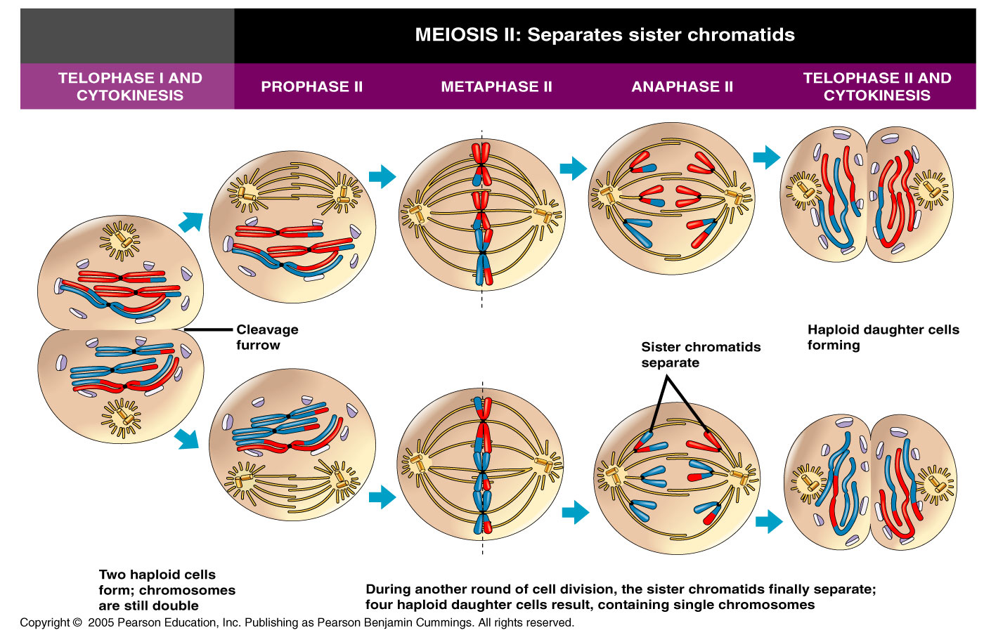

Slide 16
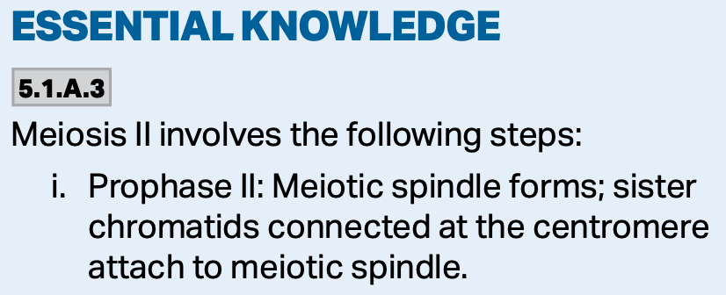
Meiosis II Sister Chromatids Separate
Prophase II: Chromosomes condense again, the nuclear envelope disappears and the mitotic spindle reforms.
No crossing over occurs.
https://courses.yarrahills.vic.edu.au/moodle/mod/book/view.php?id=60799&chapterid=996

Slide 17
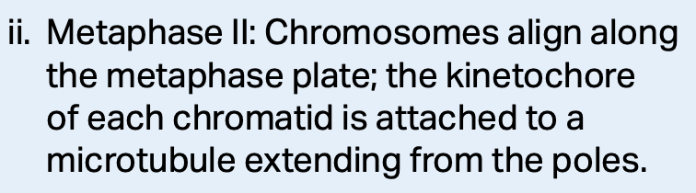
Meiosis II Sister Chromatids Separate
Metaphase II: Chromosomes align along the metaphase plate.

Slide 18
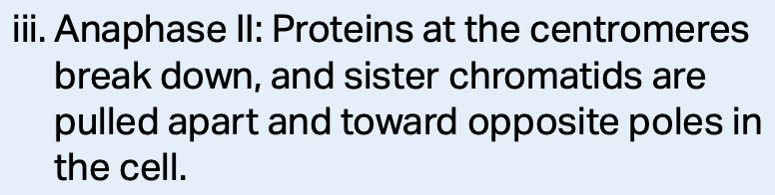
Meiosis II Sister Chromatids Separate
Anaphase II: Sister chromatids separate and migrate as individual chromosomes to the spindle poles.
The cells are now haploid and contain the correct amount of DNA.

Slide 19
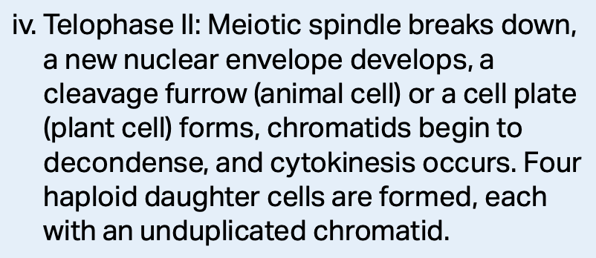
Meiosis II Sister Chromatids Separate
Telophase II: Chromosomes arrive at the poles, the spindle breaks down, the nuclear envelope reforms.
Cytokinesis: The cytoplasm divides.
https://courses.yarrahills.vic.edu.au/moodle/mod/book/view.php?id=60799&chapterid=999

Slide 20
Meiosis Overview
When
https://microbenotes.com/meiosis/

Slide 21
Meiosis Overview
When
https://microbenotes.com/meiosis/

Slide 22
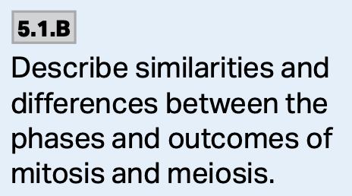
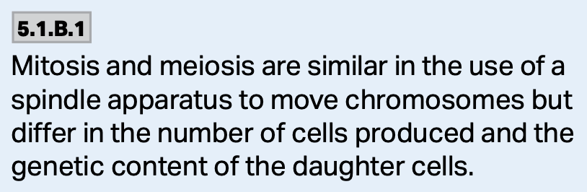
Mitosis and Meiosis, A Comparison
The biggest difference is that in mitosis, genetically identical cells are formed and ploidy is conserved.
In meiosis, genetically different cells are formed and the ploidy is reduced.

Slide 23
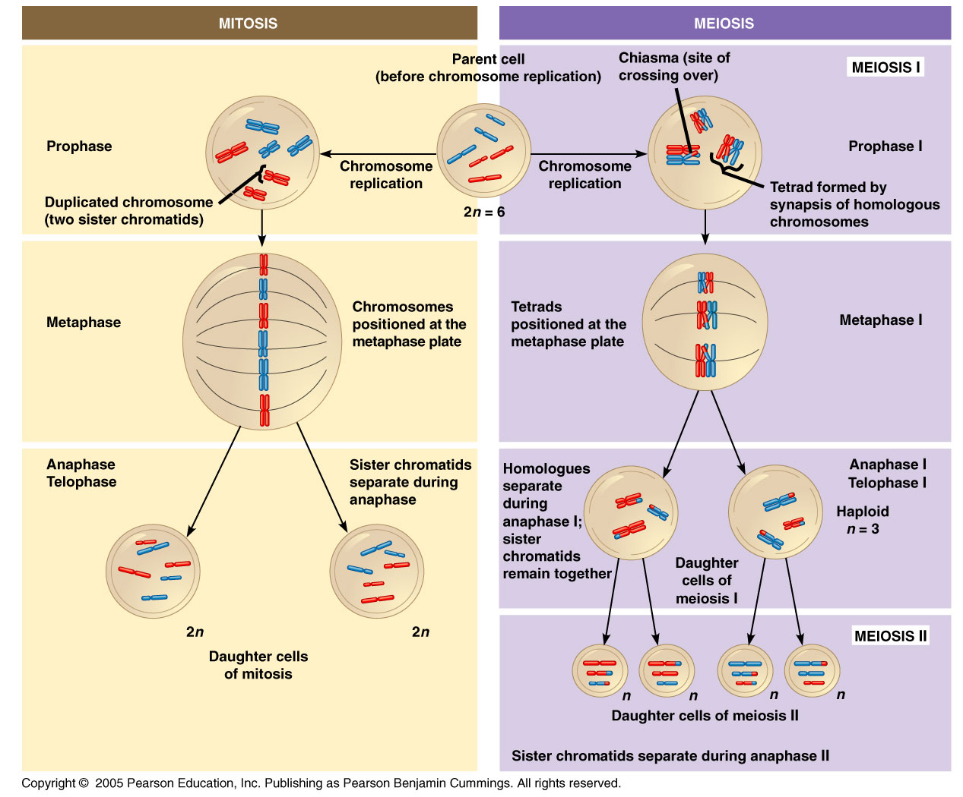

Slide 24
There are Three Main Events Unique to Meiosis
1. Tetrad Formation, Synapsis, and Crossing Over
2. Alignment of Homologous Pairs at the Metaphase Plate
3. Separation of Homologues

Slide 25
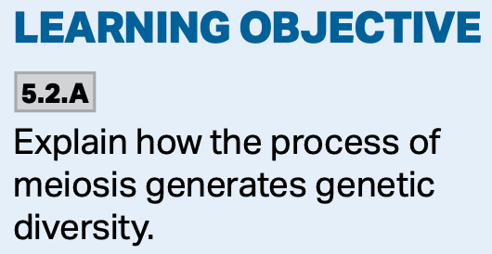
1. Tetrad Formation, Synapsis and Crossing Over
In prophase I, duplicated homologues form tetrads where they line up and become physically attached.
Crossing over occurs where genetic information is rearranged between the non-sister chromatids comprising the tetrad.
In mitosis, crossing over does not occur.

Slide 26
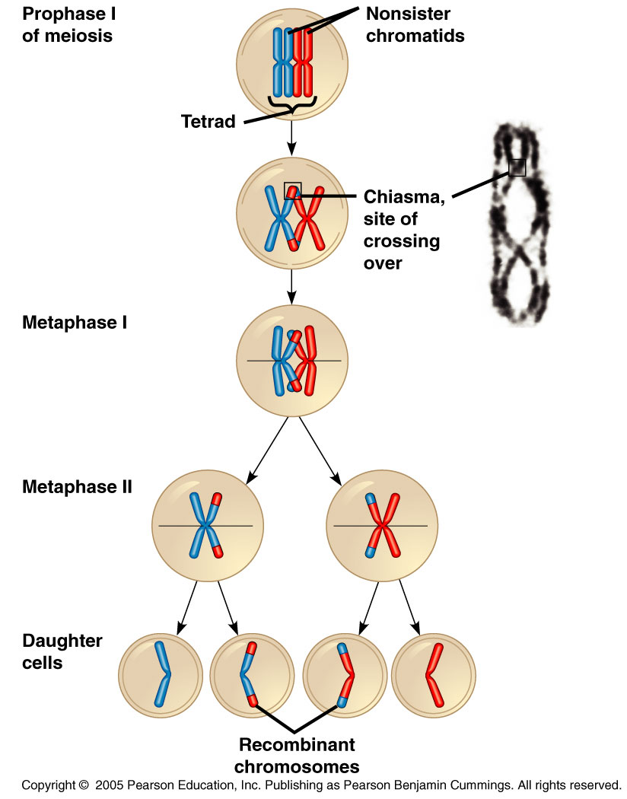
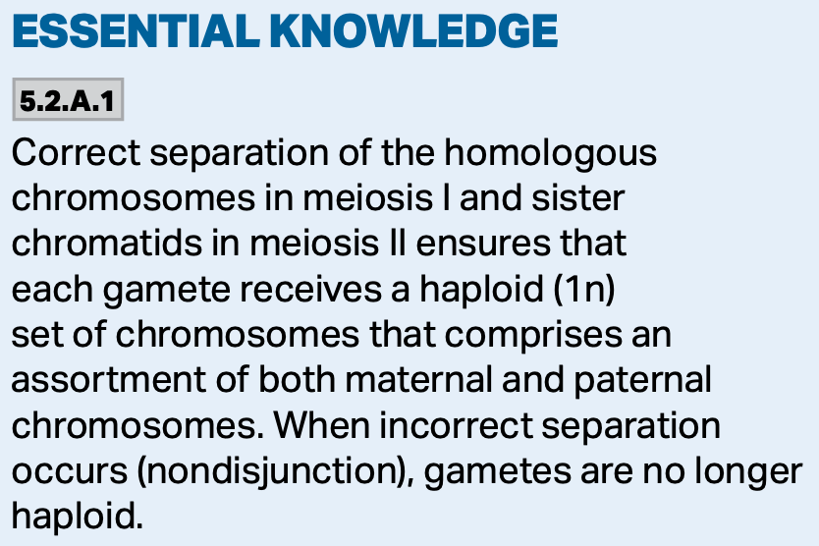

Slide 27
1. Tetrad Formation, Synapsis, and Crossing Over
The paired homologous chromosomes align along the metaphase (I) plate.
This alignment is random and adds a layer of variation to the process.
In mitosis, individual chromosomes line up at the metaphase plate.

Slide 28
2. Alignment of Homologous Pairs at the Metaphase Plate
Homologs separate and the cell goes from diploid to haploid.
Sister chromatids remain attached.

Slide 29
3. Separation of Homologues
At anaphase I of meiosis, the homologous pairs move to opposite poles.
Sister chromatids remain attached at this stage.
In mitosis, sister chromatids separate in anaphase.

Slide 30
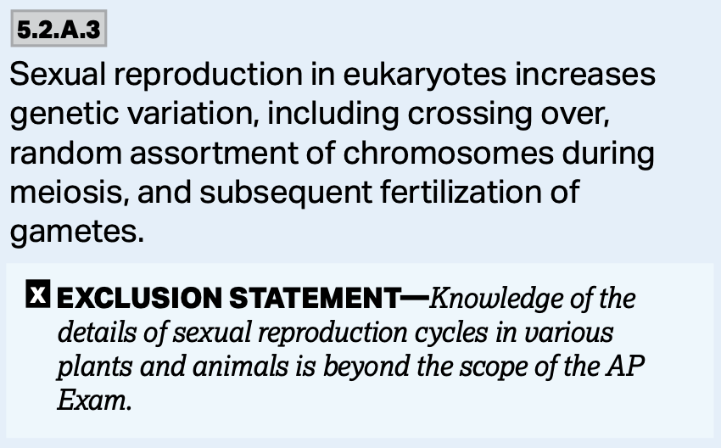
Three Mechanisms that Produce Genetic Variation
1. Independent Assortment
2. Crossing Over
3. Random Fertilization

Slide 31
1. Independent Assortment
Homologous chromosomes are positioned independently at the metaphase plate.
https://www.mun.ca/biology/desmid/brian/BIOL2060/BIOL2060-20/CB20.html

Slide 32
1. Independent Assortment
Maternal and paternal chromosomes sort independently of every other pair.
https://www.mun.ca/biology/desmid/brian/BIOL2060/BIOL2060-20/CB20.html

Slide 33
1. Independent Assortment
Independent assortment gives a large number of possible daughter cells.
The cells are dividing in two and are sorting independently.
The number of combinations is 2^{n}.
  “n” is the haploid number (23 in humans)
  2²³ possible combinations (8,388,608) based on alignment alone.

Slide 34
2. Crossing Over
The gene mixing that occurs during prophase I shuffles the genetic deck.
The variation created by crossing over makes the number of possible combinations virtually endless.

Slide 35
3. Random Fertilization
In humans, each male and female gamete represents over 8 million different chromosome combinations due to independent assortment.
Fusion of a sperm and egg during fertilization produces about 70 trillion different diploid combinations (2²³x2²³).
When you factor in crossing over, the number of gamete combinations is nearly endless.

Slide 36
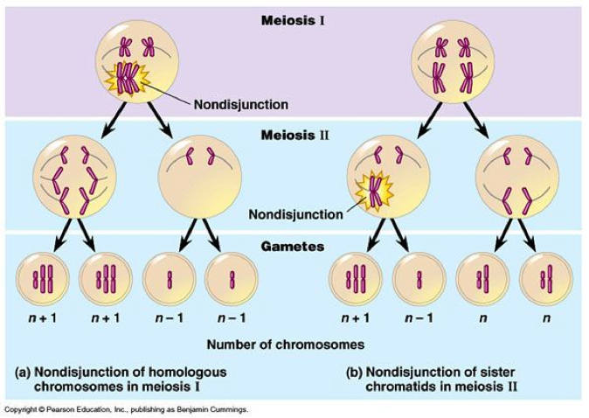
Errors in Meiosis
Occasional errors in meiosis can result in a sperm or an egg having the wrong number of chromosomes.
This is called nondisjunction.

