Slide 1
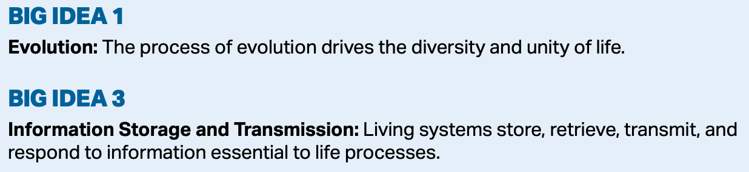
Chapter 14
Mendelian Genetics
Essential Idea: Every living organism inherits a blueprint for life from its parents.
Essential Idea: The inheritance of genes follows patterns.

Slide 2
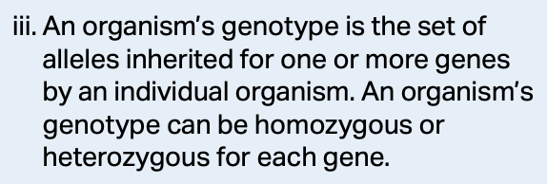
Important Terms
The genome—is all of the genetic information of an organism.
Gene—a gene is a heritable factor that consists of a length of DNA and influences a specific characteristic.
The HGP was outlined in 1988, begun in 1990, and 99+% completed by 2003.

Slide 3
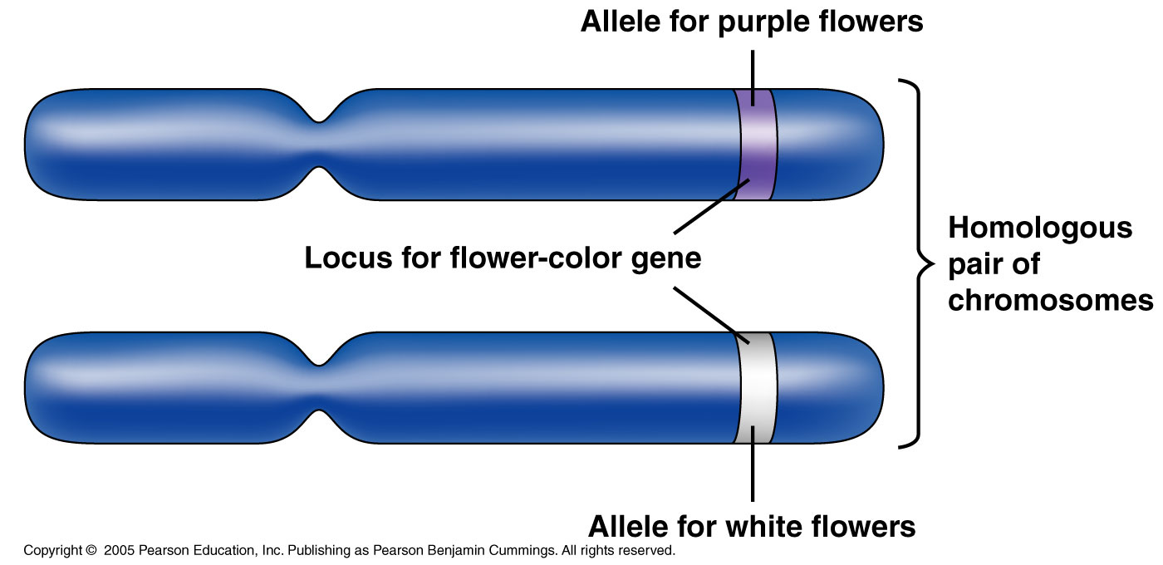
Important Terms
A gene occupies a specific spot on a chromosome which is made of DNA.

Slide 4
Important Terms
Character—something that is inherited.
  Flower color
Trait—a variant of a character.
  Purple flower vs. white flower
True breeding—produces only one type of gamete.
  No variation of traits, TT or tt.

Slide 5
Important Terms
Hybridization—crossing of two variants of a true breeding plants. The hybrid contains genes from both parents which likely come out in the next generation.
TT x tt = Tt

Slide 6
Important Terms
P generation—Usually true breeding and start the experiment.
F1 generation—1st filial which are hybrid offspring of the parents.
F2 generation—2nd filial which is offspring of the hybrids. This is when we start to see the traits reappear from the P generation.

Slide 7
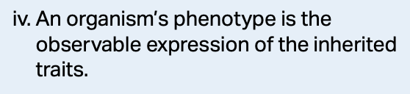
More Useful Terms
Homozygous—organisms with identical alleles for a trait in question.
Heterozygous—organisms with different alleles for a trait in question.
Phenotype—the outward appearance of an organism.
Genotype—the genetic makeup of an organism.

Slide 8
Mendel
By examining large numbers of peas through the P, F1 and F2 generations, Mendel was able to elucidate the patterns of inheritance.

Slide 9
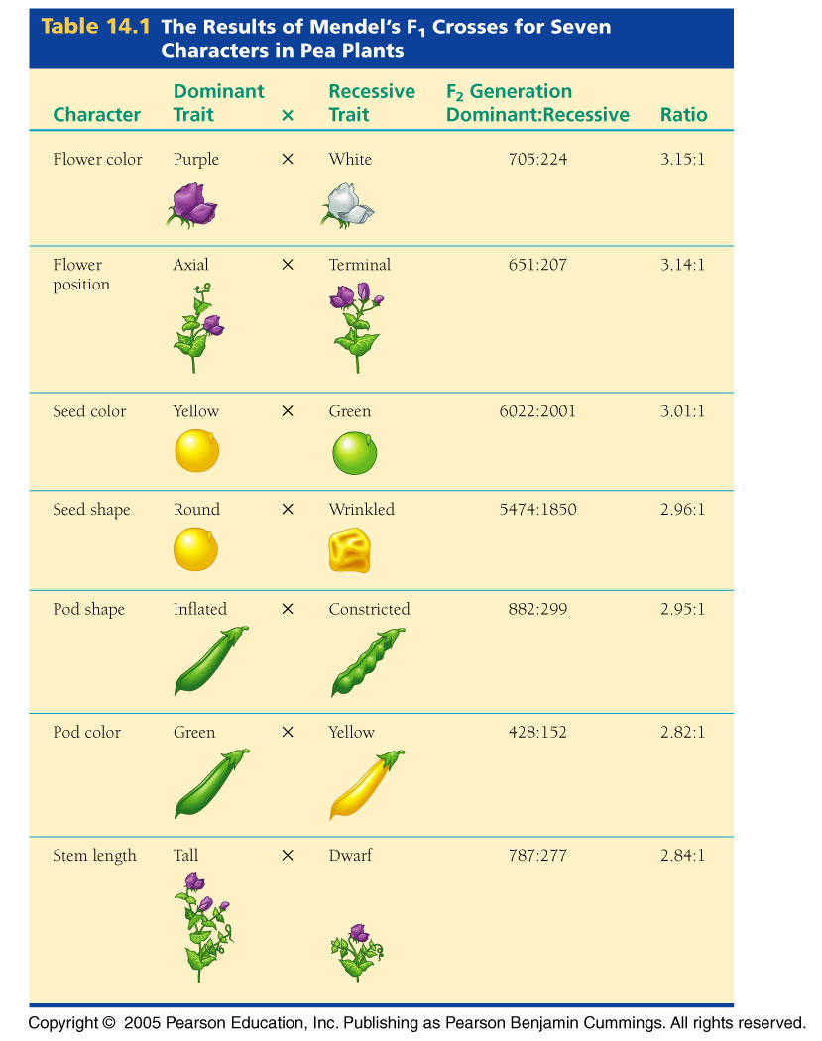

Slide 10
Mendel
What made Mendel’s work so good was that he kept excellent records of what he did and the results of his experiments.

Slide 11
Mendel
At the time, people believed in a “blending hypothesis.” They thought that the traits of a particular organism would be blended together.
Mendel’s experiments abolished this notion.

Slide 12
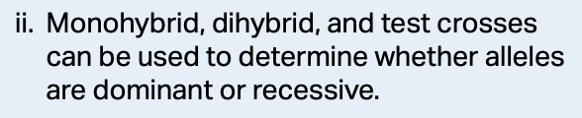
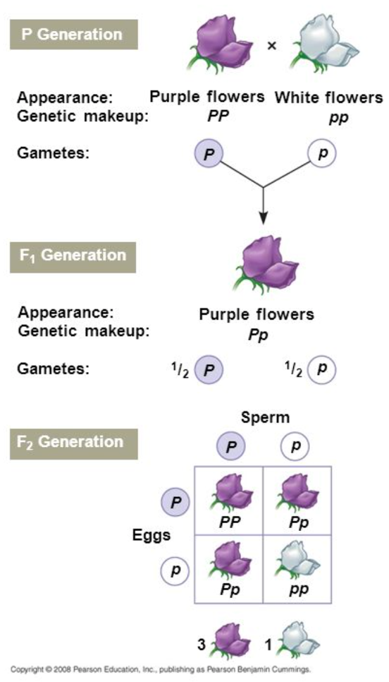
Mendel
For instance, when Mendel crossed true-breeding purple flowers and true-breeding white flowers, the offspring (F1) were all purple.
When he crossed the F1 purple flowers, he got purple and white in a 3:1 ratio in the F2 generation.
He determined that purple was dominant to white.

Slide 13
Mendel
The “blending hypothesis” was wiped out because none of the flowers were pale purple.
He also gave rise to the term “heritable factor” which we now call a gene. He said heritable factors must somehow determine flower color.

Slide 14
Mendel’s 4 Part Model to Explain What He Saw
Mendel developed a 4-part model to explain his findings:
  1. There are alternative versions of genes—alleles.
  2. Each organism inherits a copy of an allele from each parent.
  3. Some alleles are dominant, while others are recessive.
  4. The 2 alleles segregate independently from one another during meiosis.

Slide 15
Mendel’s 4 Part Model to Explain What He Saw
1. Alternative versions of genes account for variations in inherited characteristics.

Slide 16
In Today’s Terminology
Each gene resides at a specific locus on a specific chromosome.
The DNA at this locus can vary slightly in its sequence of nucleotides and thus its information.
The sequence of nucleotides, in this case, can change the flower color.
The alleles are due to variations in the DNA and can arise from mutations.

Slide 17
Mendel’s 4 Part Model to Explain What He Saw
2. For each character, an organism inherits 2 “heritable factors”, one from each parent.
This was a remarkable deduction from Mendel considering he knew nothing about chromosomes or ploidy.
We now know that each parent’s alleles are carried in haploid gametes.

Slide 18
Mendel’s 4 Part Model to Explain What He Saw
3. If 2 alleles at a locus differ, then the dominant allele determines the organism’s appearance while the recessive allele gets masked and no noticeable change in the organism’s appearance can be seen.

Slide 19
Mendel’s 4 Part Model to Explain What He Saw
4. The 2 alleles for a heritable characteristic segregate independently during gamete formation and end up in different gametes, haploid gametes.
This makes up what is known as the Law of Segregation.

Slide 20
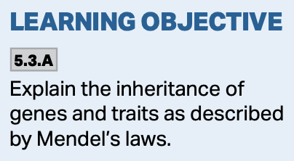
The Law of Segregation
The Law of Segregation applies to all genes on a particular chromosome.
It says that allele pairs segregate independently during gamete formation.

Slide 21
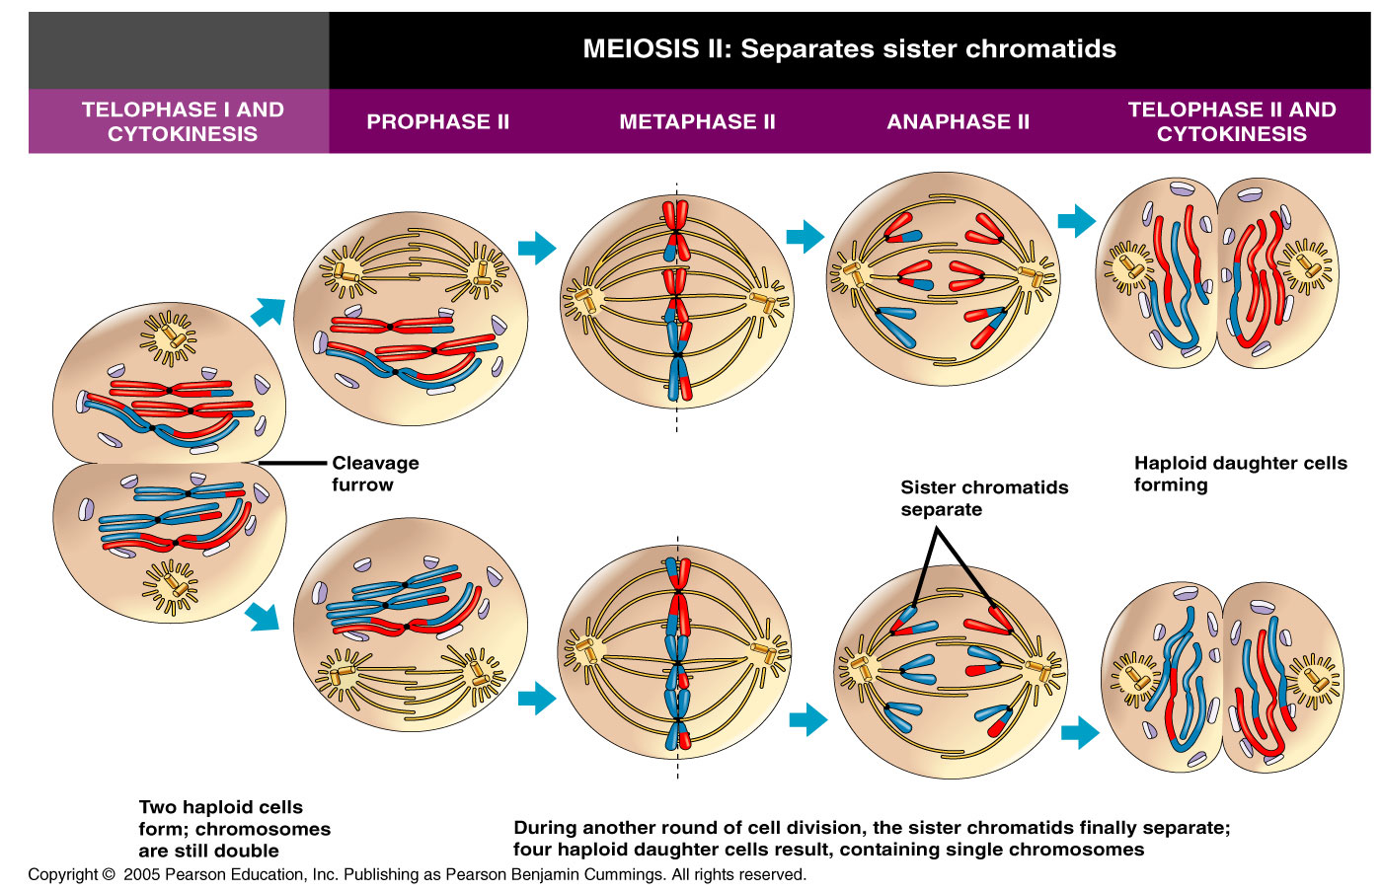
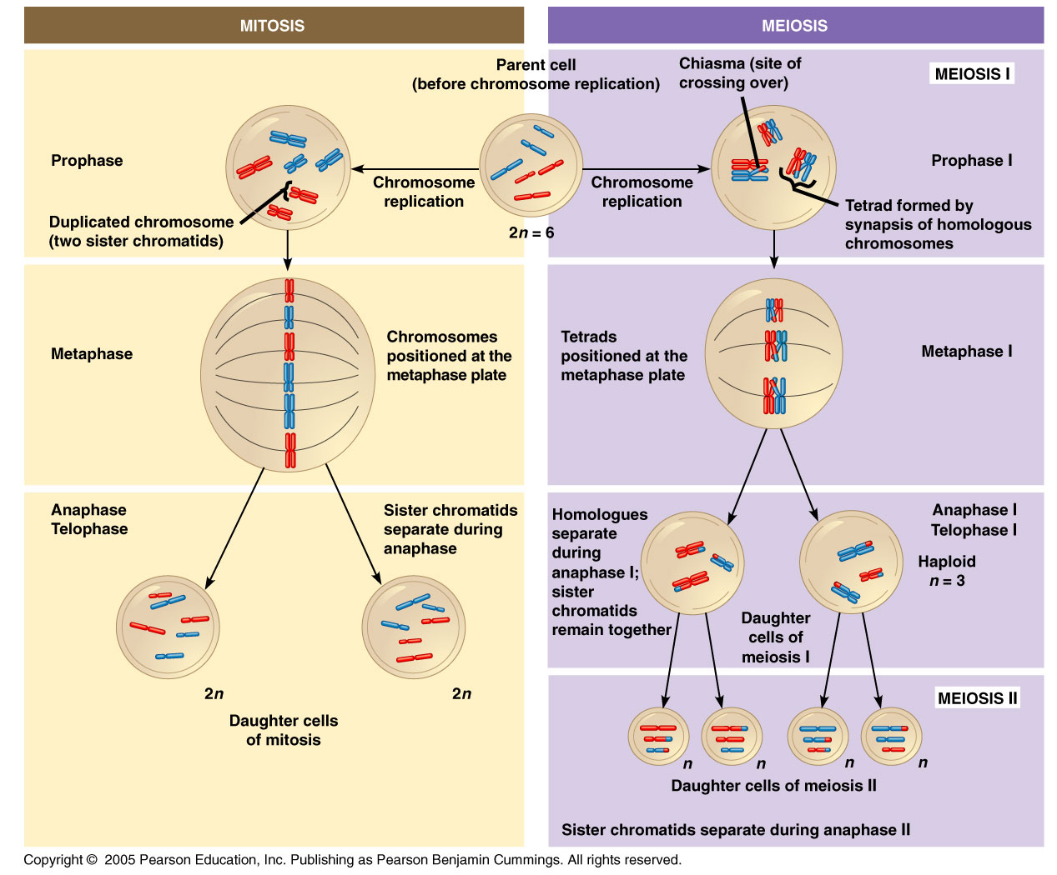
The Law of Segregation
In terms of chromosomes, recall that homologous chromosomes are being separated and distributed to different gametes during meiosis.

Slide 22
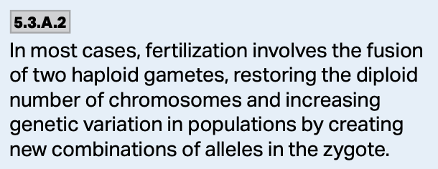
Fusion of Gametes
These gametes then fuse during reproduction resulting in a diploid zygote containing one copy of each allele, one from either parent.
The result may be each of the two alleles being the same, or each being different.

Slide 23
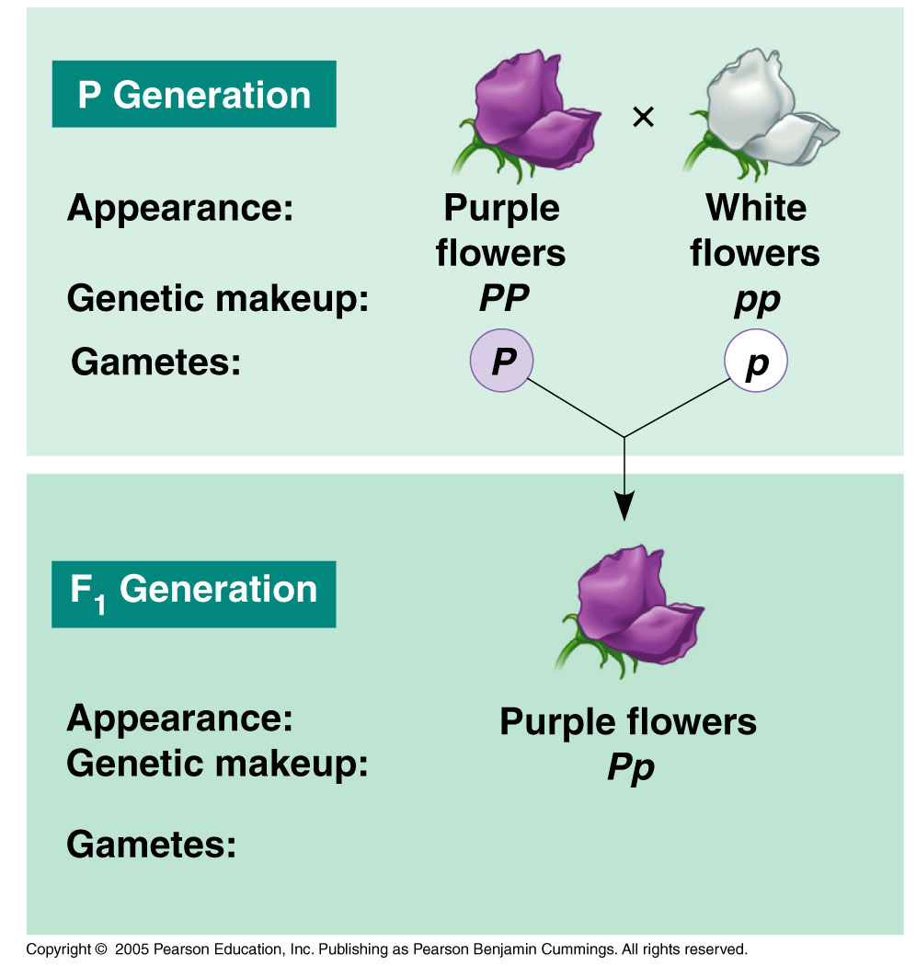
Law of Segregation
Mendel used a monohybrid cross to show that allele pairs segregate during gamete formation.

Slide 24
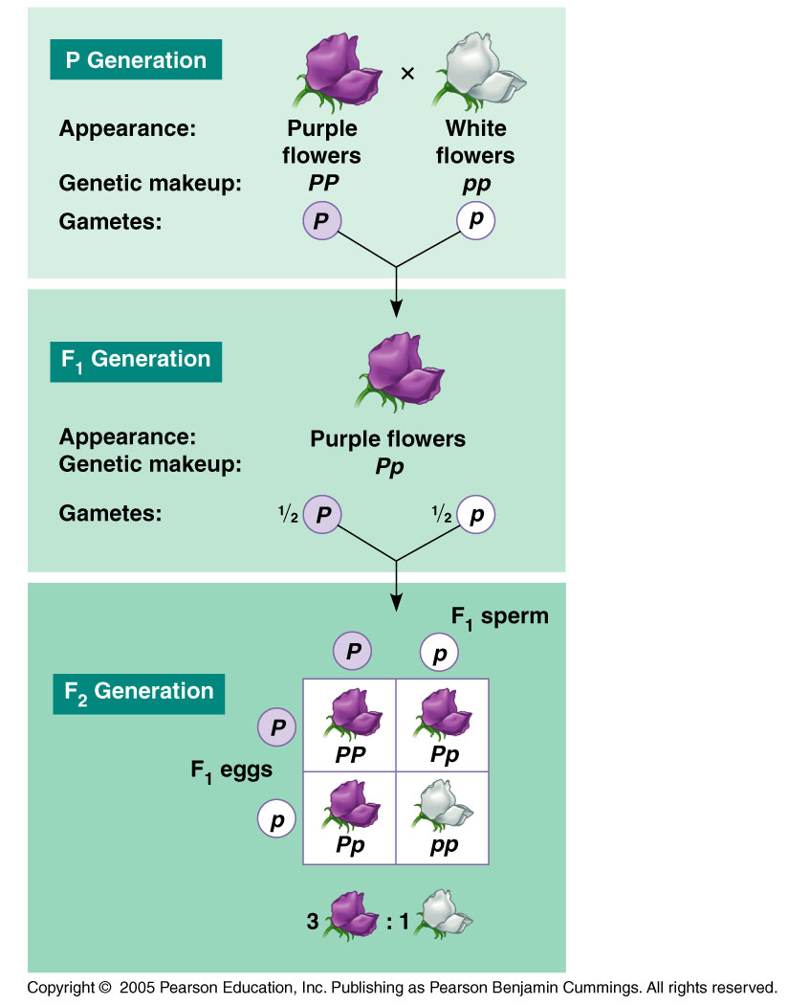
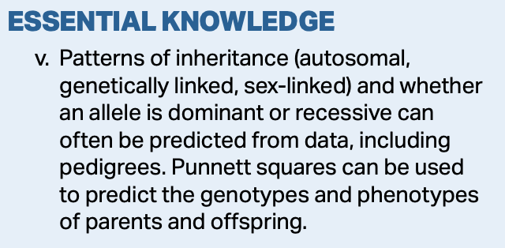
Law of Segregation
If the alleles are the same, each gamete contains the same version of the gene and the organism is said to be true-breeding for the particular trait.

Slide 25
Law of Segregation
However, if the alleles are different, half of the gametes will contain one version of the gene, while the other half will contain the alternative version and the organism is said to be heterozygous for the particular trait.

Slide 26
Law of Segregation
When Mendel crossed the true-breeding purple flower with the true-breeding white flower, no pale purple flowers were produced.
Additionally, when he crossed the two heterozygotes, he got purple and white flowers demonstrating the particulate nature of inheritance.

Slide 27
Law of Independent Assortment
Mendel then moved on to breeding experiments with dihybrid crosses.
From these, he arrived at the Law of Independent Assortment which says that all alleles of a gene pair will assort independently of other pairs during gamete formation.
*This law only applies to genes residing on different chromosomes.

Slide 28
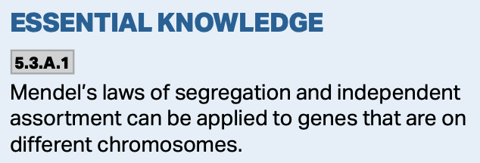
Mendel’s Dihybrid Cross
Plants producing yellow colored, round seeds were crossed with plants producing green colored, wrinkled seeds.
If seed color was linked to seed shape, then a 3:1 ratio would be observed in the F2 generation when the F1 was crossed.
If seed shape assorts independently of seed color, then a 9:3:3:1 ratio would be produced.

Slide 29
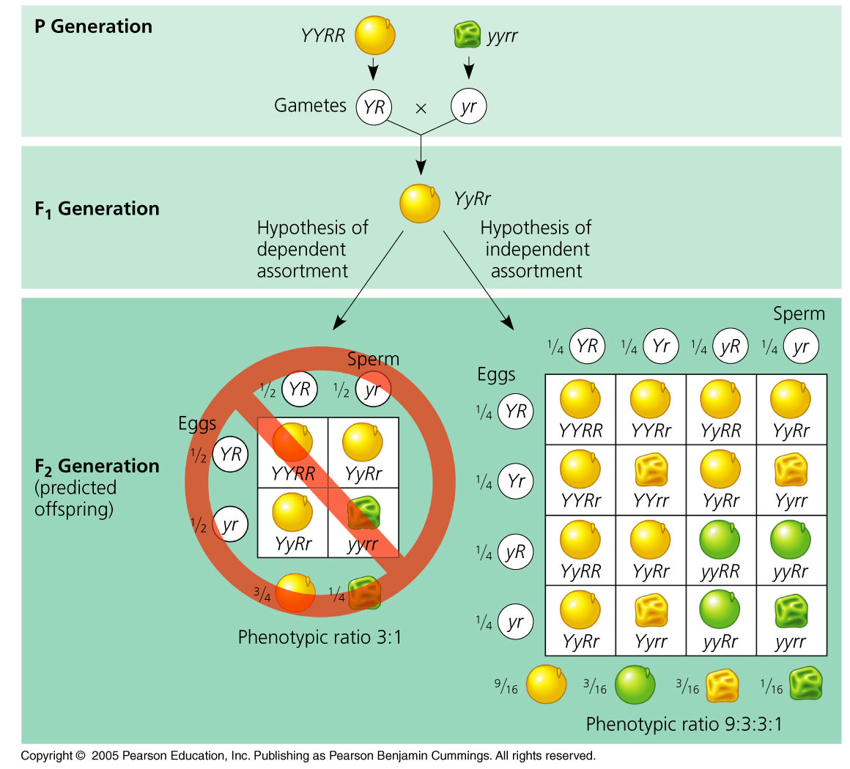

Slide 30
Conclusions
From the dihybrid cross, Mendel concluded that the alleles for seed shape segregate independently from those for seed color.
In other words, being round does not mean you have to be yellow, and being green does not mean you have to be wrinkled.

Slide 31
A Test Cross
Suppose we have a purple flower and we want to know if it is homozygous dominant or heterozygous.
To do this, we cross the organism with a homozygous recessive and observe the ratios of the offspring.
If any white are produced, the trait is said to be heterozygous, and will be produced in a 1:1 ratio.

Slide 32
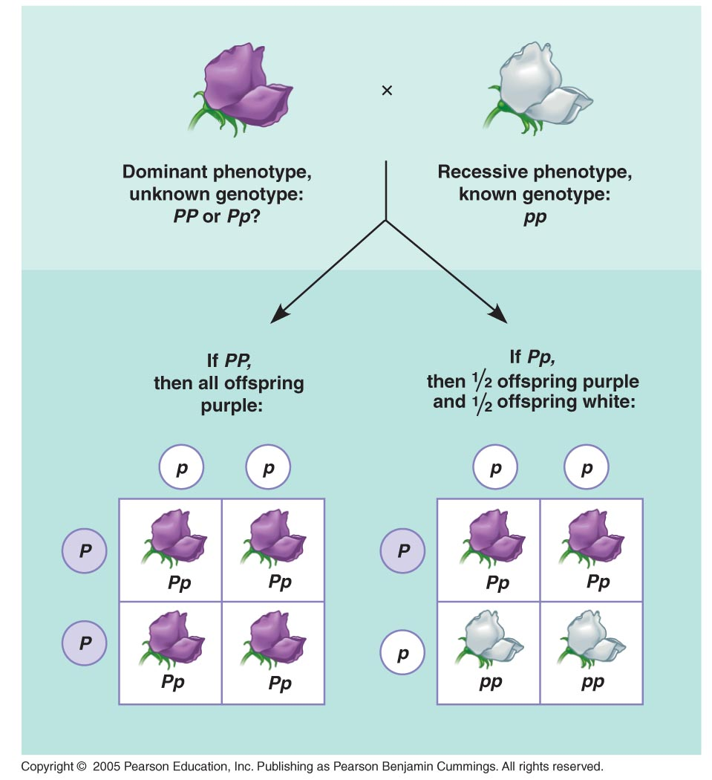

Slide 33
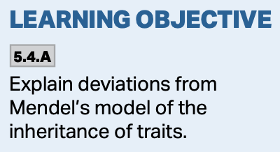
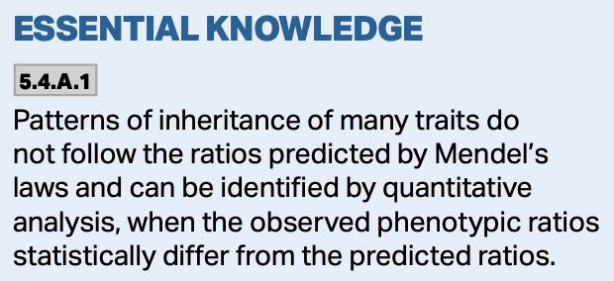
Dominance
In addition to what Mendel has taught us about dominance, there are other forms of dominance as well.
For instance, some characters are completely dominant to others, while others are codominant, or incompletely dominant.

Slide 34
Complete Dominance
Mendel’s peas showed complete dominance. One trait was completely dominant to another (purple to white).

Slide 35
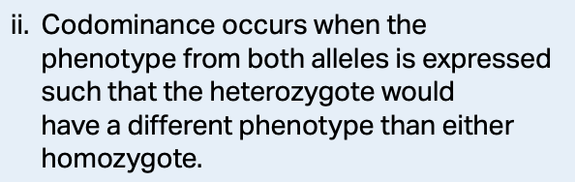
Codominance
Another pattern of inheritance involves codominance where an organism has 2 different alleles that affect the phenotype in separate, distinguishable ways.

Slide 36
Codominance Using MN Blood Groups
In addition to the ABO blood grouping, humans also have an MN blood type determined by the alleles they have of a certain gene.
There is an L^{M} allele, which codes for the M marker.
There is an L^{N} allele, which codes for the N marker.

Slide 37
Codominance Using MN Blood Groups
People who are homozygous, either L^{M}L^{M} or L^{N}L^{N} make only the M or N markers on their respective cell surfaces.
However, those heterozygotes that are L^{M}L^{N} make both markers in equal amounts on their surfaces.
In the case of heterozygotes, both alleles are simultaneously expressed, that is, they are codominant.

Slide 38
Codominance in Cows
Black and white spotted cows are another example of codominance. Both the black and the white alleles are being expressed, resulting in the spotted phenotype.
https://biologydictionary.net/codominance/

Slide 39
Incomplete Dominance
Some alleles exhibit incomplete dominance—certain phenotypic characteristics fall somewhere in between producing an intermediate phenotype compared to each of the two homozygotes.
  For example: The flowering time of Mendel’s peas, and the flower color of pink snapdragon flowers.

Slide 40
Incomplete Dominance
Mendel knew he had peas that flowered shortly after germination and some that took a long time to flower.
When he crossed them, he found that their offspring produced flowers somewhere in between the time when the two homozygotes’ flowered.
In other words, flowering time was intermediate between the two parents.

Slide 41
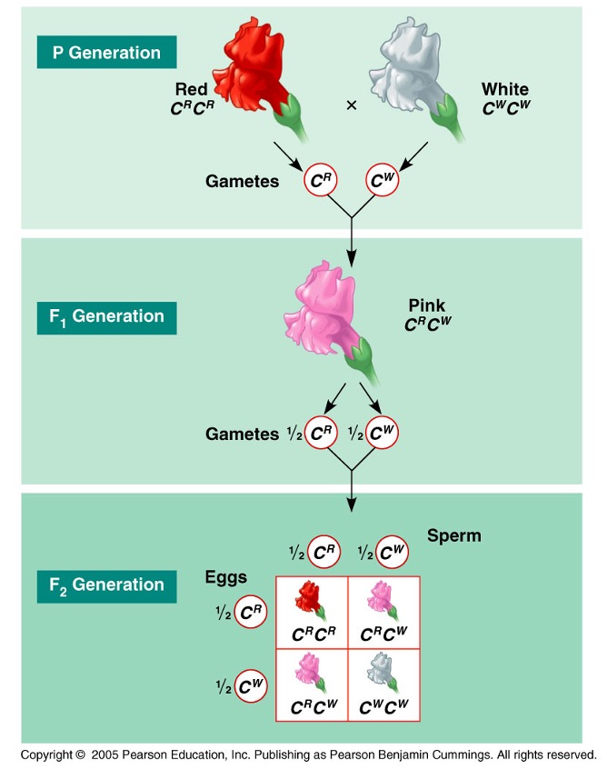
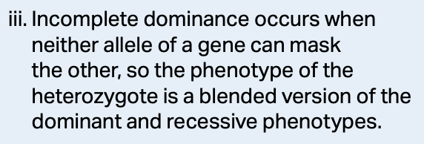
Incomplete Dominance
With pink snapdragons, a red and a white will produce a pink flower—incomplete dominance.
Can you explain why this is it not “blending?”

Slide 42
Multiple Alleles
Thus far we have been talking about 2 alleles that govern certain traits. Often times there are multiple alleles within a population that govern traits of that population.
  For example, there are 3 alleles which code for the 4 major blood types, A, B, AB, and O.

Slide 43
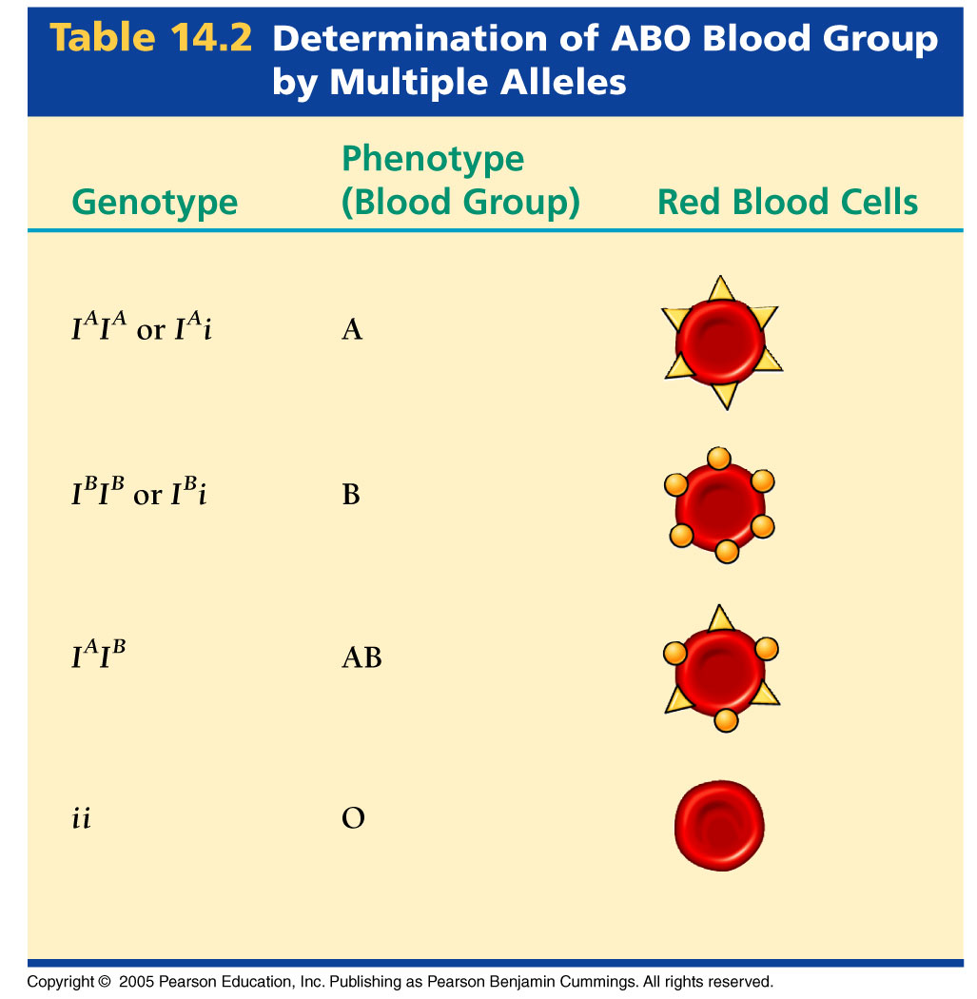

Slide 44
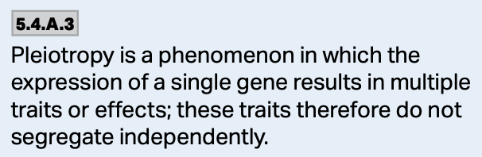
Pleiotropy—Multiple Phenotypes
Most genes exhibit pleiotropy. This occurs when one gene has multiple phenotypic effects.
Examples include cystic fibrosis and sickle cell anemia.

Slide 45
Polygenic Inheritance
The opposite of pleiotrophy (one gene, many characteristics) is polygenic inheritance which is when many genes act on a single characteristic.
  For example: skin color is determined by at least 150 separately inherited genes.
  Variations of the genotype of these individuals produces all of the varieties of skin color we see.

Slide 46
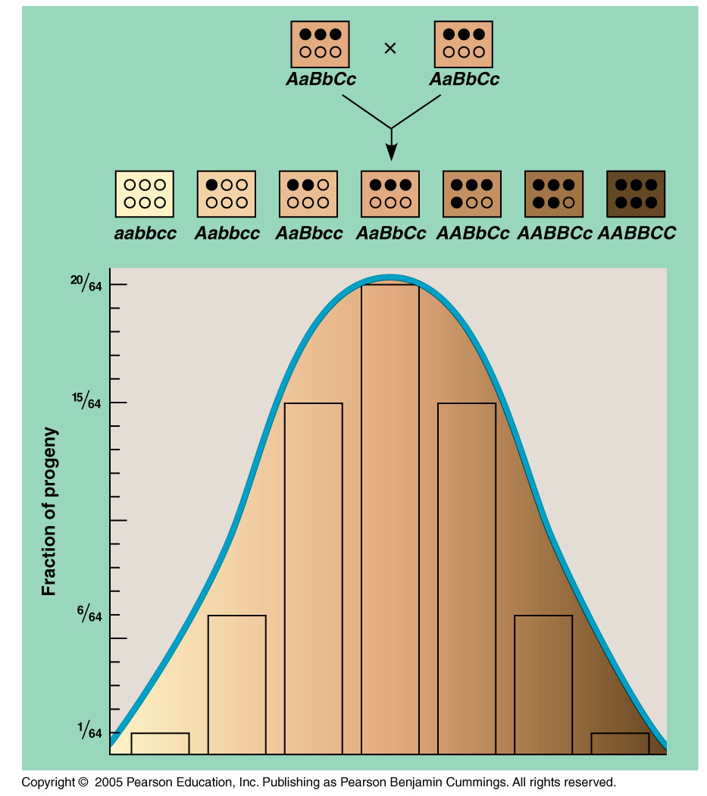

Slide 47
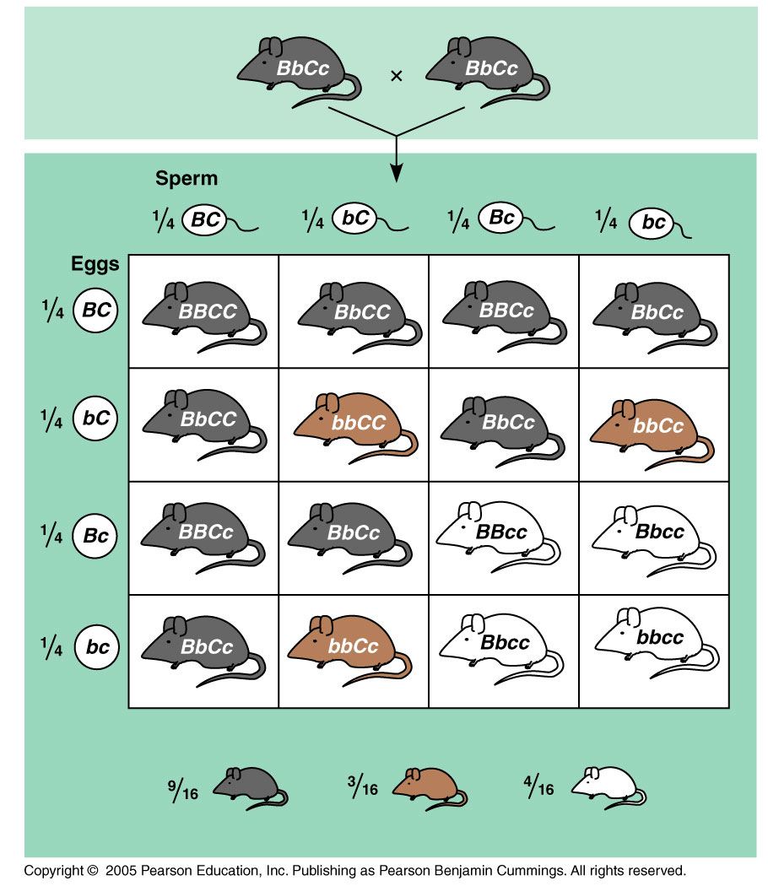
Gene Masking—Epistasis
Epistasis occurs when one gene alters the phenotypic expression of another gene.
An example of recessive epistasis occurs in the coat color of mice.
  Black, brown, albino
  We get a modified 9:3:3:1 ratio.

Slide 48
Genetic Disorders
There are many different types of genetic disorders.
Some of them come from dominant mutations, others are recessive, while others display codominance, or have pleiotropic effects.
Still others are sex-linked, meaning they reside on the X or the Y chromosome. We’ll look at these in our next lesson.

