Slide 1
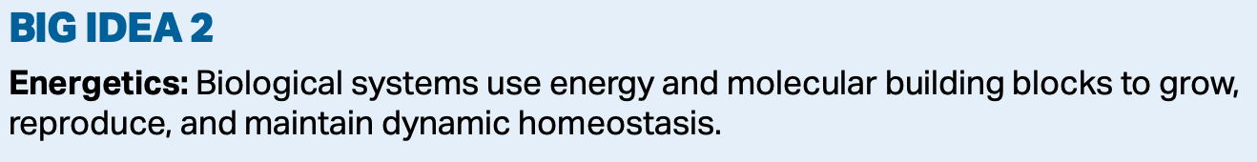
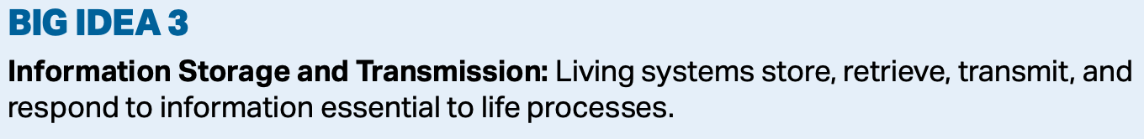
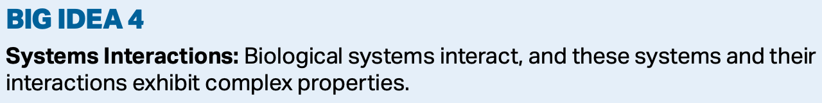
Population Ecology

Slide 2
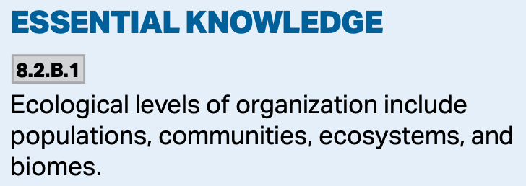
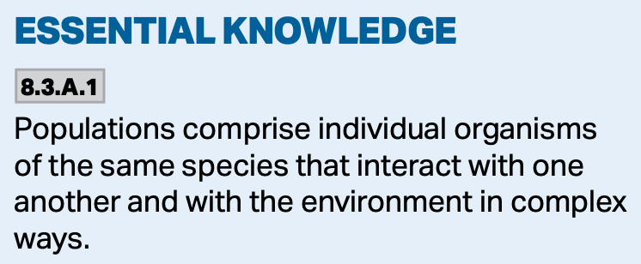

Populations
Populations of organisms are groups of individuals of the same species living in a given area.
These individuals interact with the environment, and interbreed with one another.

Slide 3
Populations
Populations are defined by their size, density, and dispersion.

Slide 4
Populations
The size of a population is determined by the number of births, the number of deaths, the amount of immigration, and the amount of emigration.

Slide 5
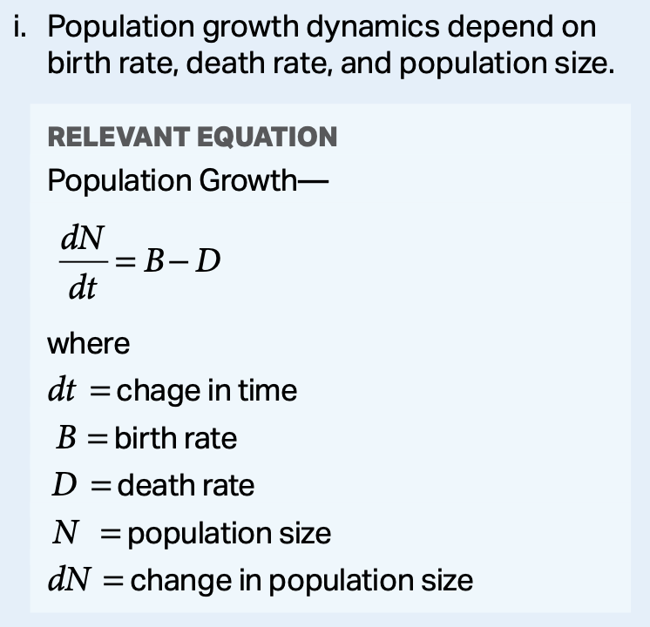
Populations
The amount of population growth can be determined using the following:
dN/dt = B - D
  dt = change in time
  B = birth rate
  D = death rate
  N = population size

Slide 6
Populations
Problem:
As of 2019, India’s population was 1.366 billion people. The birth rate was 27.2 births per 1,000 people, and 9.2 deaths per 1,000 people. If we ignore immigration and emigration, calculate the country’s net population growth in 2019? Describe what is happening to the population, and justify your answer.

Slide 7
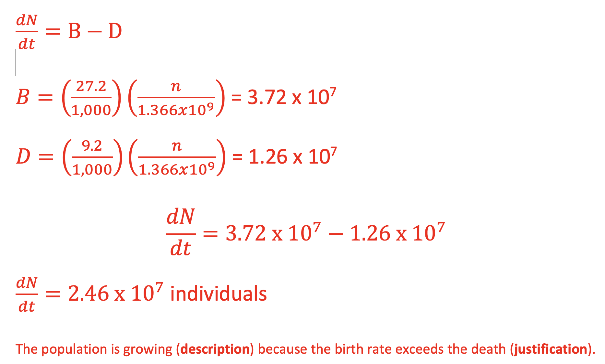
Populations

Slide 8
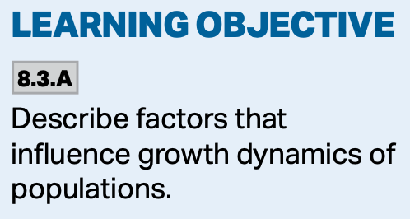
Populations
Population growth is based upon the biotic potential—the maximum rate at which the population could increase under ideal conditions.
It is based upon the following factors:
  The age reproduction begins.
  The lifespan during which reproduction occurs.
  The number of reproductive periods within the lifetime.
  The number of offspring the organism is capable of having at one time.

Slide 9
Populations
Ideally, a population without constraints would grow exponentially, but it soon becomes limited by many things, including:
  Predation
  Competition
  Parasitism
  Immigration
  Emigration
Regardless of the size of the population, growth will occur until it reaches its carrying capacity.

Slide 10
Populations

Slide 11
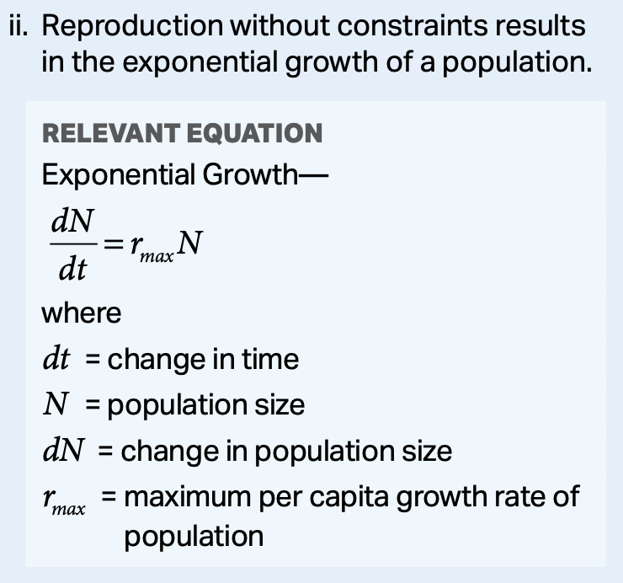
Populations
Exponential populations growth can be determined with the following:
dN/dt = rmaxN
  dt = change in time
  rmax = maximum per capita growth rate of the population
  N = population size

Slide 12
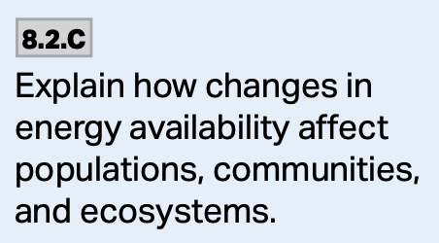
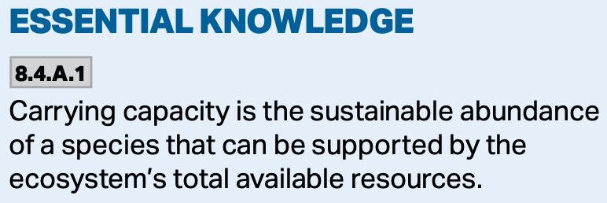
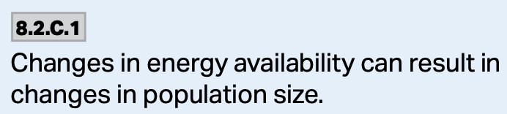
Populations
Carrying capacity is the amount of individuals that an environment can support. It can change as the environment changes.
https://schoolbag.info/biology/humans/34.html

Slide 13
Populations
Reproductive strategies fall into one of two categories:
  r-strategists
  K-strategists
http://www.old-ib.bioninja.com.au/options/option-g-ecology-and-conser/g5-population-ecology.html

Slide 14
Populations
https://spark.adobe.com/page/9xj6qyIfnfNI4/images/8027661f-b7f7-4fff-8a2f-1f1503a03278.jpg?asset_id=35c3e362-671a-491d-a20f-9c4ac2650117&img_etag=031f14b0d33cef83cb942aa98435c3b3&size=1024

Slide 15
Populations
Two categories of factors limit population growth:
  Density-dependent factors—those that increase directly as population density increases.
    Competition, predation, disease, etc.
  Density independent factors—those that are unrelated to population density.
    Major disturbances—fires, floods, etc.

Slide 16
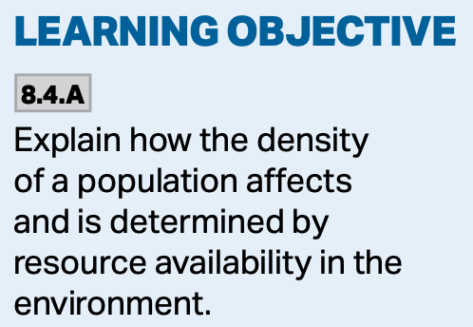
Population Density
Population density is determined by resource availability.
The population can produced a density that exceeds the carrying capacity, at which point limits to growth occur.

Slide 17
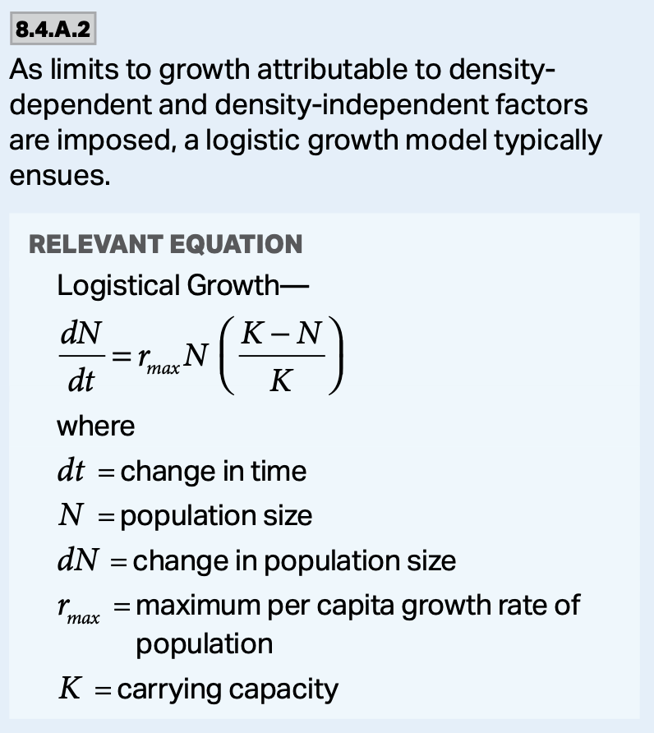
Population Density
When the carrying capacity of the environment is exceeded, density-dependent and density-independent factors start to take over and slow the population growth.
A logistic growth model usually ensues.
https://socratic.org/questions/why-is-logistic-growth-more-realistic-than-exponential-growth

Slide 18
Population Density
Logistic Growth:
dN/dt = rmaxN(K-N/K)
  dt = change in time
  rmax = maximum per capita growth rate of the population
  N = population size
  K = carrying capacity

Slide 19
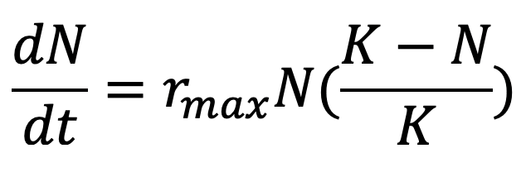
Population Density
Problem: A researcher was studying population growth rates, and has developed a program which uses the following equation to estimate what is happening in the real world. Consider a hypothetical population that has a carrying capacity of 18,000 individuals, and an rmax of 1.5. Calculate the population growth rate for each of the following populations using the following equation:
a) 1,000 individuals. Describe what is happening to this population.
b) 15,000 individuals. Describe what is happening to this population.
c) 20,000 individuals. Describe what is happening to this population.

Slide 20
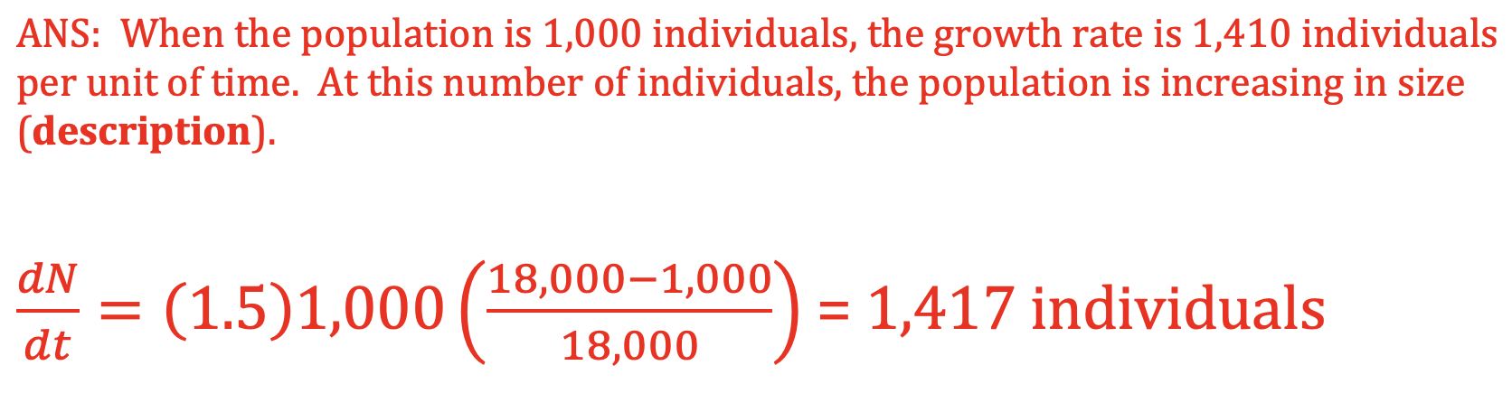
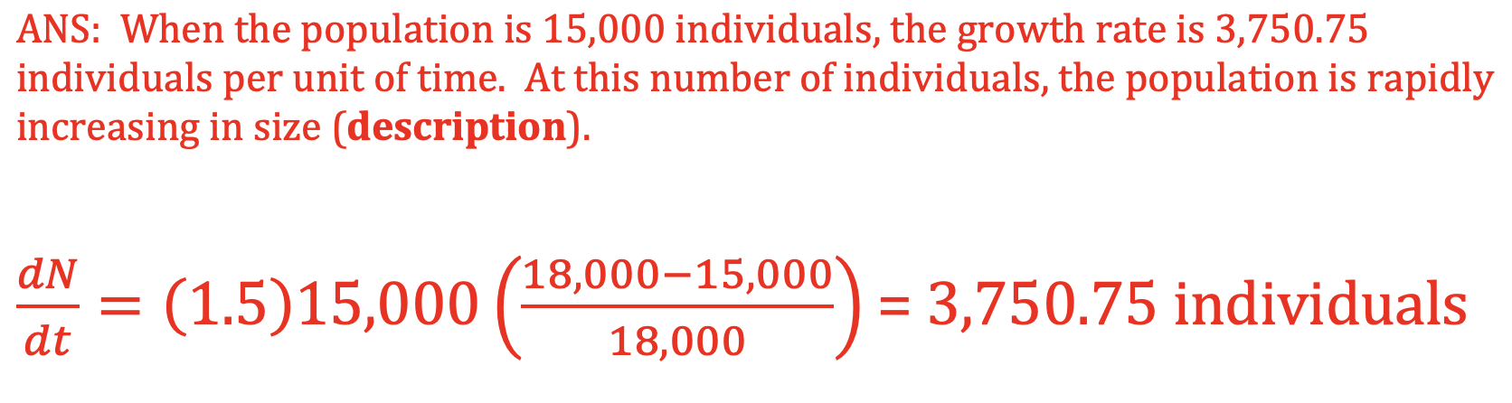
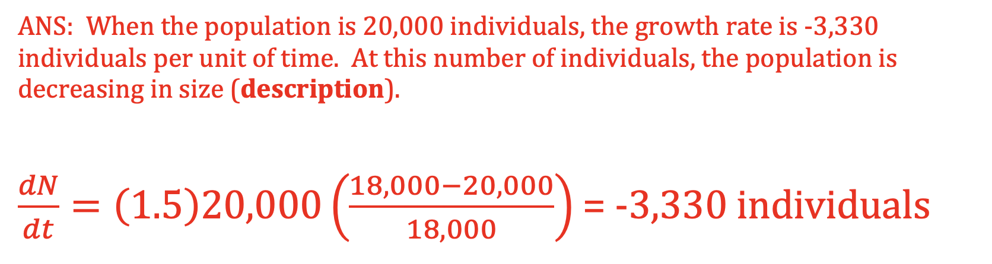
Population Density

Slide 21
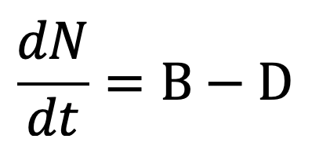
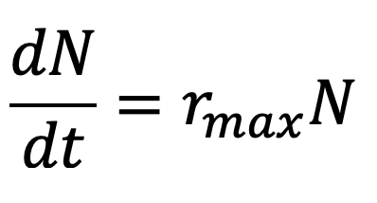
Population Density
Problem: Consider a population of 3,500 rabbits in a field. If 1,200 rabbits are born each year, and 750 die each year, calculate the maximum per capita growth rate over the course of the year.

Slide 22
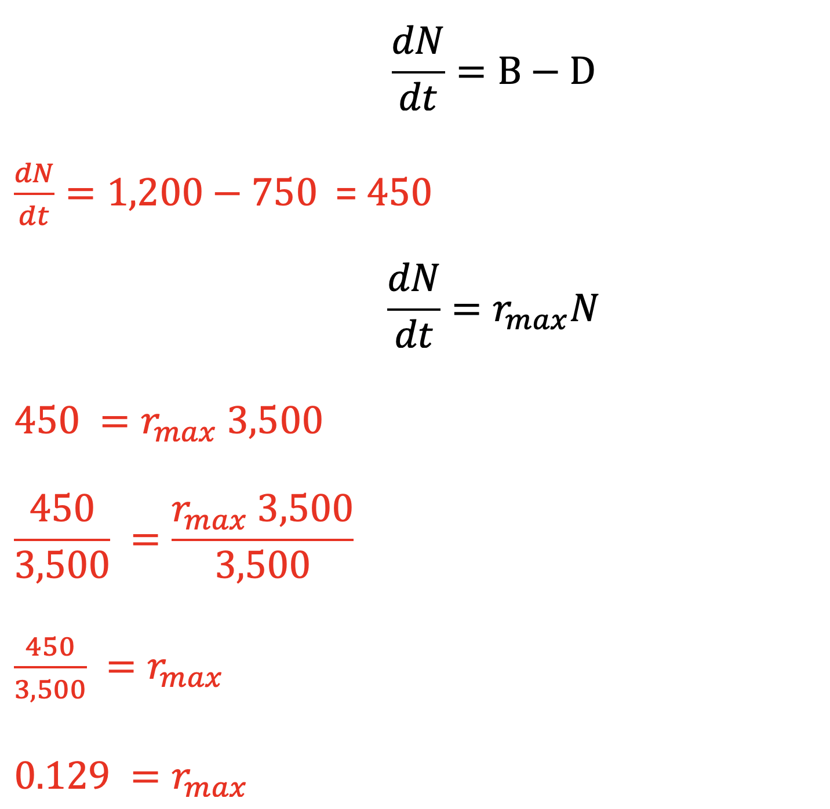
Population Density

Slide 23
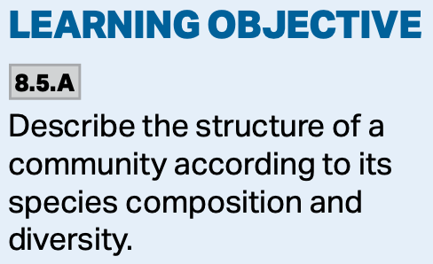
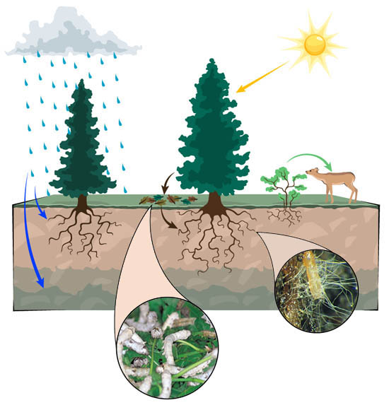
A Community
All of the organisms within the community form an ecosystem consisting of the interactions between the biotic and abiotic environment.
askabiologist.asu.edu

Slide 24
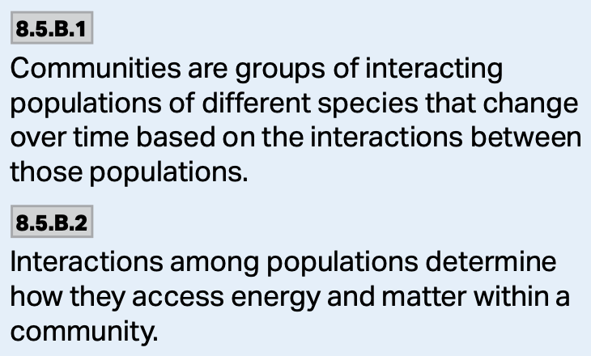
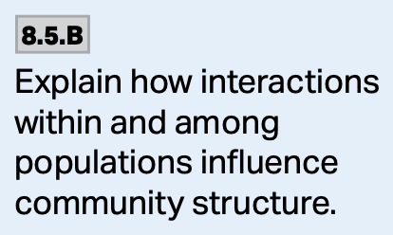
A Community
Community structure is chiefly governed by the interactions of the organisms and their environments.
Interactions among populations determine how they access energy and matter within a community.

Slide 25
A Community
Biotic factors—the living components of the community.
  The different species of organisms which live in the community.
Abiotic factors—the nonliving components.
  Climate patterns.
  Soil.
  Amount of light.
  Etc.

Slide 26
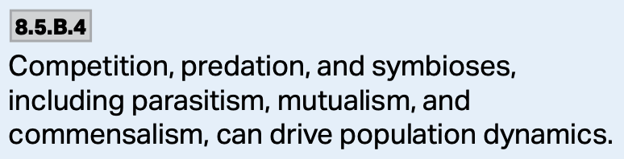
A Community
These interactions are complex, but can be categorized into one of five categories.
  1. Competition
  2. Predation
  3. Parasitism
  4. Mutualism
  5. Commensalism
https://slideplayer.com/slide/9495429/29/images/19/Predation+Commensalism+Parasitism+Mutualism+Competition.jpg

Slide 27
Competition
The competitive exclusion principle states that two species who share a niche cannot coexist within a community because they share the same resources.

Slide 28
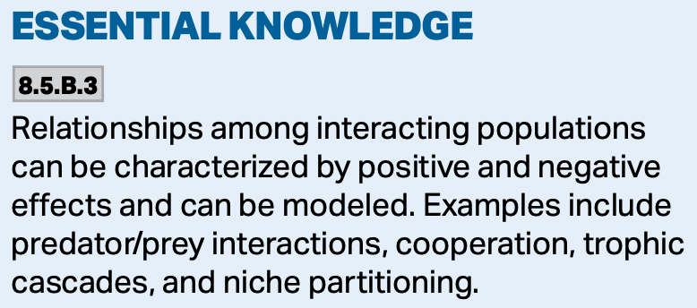
Competition
The relationships among interacting populations can be characterized by positive and negative effects.
Examples include predator-prey interactions, character displacement, trophic cascades, and niche partitioning.

Slide 29
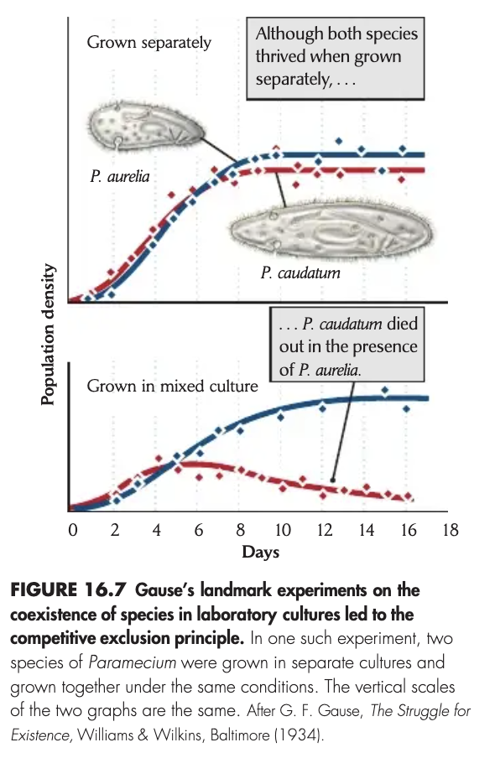
Resource/Niche Partitioning
With resource partitioning, one of the species will evolve to exploit different resource/niche.
https://encrypted-tbn0.gstatic.com/images?q=tbn:ANd9GcRqYXD6sNXZLzxxGmBpE34DEpuHJ2y1zGo7rtbyr0k2JRs3UrQ_W5SFnaZE39Oztcizj1M&usqp=CAU

Slide 30
Resource/Niche Partitioning
https://slidetodoc.com/presentation_image/180dc28206c354b82ffc519c24d42a69/image-7.jpg

Slide 31
Character Displacement
With character displacement a character of the species changes to make use of a resource and avoid competition.

Slide 32
Trophic Cascades
Trophic cascades are interactions between the different species within an ecosystem.
https://www.biointeractive.org/sites/default/files/styles/square_thumbnail/public/media/image/2020-02/TrophicCascades_thumbnail_0.png?itok=TAO4vJpj

Slide 33
Trophic Cascades
When one level of the trophic pyramid is disrupted, it has a bottom-up and a top-down effect.
https://www.biointeractive.org/sites/default/files/styles/square_thumbnail/public/media/image/2020-02/TrophicCascades_thumbnail_0.png?itok=TAO4vJpj

Slide 34
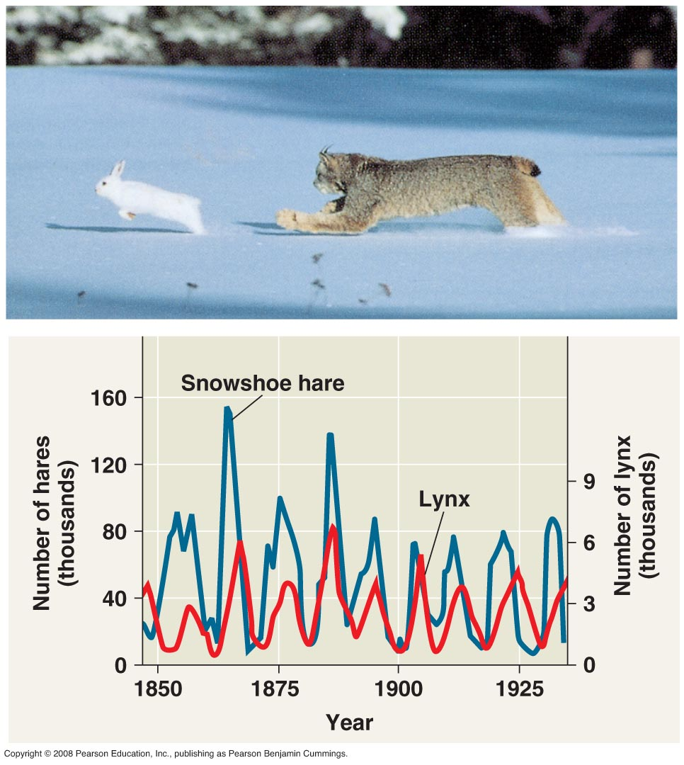
Predator-Prey Interactions
Predator-prey interactions are a major evolutionary driver.
These interactions also influence the numbers of predators and prey within the environment.

Slide 35
Predation
Predation takes on two forms, animals eating other animals, or animals eating plants.
  To defend against this, animals have evolved different mechanisms, hiding, fleeing, or defending themselves.
    Aposematic coloration, Batesian and Müllerian mimicry.
  Plants have evolved spines/thorns and chemicals.

Slide 36
Mimicry for Defense
Batesian is where a benign version mimics a poisonous one.
Müllerian is where to poisonous ones look alike.

Slide 37
Parasitism
This is a relationship where one organism—the parasite—benefits, and the other—the host—suffers.
  Tapeworms in humans is an example.
https://www.scmp.com/news/world/united-states-canada/article/3013517/new-york-surgeons-find-tapeworm-rachel-palmas-brain

Slide 38
Mutualism
Mutualism is a symbiotic relationship where both organisms benefit.
  Clownfish and sea anemones are an example.
https://news.mit.edu/2016/species-relationships-jointly-beneficial-competitive-environments-0824

Slide 39
Commensalism
Commensalism is a relationship where one organism benefits and the other is nether helped nor harmed.
  Egrets hanging around grazing animals is an example. The animals aren’t helped, but the egrets eat the insects they kick up.
http://moodle.monashores.net/mod/page/view.php?id=41697

Slide 40
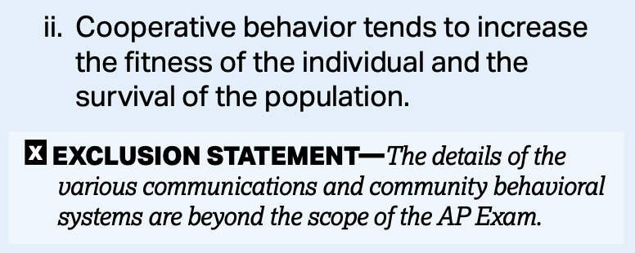
Cooperation
Cooperation is a beneficial behavior that organisms use to increase chances for survival.
Many different types of organisms (plants, animals individual cells, etc.) cooperate in some fashion to achieve a common goal.
https://www.nature.com/scitable/content/ne0000/ne0000/ne0000/ne0000/13307548/rubenstein_figure1.jpg

Slide 41
Cooperation
Cooperation can occur within and between species.
Examples include:
  Birds-when a predatory bird enters the area of a prey bird, the prey birds team up to fend off the predator.
  Fish-cleaner fish swimming into the mouth of a larger fish to rid it of bacteria.
  Bees-work together to bring food back to the hive.

Slide 42
Populations
Community structure can be determined by examining population distribution.
Sampling populations helps determine dispersion patterns.
There are three common ones:
https://apbiologyctd.wordpress.com/ecology/population-ecology/

Slide 43
Populations
The density of a population is the given number of individuals within a given area.
Determining the number of organisms in a given area is difficult.
Scientists use a number of sampling techniques to accomplish this.

Slide 44
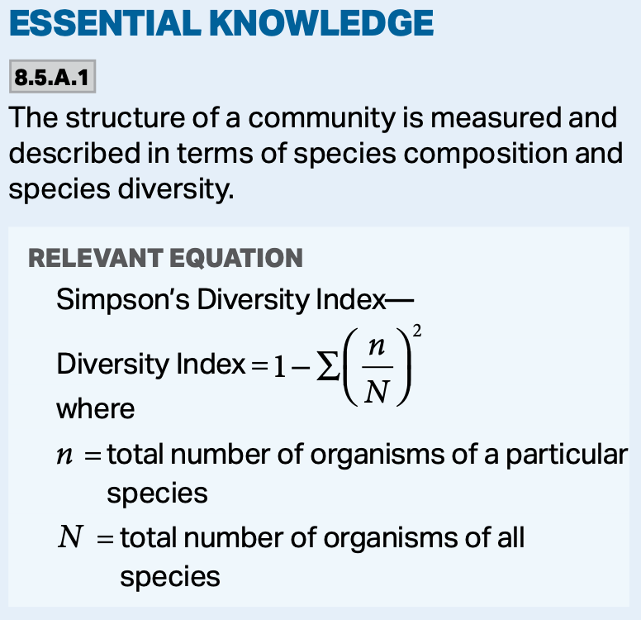
Populations
Mark and recapture.
Quadrat sampling.

Slide 45
Mark and Recapture
N = (M x C)/R
N = estimated Number of individuals in the population.
M = the number of individuals captured and Marked the first time.
C = total number Captured the second time.
R = the number of individuals Recaptured.

Slide 46
Mark and Recapture
Let’s say you have a population of birds that you can trap with special nets. The first time you go out, you capture 20 of them and put a small plastic tag on their ankles.
The following month, you catch 15 of them and 6 of them have the tags, what is the estimated size of the population?

Slide 47
Mark and Recapture
N = (M x C)/R
N = (20 x 15)/6
N = 50
You have to assume the following:
  The mark can’t come off and must not harm the individuals, or make them more/less likely to be recaptured.
  There is no immigration of emigration.
  No individuals die between samplings.

Slide 48
Quadrat Sampling
Quadrat sampling is a way to look at the richness, evenness, and overall diversity of a sample plot.
It uses the Simpson’s Diversity Index:
DI = 1 - ∑(n/N)²
  DI = Diversity Index
  N = total number of all species counted
  n = number of individuals of a particular species.

Slide 49
Quadrat Sampling
A value close to 1 means high richness and evenness, low competition, and many open niches.
A low value, close to zero, means no diversity.
1 is infinite diversity.
0 is no diversity.

Slide 50
Quadrat Sampling
Problem: The diversity of species within a given area is important to the overall structure and organization the ecosystem being studied. There are many ways to measure this diversity, and scientists often do so in an attempt to monitor its resilience to changes in the environment.
a) Distinguish between the terms richness and evenness.

Slide 51
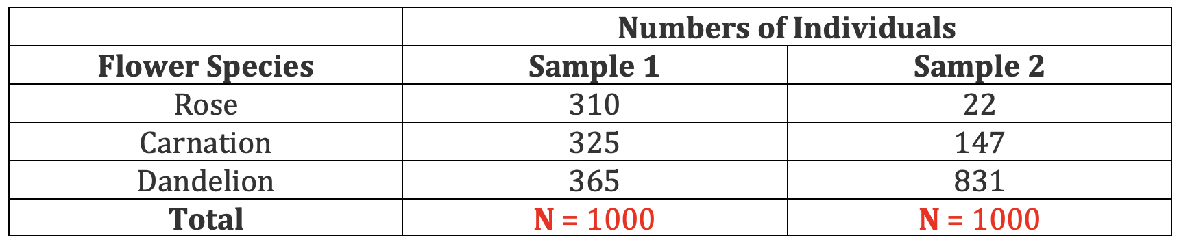
Quadrat Sampling
Problem:
b) Using the following data table, explain the two samples in terms of richness and evenness.

Slide 52
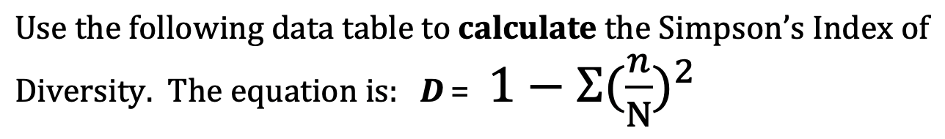
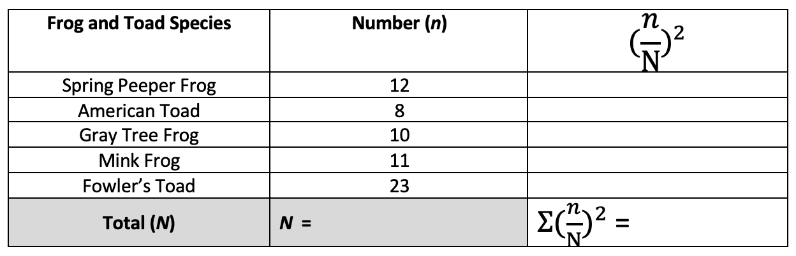
Quadrat Sampling
Problem:
c)

Slide 53
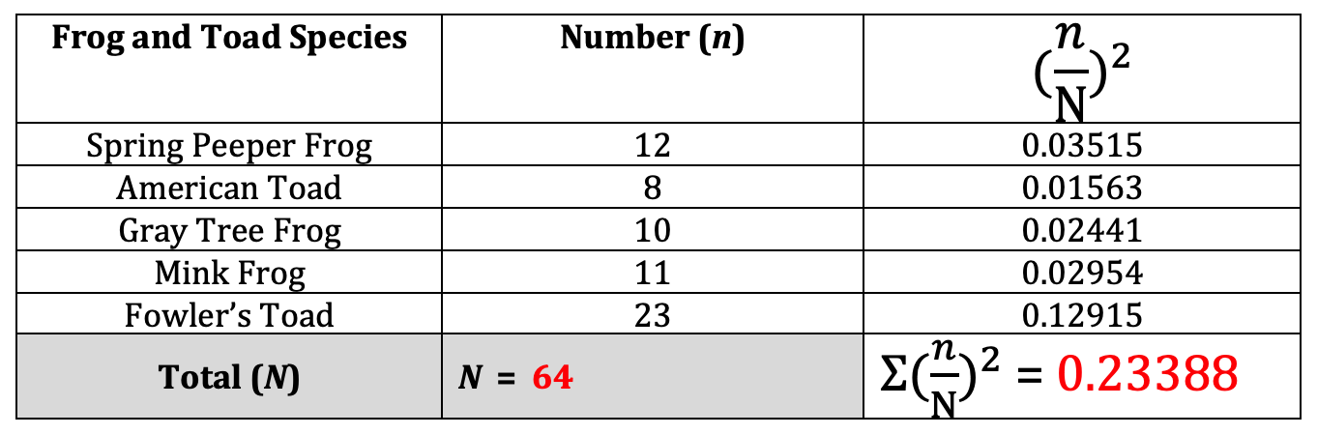
Quadrat Sampling
Problem:
c)

Slide 54
Quadrat Sampling
Problem:
d) Based on the number you calculated in the Part C above, make a claim can be made about the diversity of the sample plot? Justify your answer.

Slide 55
Quadrat Sampling
Problem:
d) Based on the number you calculated in the Part C above, make a claim can be made about the diversity of the sample plot? Justify your answer.

Slide 56
Ecosystems
Ecosystems are communities of living organisms which interact with the biotic and abiotic environment.
  Forests, reefs, lakes, and oceans are examples. There are many others.
Energy and matter flow through ecosystems with the help of producers, consumers, and decomposers.

Slide 57
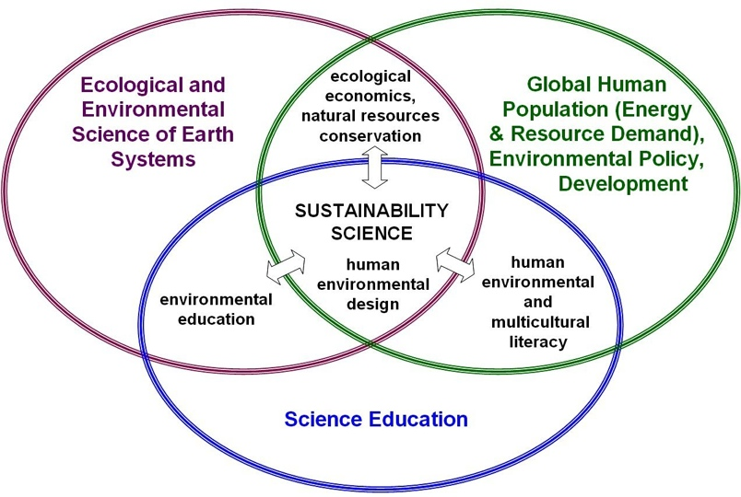
Ecosystems
Ecosystems have the potential to be sustainable over long periods of time.
www.science.widener.edu

Slide 58
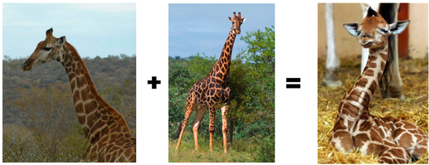
Species
Recall, according to the BSC, species are groups of organisms that can potentially interbreed and produce viable, fertile offspring.
sandburgevolution.wikispaces.com

Slide 59
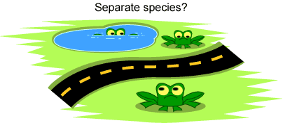
Species
Members of the same species may be reproductively isolated in separate populations.
tochango-jesuslab.blogspot.com

Slide 60
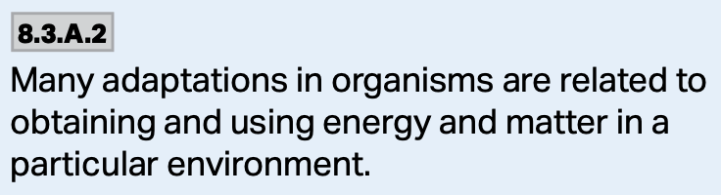
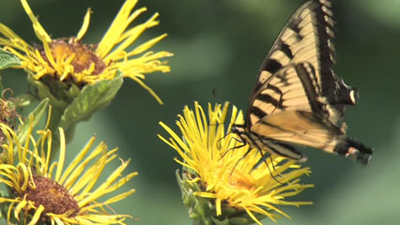
Methods of Nutrition
Regardless of the type of organism, a species may have an autotrophic or a heterotrophic mode of nutrition.
www.britannica.com

Slide 61
Autotrophs
Autotrophic organisms synthesize organic materials from inorganic ones, often using sunlight energy to do so.
They obtain inorganic nutrients from the abiotic environment.

Slide 62
Heterotrophs
Heterotrophs rely on other organisms for their complex organic compounds.
They use these compounds for energy, growth and repair.
Consumers are heterotrophs that ingest other organisms.
  Animals, fungi, and bacteria are examples of consumers.

Slide 63
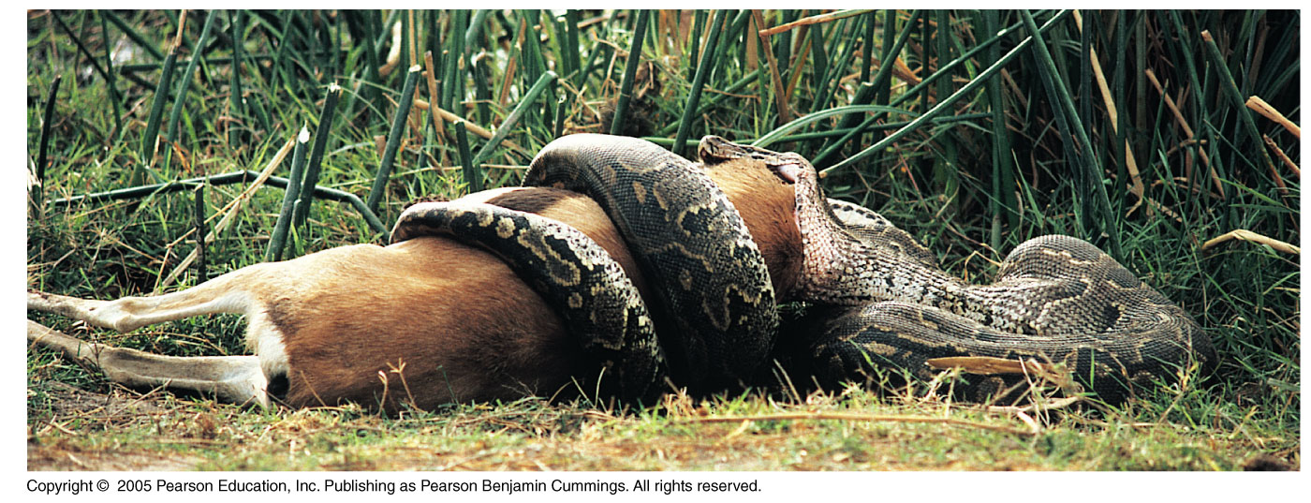
Heterotrophs
Animals are consumers that eat other organisms, can’t make their own food, and are considered heterotrophs.

Slide 64
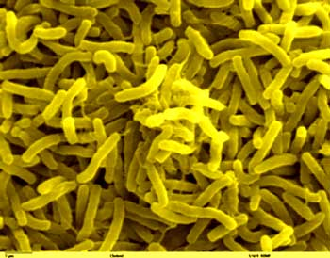
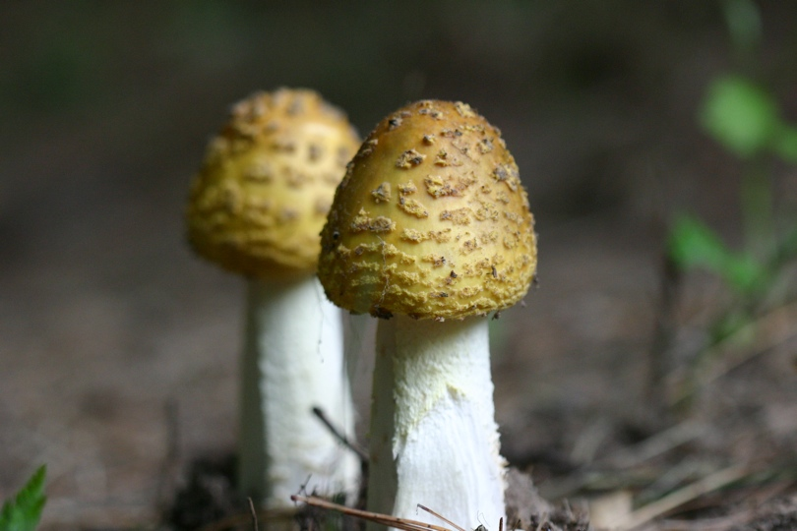
Heterotrophs
Fungi and bacteria are also heterotrophic.
leavingbio.net

Slide 65
Saprotrophs
Saprotrophs are heterotrophs that obtain organic nutrients from dead organisms by external digestion.
It is most often associated with fungi and soil bacteria.
leavingbio.net

Slide 66
Saprotrophs
These organisms release proteases, lipases, and amylases onto the substrate to break down the matter.
The matter is then reabsorbed into the saprotroph to aid in growth, repair, and energy production.

Slide 67
Detritus
Detritus is dead particulate organic matter.
It often includes the bodies of dead organisms.
It is typically colonized by microorganisms that decompose the material.

Slide 68
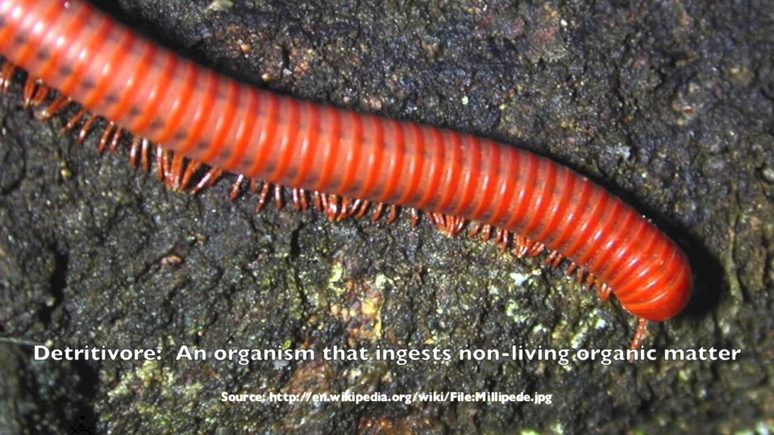
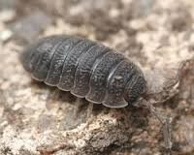
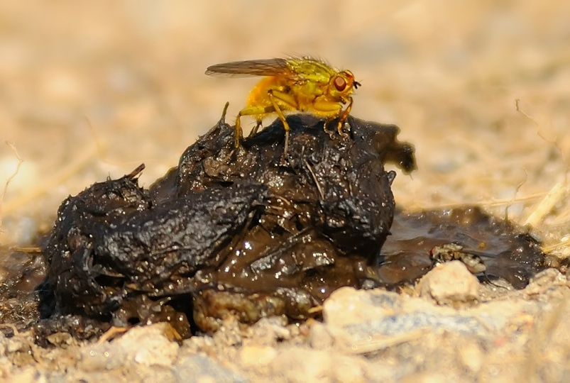
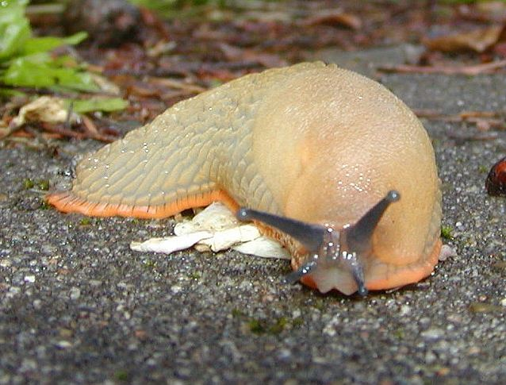
Detritivores
Detritivores are heterotrophic organisms that obtain organic nutrients from detritus by internal ingestion.
Typical detritivores:
  Millipedes
  Woodlice
  Dung flies
  Slugs
www.amentsoc.org
www.marylandinsects.com
news.zing.vn

Slide 69
Distinguish Between...
A consumer, a detritivore, and a saprotroph.
  Consumer: ingests organic matter that is living or recently killed.
  Detritivore: ingests dead organic matter.
  Saprotroph: absorbs products of external digestion of dead organic matter.

Slide 70
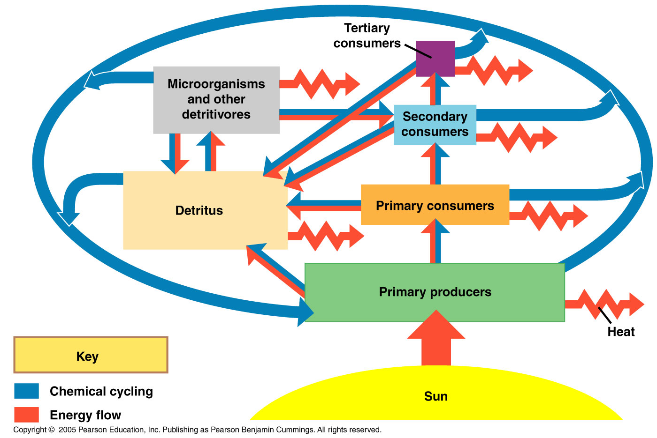
Detritivores
These organisms contribute greatly to decomposition and the nutrient cycles.
They make the chemical elements available to other organisms.

