Slide 1
Chapter 13
Cell and Nuclear Division
Chromosomes
Essential Idea: Alleles segregate during meiosis allowing new combinations to be formed by the fusion of gametes.
Guiding Question: How do eukaryotes produce genetically varied cells that can develop into gametes?

Slide 2
Inheritance/Heredity
When traits are passed down from generation to generation, we say they are inherited.
The offspring differ from one generation to the next and we use the term variation to describe these differences.

Slide 3
Chromosomes
Chromosomes carry genes from one organism to another within a species.
They are the vehicles of heredity.
Minor differences in the sequences of base pairs on these chromosomes is what contributes to variation.

Slide 4
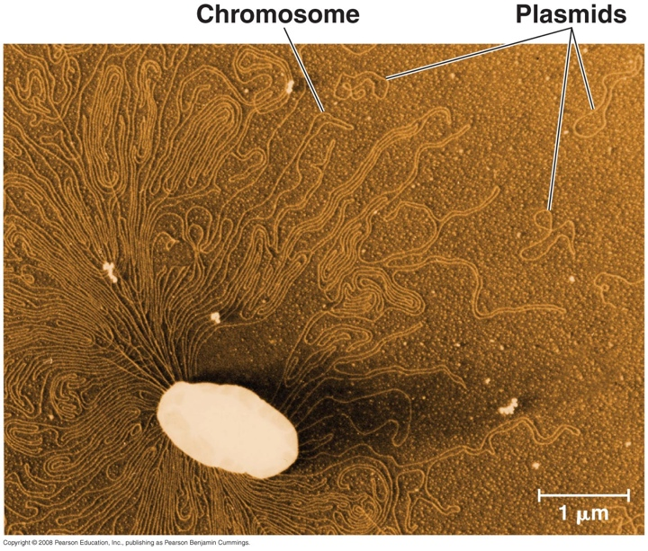
Prokaryotic Chromosomes
Bacteria have one circular chromosome that is often associated with one or more plasmids.
Plasmids are pieces of genetic material that often carry genes that help the organism.

Slide 5
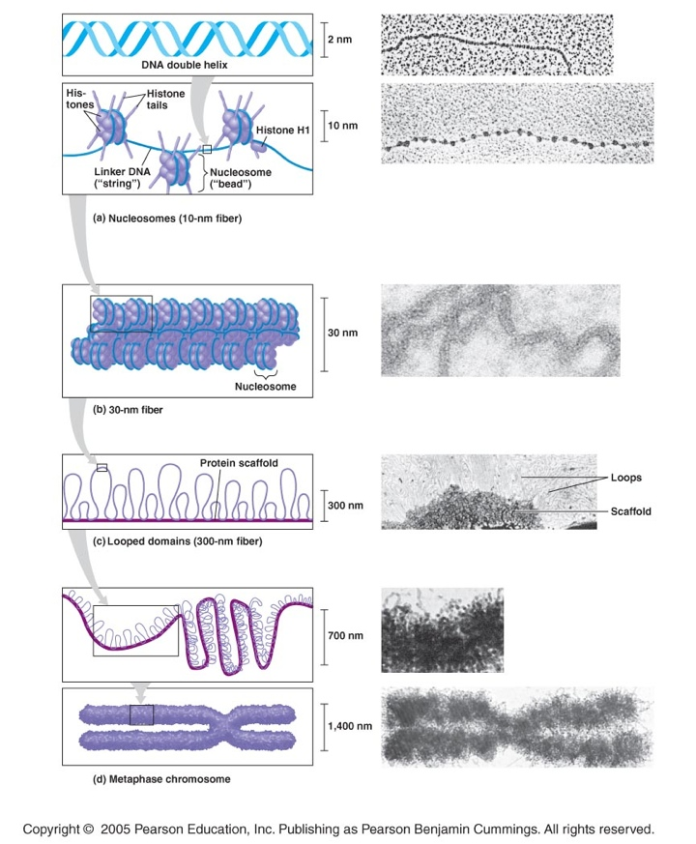
Eukaryotic Chromosomes
Eukaryotic chromosomes are linear molecules of DNA associated with histone proteins.
Different chromosomes carry different genes.

Slide 6
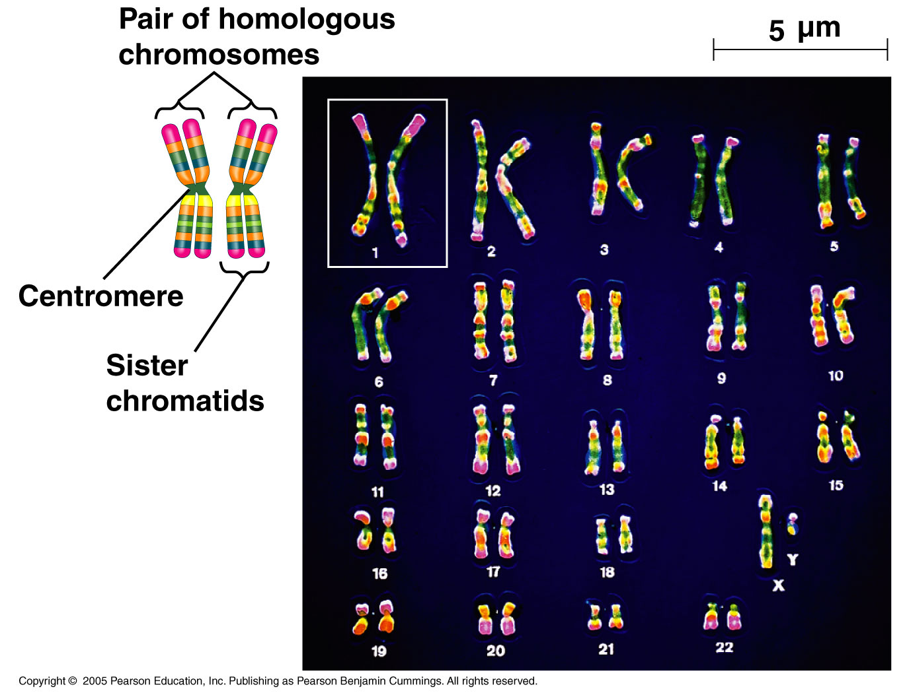
Genes
Genes are regions of our genome that program the specific traits we see (phenotype) such as eye color, height, and many other factors.

Slide 7
Homologous Chromosomes
Homologous chromosomes are chromosomes of the same number.
Each homologous chromosome contains genes that control the same inherited characteristic.
  For example, if the gene that codes for PTC tasting is found on chromosome 7 of mom, it is found at the exact same locus on the homologous chromosome 7 of dad.

Slide 8
The Locus
The locus is the region of the chromosome where a particular gene is located.
http://allaboutgenes.weebly.com/tas2r38.html

Slide 9
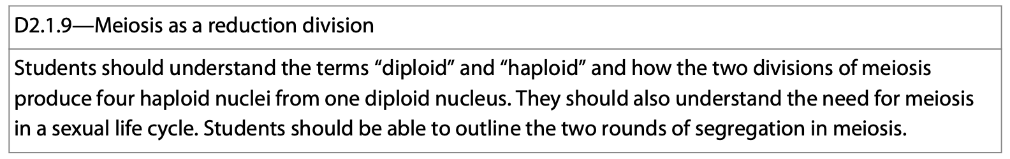
Homologous Chromosomes
Diploid organisms have pairs of homologous chromosomes within their nuclei.
During the process of meiosis, the chromosome number is halved.

Slide 10
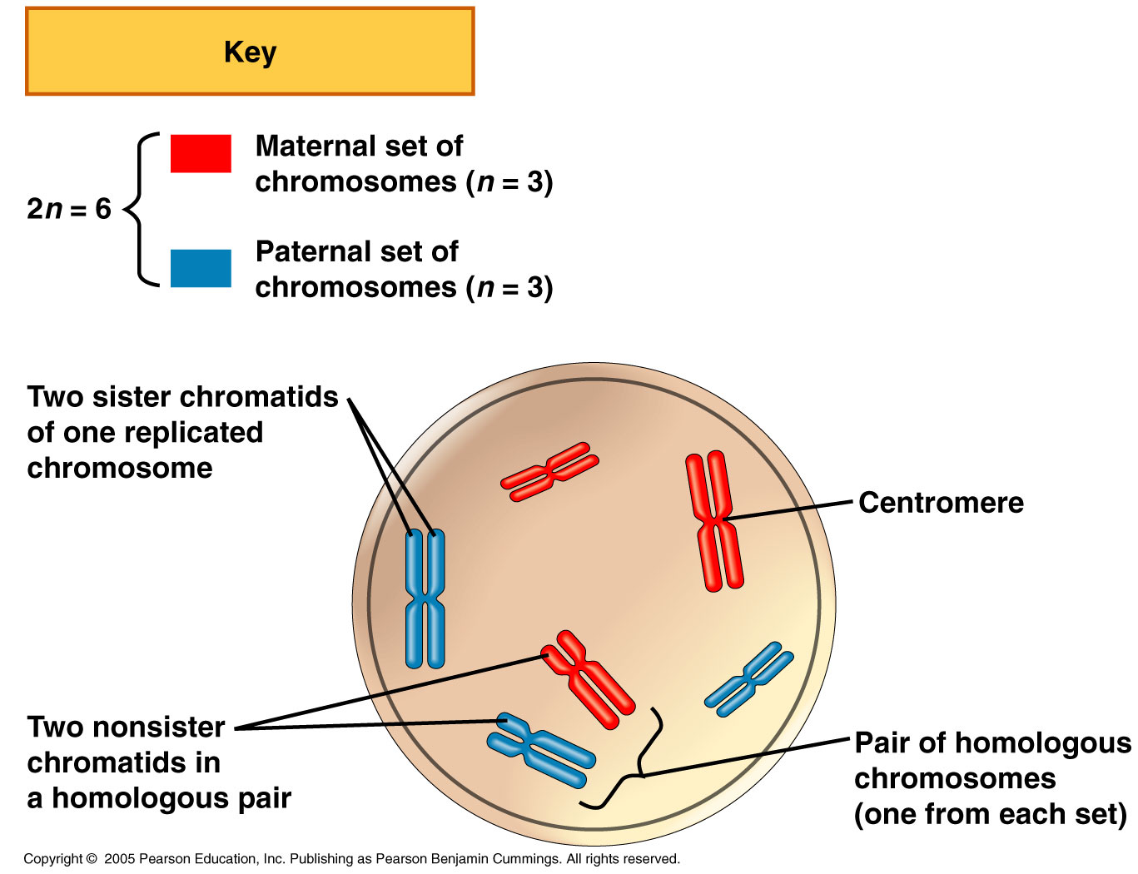

Slide 11
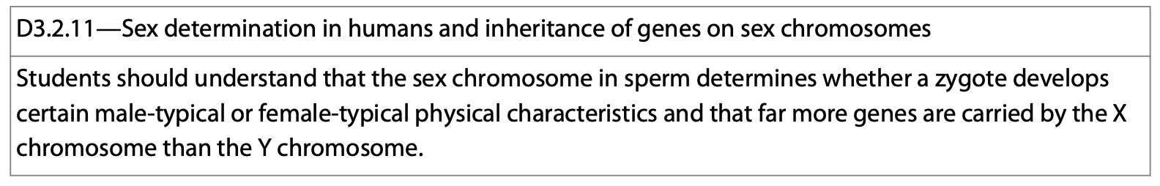
Homologous Chromosomes—Sort Of…
The only two chromosomes that don’t really fit the idea of being homologous are the sex chromosomes, the X and the Y.
The two sets of genes on these chromosomes are more different than they are alike.
They determine the sex of the individual: XX-female; XY-male

Slide 12
Chromosome Number—Autosomes
When discussing chromosome number, we use an “n” to represent this idea.
Any cell having both copies of chromosomes from the parent are said to be diploid which is 2n.
In humans, 2n=46.

Slide 13
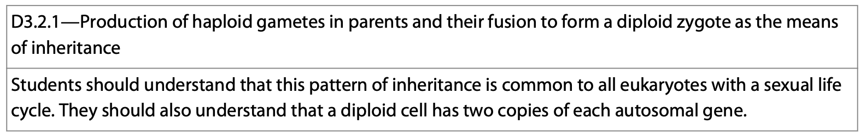
Chromosome Number—Sex Chromosomes
The gametes of sexually reproducing organisms contain a single chromosome set and are said to be haploid, 1n.
For humans:
  n=23 (22 autosomes + 1 sex c-some).
  Eggs and sperm are haploid.

Slide 14
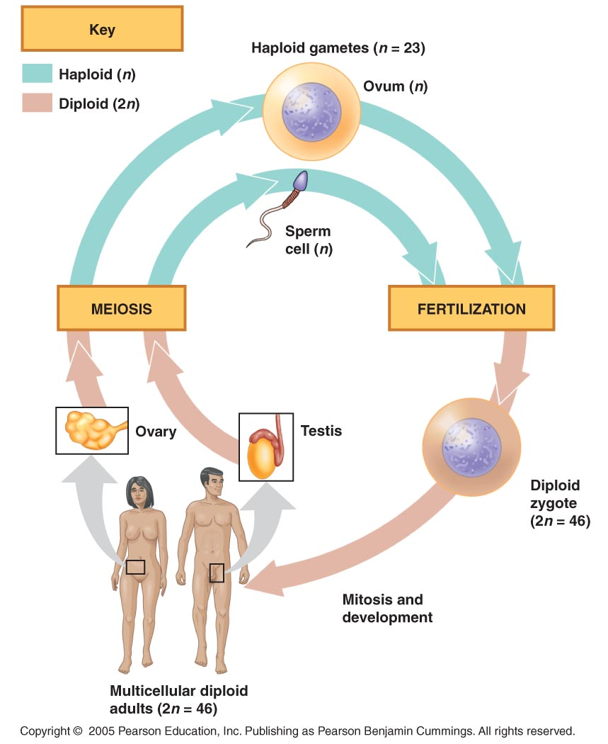

Slide 15
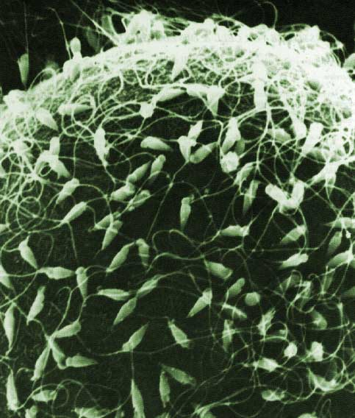
Fertilization
When 2 haploid cells fuse together, a diploid zygote is formed.
The zygote now contains a mix of genes from the two parents.
It will divide mitotically and give rise to a mature organism.

Slide 16
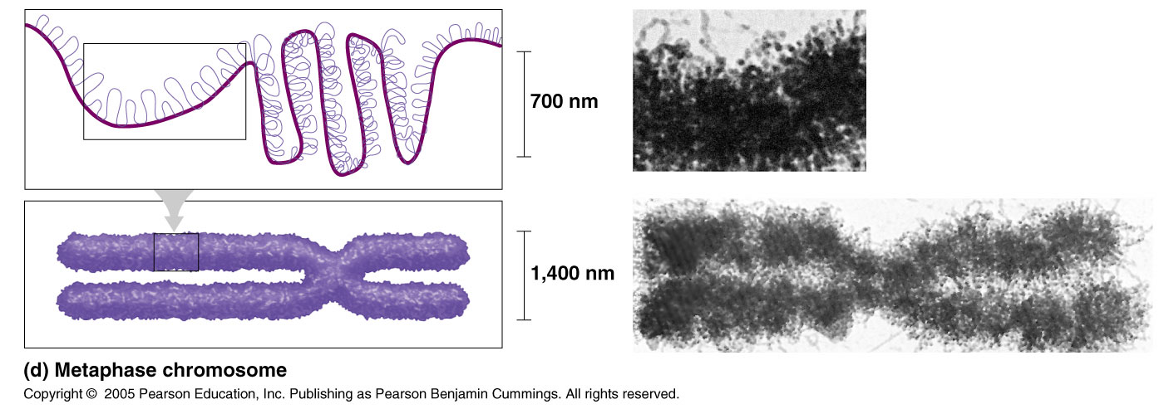
So, how does this happen?
The new individuals now have traits of both parents.
Recall, the chromosome that is inherited is tightly coiled and contains as few as 71 genes on the Y chromosome, to as many as 2,058 on chromosome 1.

Slide 17
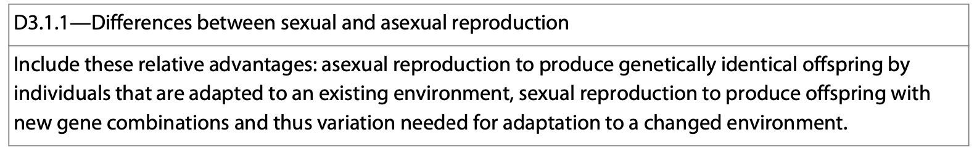
Modes of Reproduction
When discussing heredity, there are a couple of modes of reproduction that need to be discussed.
Sexual and asexual.

Slide 18
Sexual Reproduction
2 parents “mate” and give rise to offspring that have a variety of combinations of genes which are inherited by the new offspring.
They are not genetically identical to the parents.

Slide 19
Sexual Reproduction
Advantages:
  Generation of genetic diversity.
  Allows for adaptation to a changing environment.
Disadvantages:
  Metabolically costly.
  Need to find a mate.
  Courtship takes time and consumes resources.

Slide 20
Asexual Reproduction
A single parent gives rise to the offspring.
In the process, all of the parent’s genes are passed on to the offspring and a clone is formed.
  A hydra and yeast are examples of asexually reproducing organisms.
  They reproduce by budding off clones of themselves.

Slide 21
Asexual Reproduction
Advantages:
  It is rapid.
  No need to find a mate.
Disadvantages:
  Adaptation is difficult.
  Low genetic diversity/generation of diversity.

Slide 22
The Sexual Lifecycle—Humans
Somatic cells are the cells other than the sperm and egg.
Each one contains 46 chromosomes (23 pairs, 1 pair from each parent).
Each parent contributes 22 autosomes and 1 sex c-some.

Slide 23
Genetics
When people study genetics, they are studying heredity and inherited variations.
For example, when we say we have our parent’s nose or eyes, we are actually saying that we have their segments of DNA (genes).

Slide 24
So, how does this happen?
How do the genes get passed on from one generation to the next?
The exact replication and random mixing of our genes/DNA in our gametes produces copies that can be passed from one generation to the next.
This is the topic of the next presentation.

