Slide 1
Chapter 42
Circulation and Gas Exchange
Guiding Questions:
• How are multicellular organisms adapted to carry out gas exchange?
• What are the similarities and differences in gas exchange between a flowering plant and a mammal?
travismulthaupt.com
Notes:
Copyright ©2005 Pearson Education, Inc. Publishing as Pearson Benjamin Cummings. All rights reserved.

Slide 2
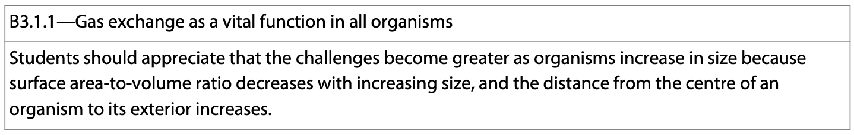
Gas Exchange
Gas exchange is a vital function in all organisms.
The challenge of gas exchange increases with increasing size of the organism due to the changes in the surface area to volume ratio.
Notes:
x

Slide 3
Respiratory System
Respiratory surfaces allow for the efficient exchange of gases.
They are always thin and bathed in water.
In most animals, the respiratory medium is a thin, moist epithelium with a large surface area that separates the respiratory medium from the blood.
Notes:
x

Slide 4
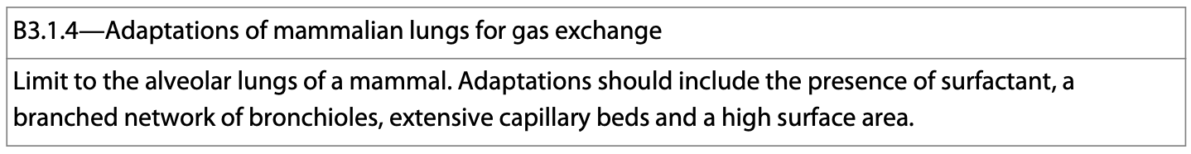
Lungs
The lungs are the respiratory organs and the site of gas exchange in mammals.
They have a dense net of capillaries immediately below the epithelium on the respiratory surface.
They are connected to a closed system that transports gases to and from other regions of the body.
Notes:
x

Slide 5
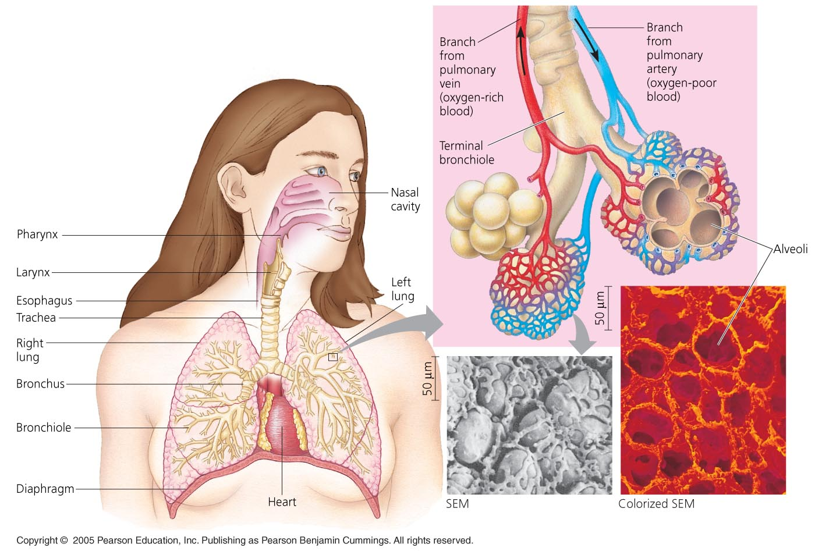
travismulthaupt.com
Notes:
x

Slide 6
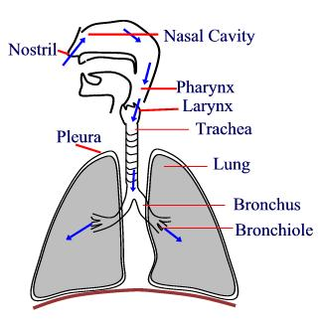
Air Pathway
Nares, pharynx, larynx, trachea, bronchi, bronchioles, alveoli
It resembles a tree tipped upside down.
The epithelial lining of the three major branches of the respiratory system are covered by cilia and a thin film of mucus.
http://www.syvum.com/cgi/online/serve.cgi/squizzes/biology/respi.html?question_hide
Notes:
x

Slide 7
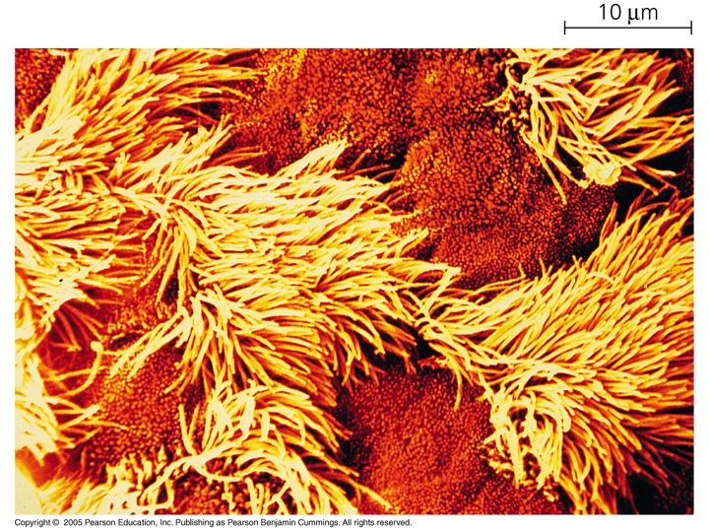
Air Pathway
The mucus traps particulate matter and the cilia sweeps it out.
Notes:
x

Slide 8
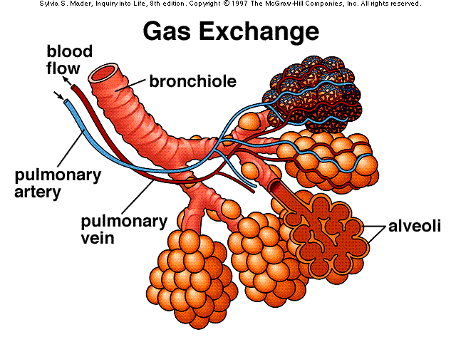
Air Pathway
The thinnest bronchioles are dead end sacs called alveoli, and have a high SA.

Slide 9
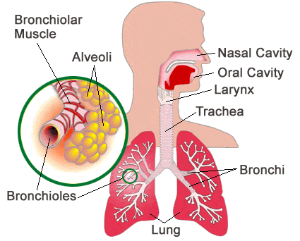
Air Pathway
Air is carried to the lungs in the trachea and bronchi and then to the alveoli in bronchioles.
http://www.medicinenet.com/smokers_lung_pathology_photo_essay/article.htm

Slide 10
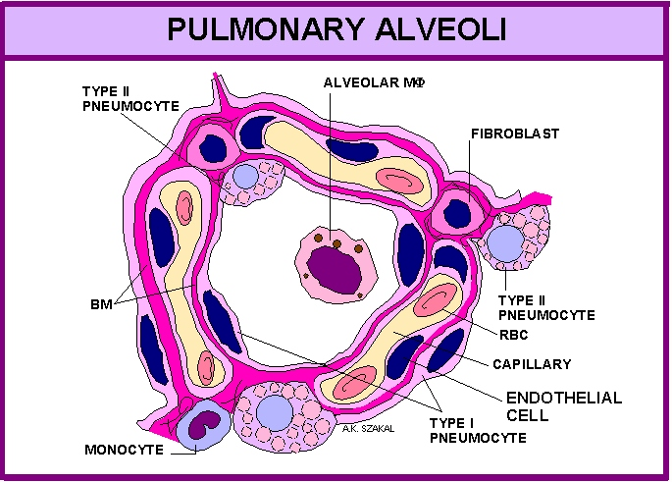
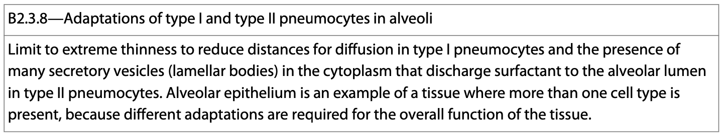
Lung Cells
The alveoli consist of a thin layer of cells adapted to carry out gas exchange, and there are two types.
  Type I pneumocytes
  Type II pneumocytes
http://www.people.vcu.edu/~aszakal/course_syllabi/RESPIRATORY%20SYS%20502.htm

Slide 11
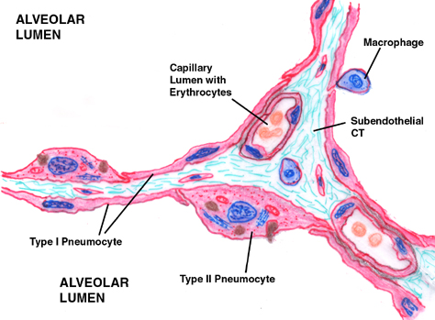
Lung Cells
Type I pneumocytes are extremely thin alveolar cells that are adapted to carry out gas exchange.
https://beyondthedish.wordpress.com/2011/11/21/

Slide 12
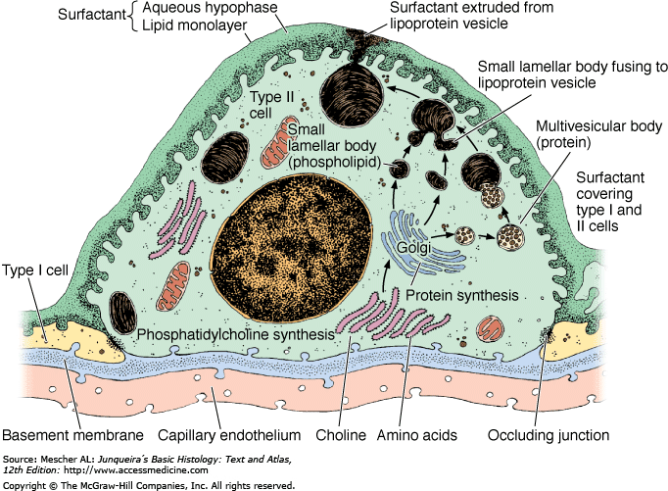
Lung Cells
Type II pneumocytes secrete a solution containing surfactant that creates a moist surface inside the alveoli to prevent the sides of the alveolus from adhering to each other by reducing surface tension.

Slide 13
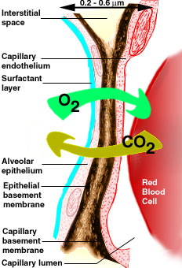
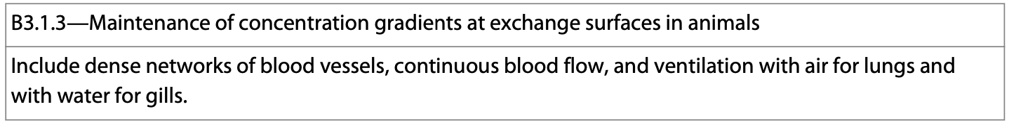
Air Pathway
A concentration gradient drives the exchange of gases at the respiratory surface.
O₂ dissolves in the moist film covering the epithelium and quickly diffuses into the web of capillaries surrounding the alveolus.
CO₂ diffuses in the opposite direction.
http://www.diatronic.co.uk/nds/webpub/gaseous_exchange.htm

Slide 14
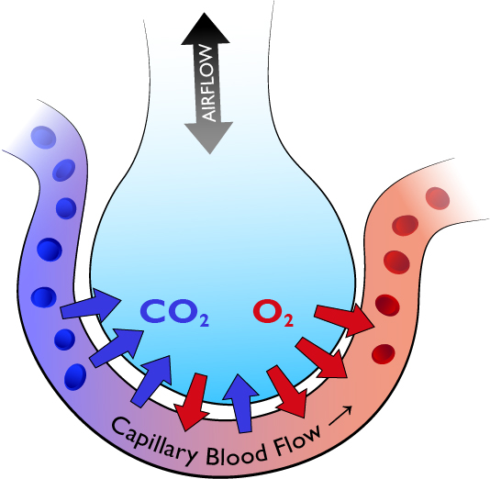
Breathing
The act of breathing is called ventilation, and it maintains the concentration gradients of oxygen and carbon dioxide between air in alveoli and blood flowing in adjacent capillaries.
http://rrapid.leeds.ac.uk/ebook/04-breathing-01-1.html

Slide 15
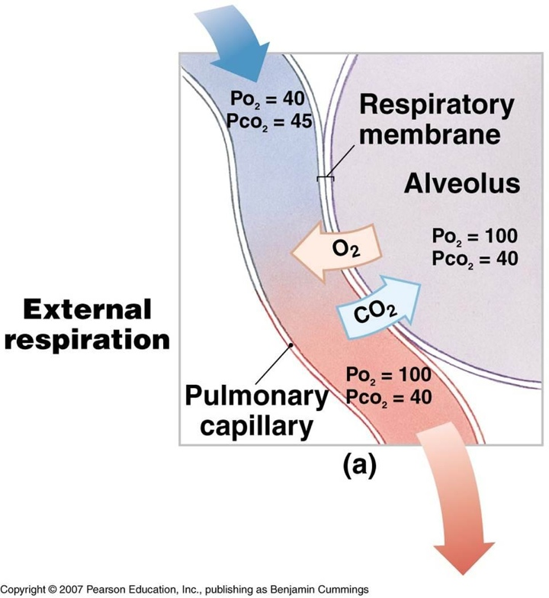
Breathing
The diffusion of a gas depends on partial pressures.
When water is exposed to air, the amount of gas dissolved in the water is proportional to the partial pressure in the air, and its solubility in water.
Gases always diffuse from regions of high partial pressure to regions of low partial pressure.
Notes:
x

Slide 16
Breathing
Muscle contractions cause the pressure changes inside the thorax that force air in and out of the lungs to ventilate them.

Slide 17
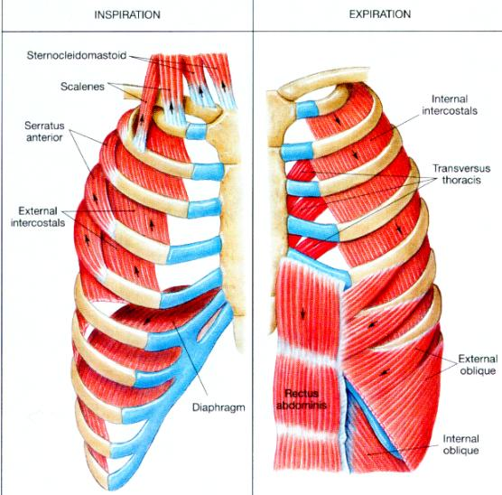
Breathing
Of the muscles involved in breathing, three of them are of particular importance:
    A. Diaphragm
    B. External intercostal muscles
    C. Internal intercostal muscles
http://www.howtosingbettertoday.com/how-to-improve-your-voice-role-support/

Slide 18
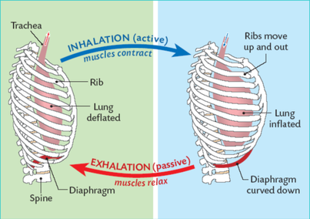
Breathing
Different muscles are required for inspiration and expiration because muscles only do work when they contract.
http://g09respirationc.wikispaces.com/(4)%09+Breathing+%26+gas+exchange?showComments=1

Slide 19
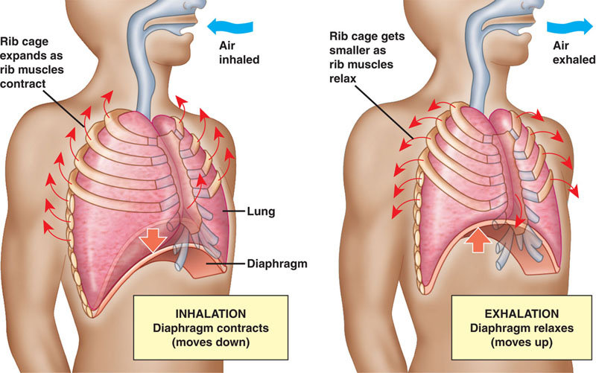
Breathing
When people breathe, their diaphragm contracts enlarging the thoracic cavity and lowering the pressure inside the lungs.
www.actors.co.ke

Slide 20
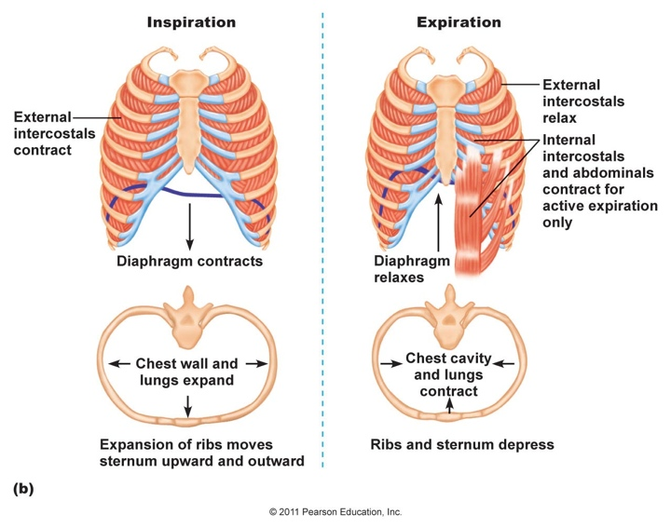
Breathing
The external intercostal muscles assist the diaphragm by increasing the diameter of the chest cavity.
http://droualb.faculty.mjc.edu/Course%20Materials/Physiology%20101/Chapter%20Notes/Fall%202011/chapter_16%20Fall%202011.htm

Slide 21
Breathing
The internal intercostal muscles help with exhaling by pulling the rib cage down helping to force air out of the lungs.
http://droualb.faculty.mjc.edu/Course%20Materials/Physiology%20101/Chapter%20Notes/Fall%202011/chapter_16%20Fall%202011.htm

Slide 22
Breathing
Humans have negative pressure breathing.
Tidal volume is the volume of air inhaled with each breath.
  Max. during forced breathing is 3-4.8L
Residual volume is the amount remaining in the lungs after a forced exhale.
Notes:
x

Slide 23
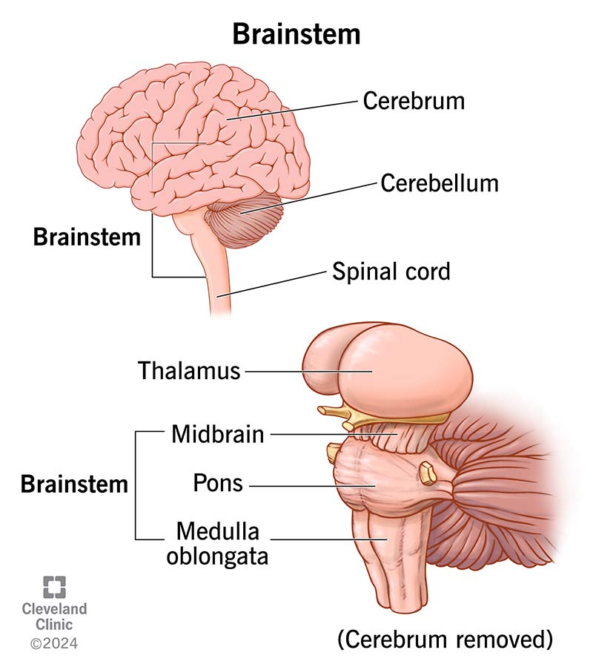
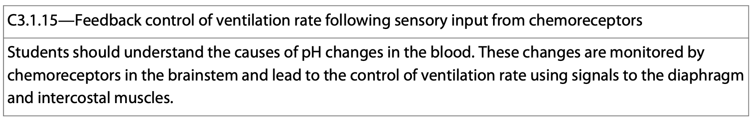
Breathing
Human breathing is mostly under autonomic control.
  2 regions of the brain control this:
    The pons and the medulla.
The pons controls the medulla which sets a basic breathing rhythm based on feedback from baro– and chemoreceptors.
Notes:
x

Slide 24
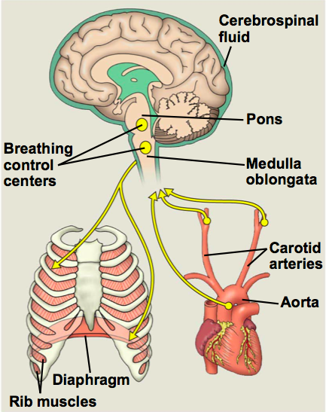
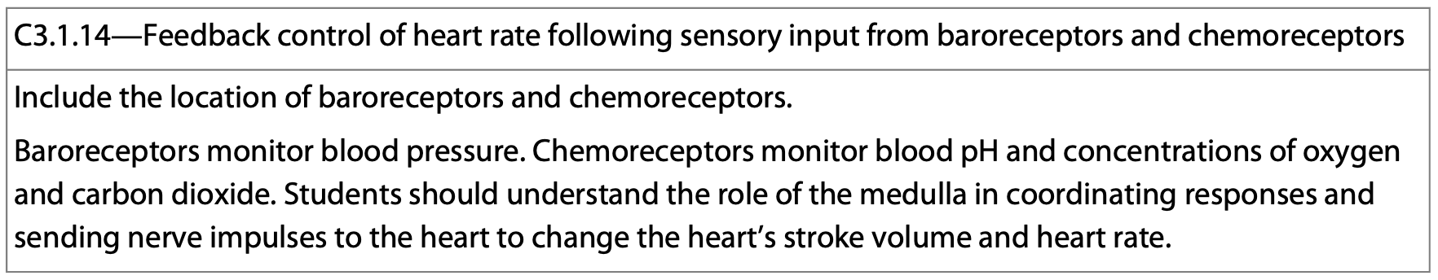
Breathing
Baro receptors and chemoreceptors are sensors in the aorta and carotid arteries exert secondary control over breathing.
These sensors monitor O₂, CO₂ and blood pH.
The pH is largely controlled by CO₂ levels.
https://www.studyblue.com/notes/note/n/bild2-midterm-2/deck/198039
Notes:
x

Slide 25
Breathing
When CO₂ levels increase, carbonic acid levels increase lowering the blood pH.
When pH drops, the depth and rate of breathing increases helping to remove excess CO₂.
O₂ levels only have an effect on breathing rate at high altitudes.
https://www.studyblue.com/notes/note/n/bild2-midterm-2/deck/198039
Notes:
x

Slide 26
Blood Gases
Carbon dioxide is transported in the blood three ways:
1. A small amount of carbon dioxide is dissolved in the blood plasma.
2. Some carbon dioxide is bound to hemoglobin.
3. Most carbon dioxide is reversibly converted to hydrogen carbonate ions and hydrogen ions in red blood cells.
Notes:
x

Slide 27
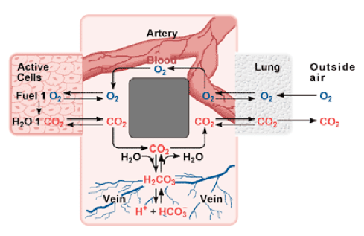
Breathing
In addition to transporting O₂, hemoglobin helps transport CO₂ and assists in buffering.
Respiring cells produce CO₂. Carbonic anhydrase catalyzes the reaction of CO₂ with H₂O to form H₂CO₃.
https://fmss12uchemd.wordpress.com/2013/05/06/carbonic-acid-bicarbonate-buffer-system/
Notes:
x

Slide 28
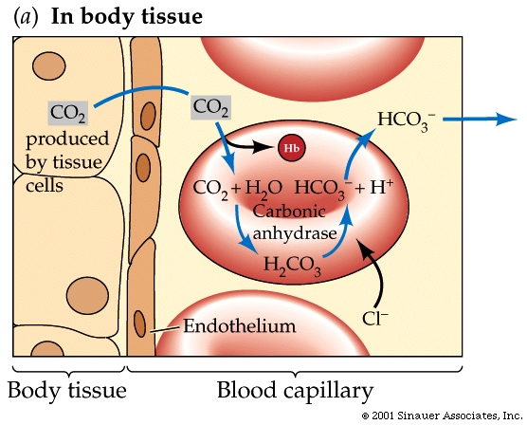
Breathing
H₂CO₃ dissociates into H⁺ + HCO₃⁻
Most of the H⁺ attaches to hemoglobin and other proteins minimizing the change in blood pH.
HCO₃⁻ diffuses into the plasma.
http://www.blc.arizona.edu/courses/schaffer/182/CO2-Bicarb.HTM

Slide 29
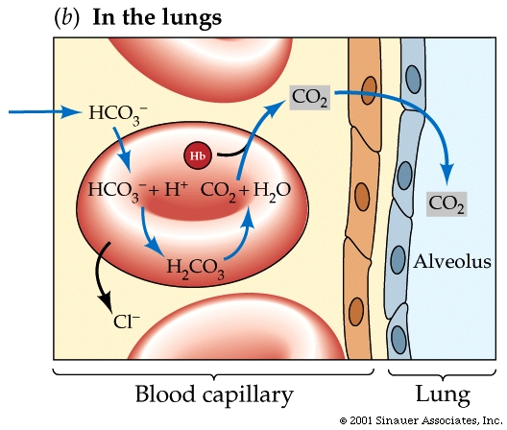
Breathing
As blood flows through the lungs, the process is reversed.
Diffusion of CO₂ out of the blood shifts the chemical equilibrium in favor of the conversion of HCO₃⁻ to CO₂.
This reaction is sped up by carbonic anhydrase.
http://www.blc.arizona.edu/courses/schaffer/182/CO2-Bicarb.HTM
Notes:
x

Slide 30
Breathing
The key to the gas exchange are reversible reactions:
CO2 + H2O H2CO3 HCO3⁻ (+ H⁺)

Slide 31
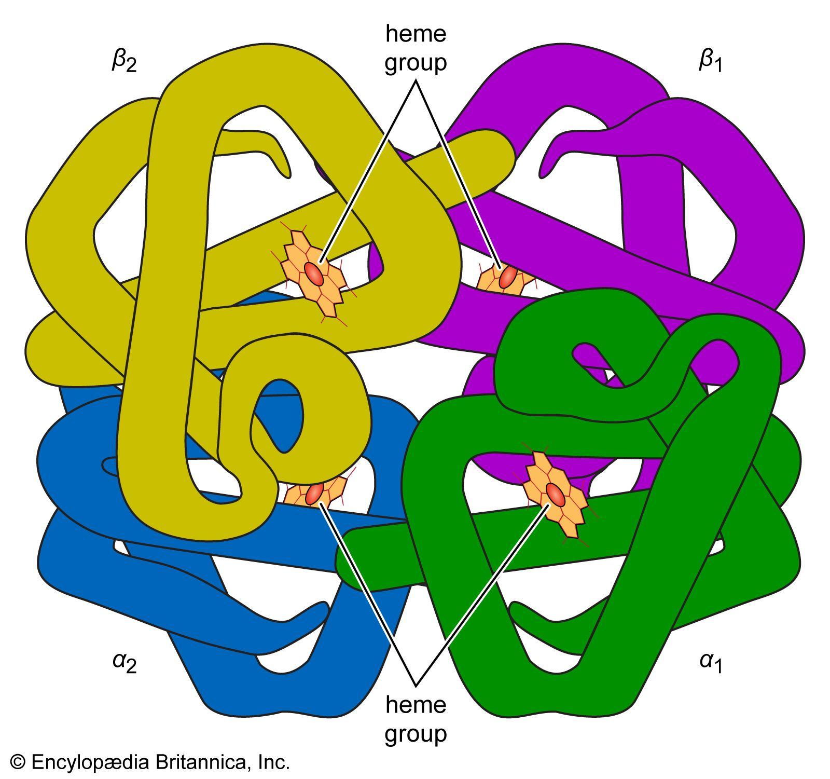
Hemoglobin
Hemoglobin is a protein within red blood cells complexed to a heme group.
Heme is a ring-shaped, iron containing component of hemoglobin that is necessary for oxygen to bind.

Slide 32
Breathing and Oxygen Dissociation
An oxygen dissociation curve is a graphical representation of hemoglobin’s affinity for oxygen under changing conditions.
The air we breath is a mixture of various gases. The “partial pressure” of a gas refers to the partial pressure each gas contributes to the whole.

Slide 33
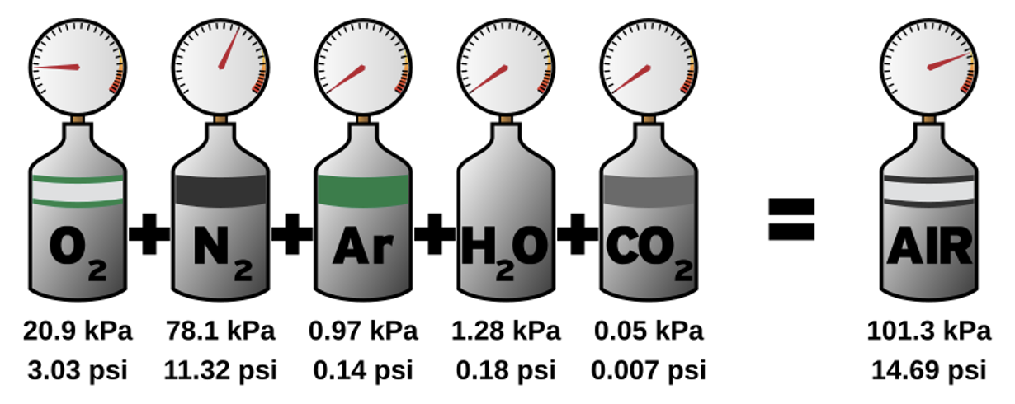
Breathing and Oxygen Dissociation
The air we breath is mostly nitrogen (78%), oxygen (21%), argon (<1%), and carbon dioxide (<1%), along with some other trace gases.
Each gas contributes a partial pressure to the whole.
https://upload.wikimedia.org/wikipedia/commons/thumb/c/cb/Dalton%27s_law_of_partial_pressures.svg/800px-Dalton%27s_law_of_partial_pressures.svg.png

Slide 34
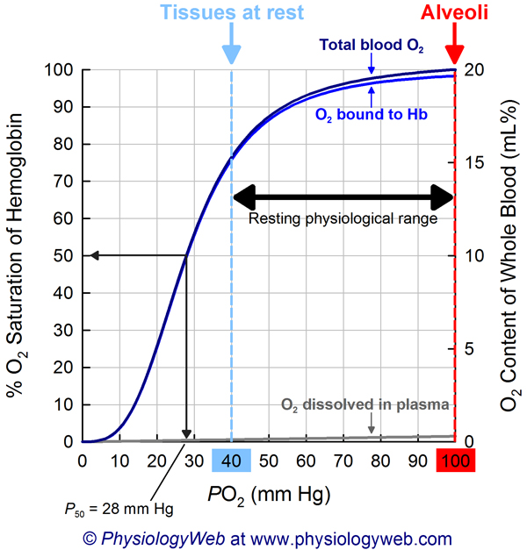
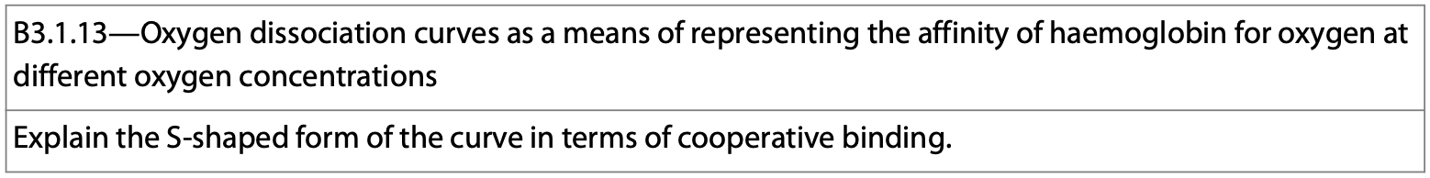
Oxygen Dissociation
Hemoglobin has a very low affinity for oxygen at low partial pressures.
As the partial pressure of oxygen increases, so too does hemoglobin’s affinity for it.
At very high partial pressures, the curve flattens out as most of the hemoglobin have four molecules of oxygen attached.

Slide 35
Oxygen Dissociation
The curve has an S-shape (sigmoidal).
Looking at the slow growth of the curve at the bottom, one can see that at low partial pressures, hemoglobin has a low affinity for oxygen.

Slide 36
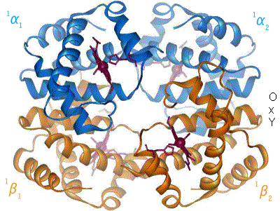
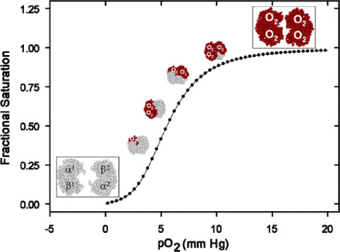
Oxygen Dissociation
Oxygen binding changes the shape of hemoglobin, rapidly increasing its affinity for oxygen.
https://earth.callutheran.edu/Academic_Programs/Departments/BioDev/omm//jsmol/hemo/Hemoglobin_t-r_state_ani.gif
https://encrypted-tbn0.gstatic.com/images?q=tbn:ANd9GcQtju7uGVJ18HgQNQ9gcueLgz4OhdTEyRUHEg&s

Slide 37
Oxygen Dissociation
This behavior of hemoglobin is an example of cooperative binding.
At high partial pressures the curve flattens because most hemoglobin molecules are saturated with oxygen.

Slide 38
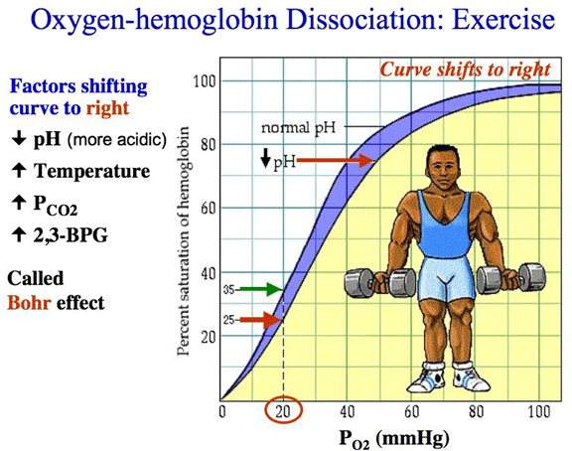
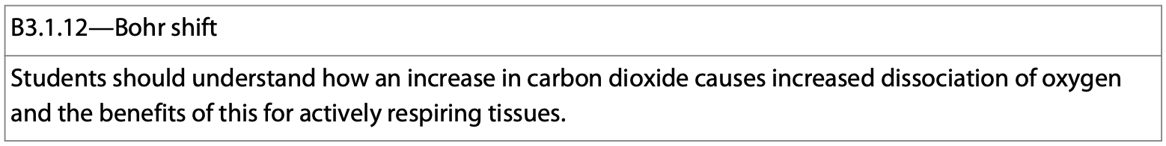
The Bohr Effect (Shift)
The Bohr shift occurs when an increase in carbon dioxide in the blood triggers the hemoglobin to readily release oxygen into the surrounding tissues.
A high CO₂ level means that hemoglobin is less likely to hold onto oxygen.
https://www.unm.edu/~lkravitz/Extras2/Bohreffect3.gif

Slide 39
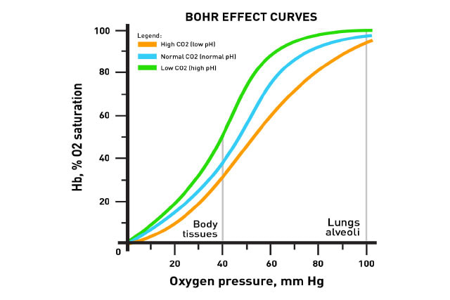
The Bohr Effect (Shift)
This graph does a nice job of summarizing the changes in oxygen saturation due to changes in CO₂ and pH levels.
https://www.unm.edu/~lkravitz/Extras2/Bohreffect3.gif
https://www.mrgscience.com/d6-transport-of-respiratory-gases-hl.html

Slide 40
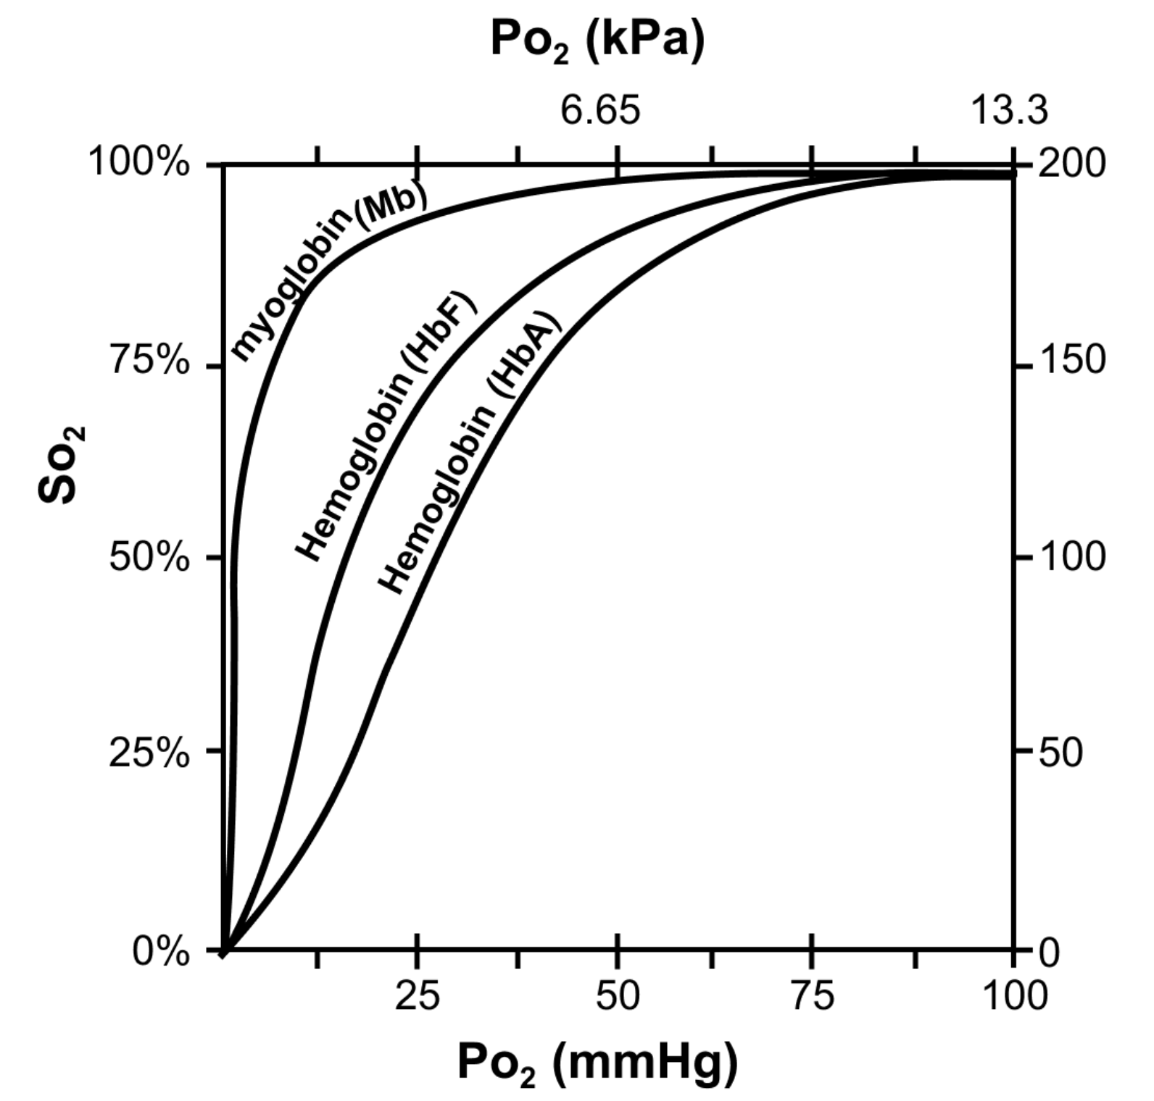
Adult vs. Fetal Hemoglobin
Adult (HbA) and fetal (HbF) hemoglobin differ significantly from each other and from myoglobin (Mb) in their ability to bind and transport oxygen to cells.
https://www.khanacademy.org/test-prep/mcat/biological-sciences-practice/x04f6bc56:mcat-bio-biochem-foundation-3-passages/e/hematologic-system--passage-2

