Slide 1
Chapter 42
The Blood System
Essential Idea: The blood system continuously transports substances to cells and simultaneously collects waste products.
travismulthaupt.com
Notes:
Copyright ©2005 Pearson Education, Inc. Publishing as Pearson Benjamin Cummings. All rights reserved.

Slide 2
TOK: Our current understanding is that emotions are the product of activity in the brain rather than the heart. Is knowledge based on science more valid than knowledge based on intuition?

Slide 3
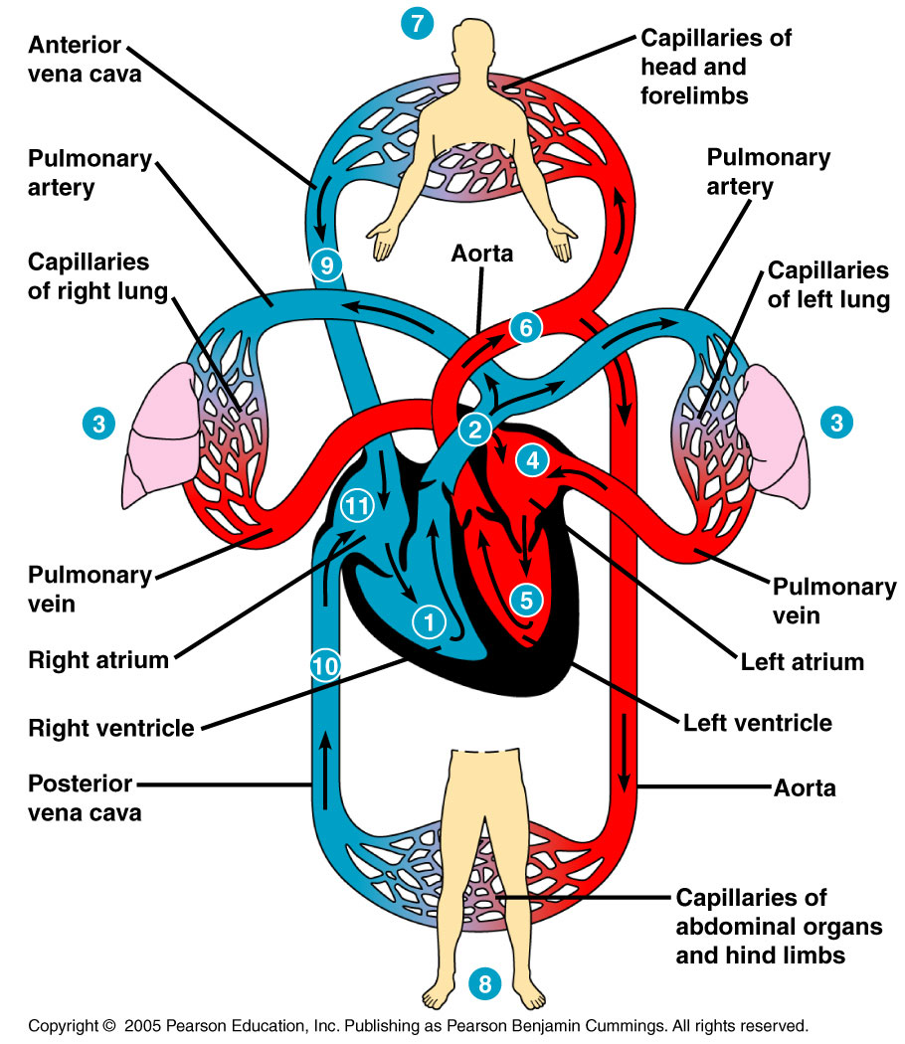
Vertebrate Circulation
Vertebrates generally have 1 or 2 atria, and 1 or 2 ventricles.
It is a closed system.
Cardiovascular.
Atria receive blood
Ventricles pump blood
Notes:
x

Slide 4
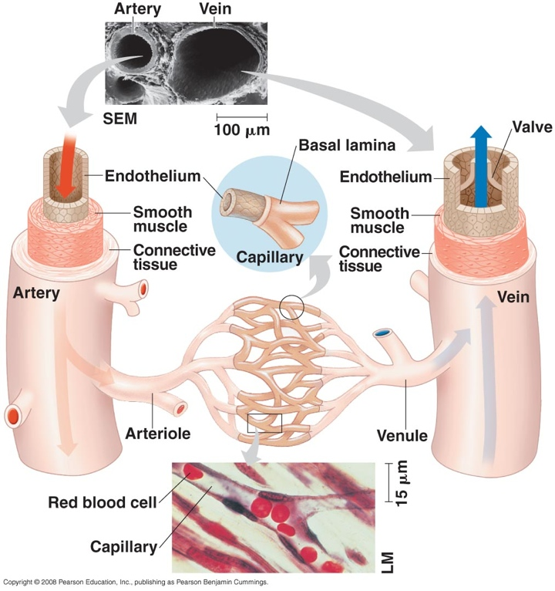
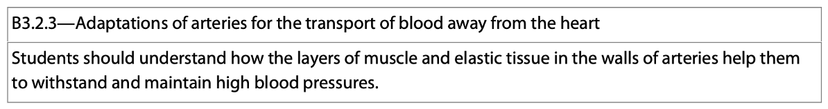
3 Main Blood Vessel Types
1. Arteries—carry blood away from the heart.
2. Veins—carry blood to the heart.
3. Capillaries—the spots where arteries and veins meet and nutrient exchange occurs.
Notes:
x

Slide 5
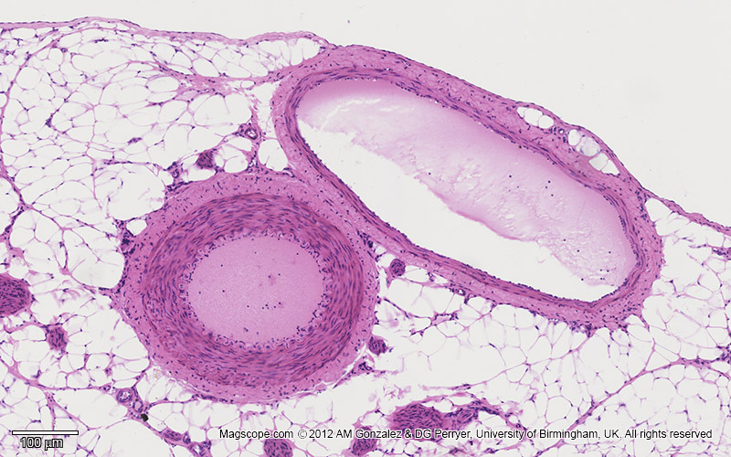
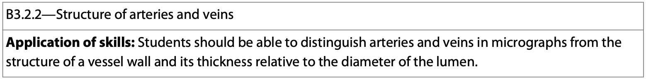
3 Main Blood Vessels
Blood vessel A is an artery.
  It has a thicker wall and a narrower lumen.
Blood vessel V is a vein.
  It has a much thinner wall and a wider lumen.
V
A
Notes:
x

Slide 6
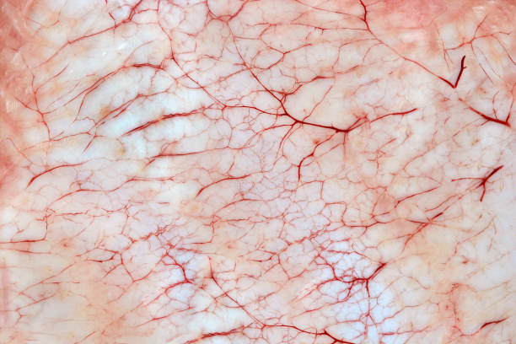
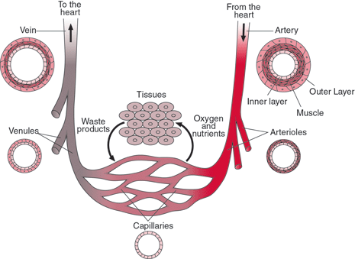
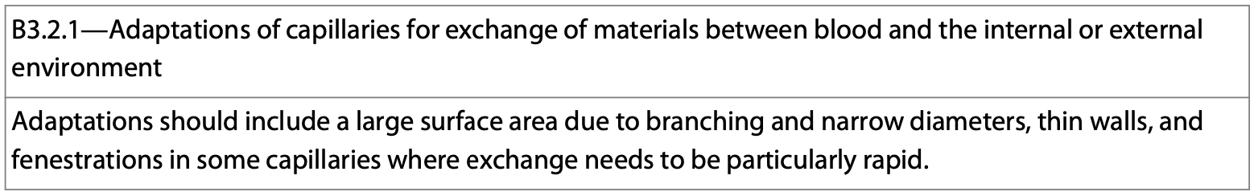
Blood Vessel Types
Networks of capillaries infiltrate each tissue and exchange many nutrients with the tissues.
https://media.istockphoto.com/id/940502394/photo/bloody-inflammatory-capillaries-on-the-skin.jpg?s=612x612&w=0&k=20&c=i7Vx3PFcHAQaJEFS_L2zfdWbdESXL6C3e3vSW83dVUc=
https://blogger.googleusercontent.com/img/b/R29vZ2xl/AVvXsEhmPUSw_8ClPiA8CuXATn05dQd8moLZxItx9EmfPC0DQl0rxi6Ch-O8KhQ5Yb-a4Kv7YHdNqp4eOQmi6zz1AcOLh4bXjSYSsBdwiy70BVmtfetFbPOCSb9TRMm0MOuv9SONIRtMbpcdJFXE/s1600/capillary+3.jpg
Notes:
x

Slide 7
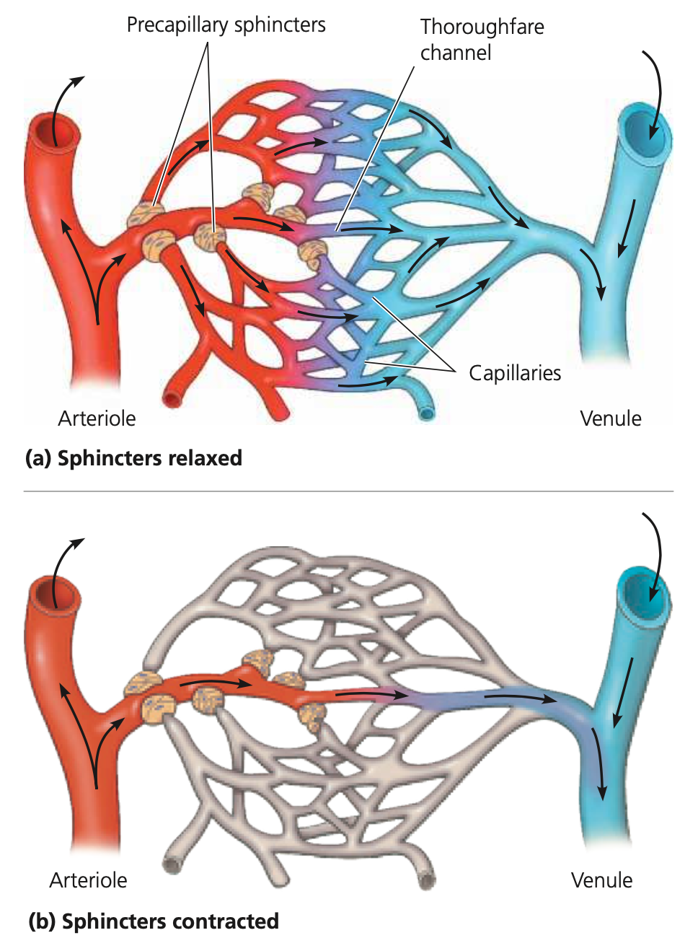
Capillaries
Capillaries contain adaptations for the exchange of materials between the blood and the surrounding tissues.
  Narrow diameters
  Thin walls
  Some fenestrations
  Sphincters
    Capillary lacks
    smooth muscle
Notes:
x

Slide 8
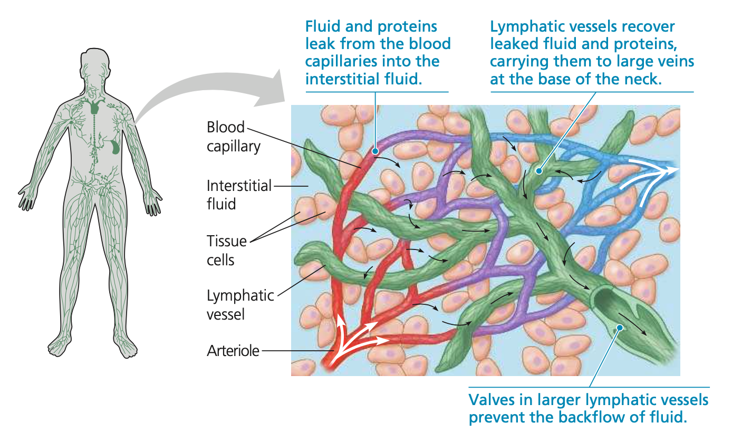
Capillaries
The exchange of materials from inside to outside is an important function for organisms.
It’s easy for unicellular organisms, but becomes more difficult for multicellular organisms.
Complex structures such as capillaries have evolved to allow for the exchange of materials.
Notes:
x

Slide 9
In the Capillary Beds
Substances move in and out by diffusion, endocytosis, and exocytosis.
There are many clefts between the endothelial cells—diffusion occurs here.
Blood pressure is largely responsible for movement of materials through the clefts however.
Notes:
x

Slide 10
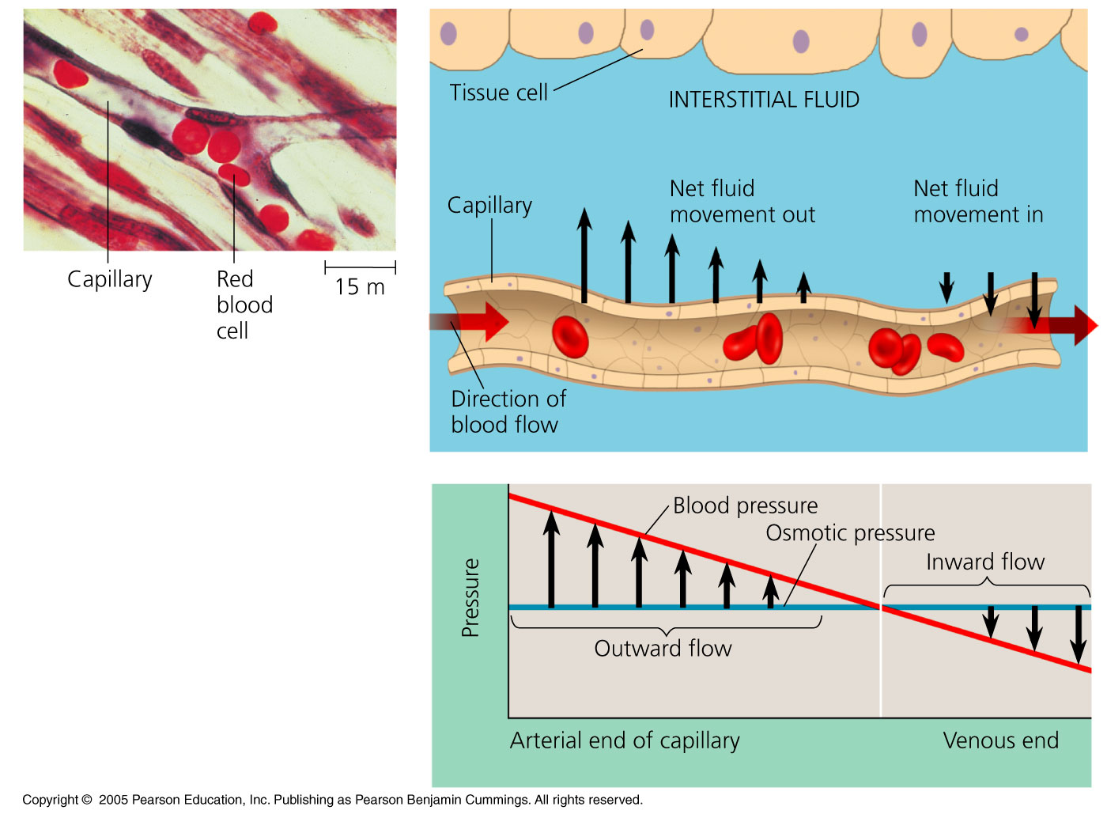
In The Capillary Beds
Many substances are too large to cross the endothelium.
Osmotic pressure between the arteriole and venule remains constant.
However, blood pressure drops significantly between the arteriole and venule.
Notes:
x

Slide 11
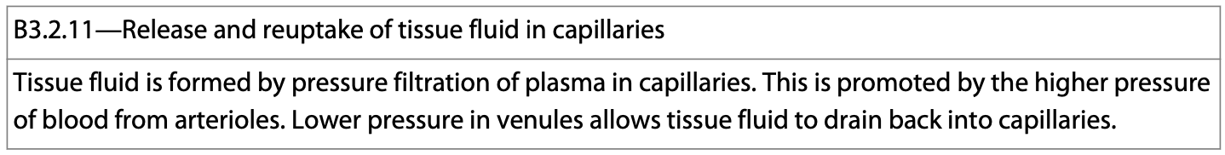
In The Capillary Beds
At the arteriole end, blood pressure is high compared to the osmotic pressure.
Fluids flow out of the arteriole and into the interstitial fluid.
Notes:
x

Slide 12
In The Capillary Beds
At the venule end, the blood pressure is low compared to the osmotic pressure.
Fluid flows into the venule from the interstitial fluid.
  85% of the fluid lost from the arteriole end is recovered.
  15% of the fluid is recovered by the lymphatic system.
Notes:
x

Slide 13
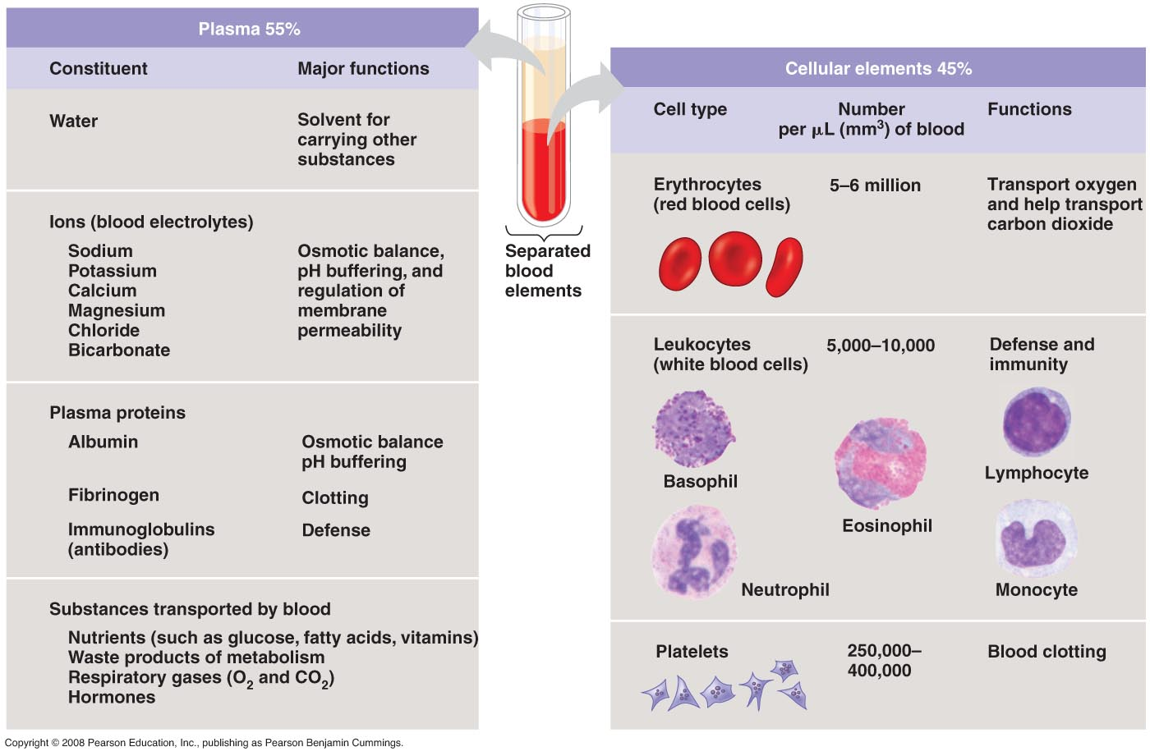
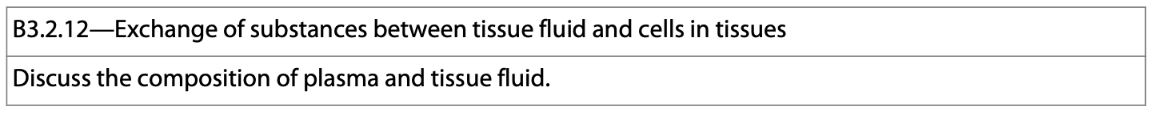
The Exchange of Materials
Within the capillary beds there is an exchange of materials between the blood and the surrounding tissues.
The blood contains a variety of substances the respiring tissues need, and the tissues need to get rid of the wastes they are producing.
Notes:
x

Slide 14
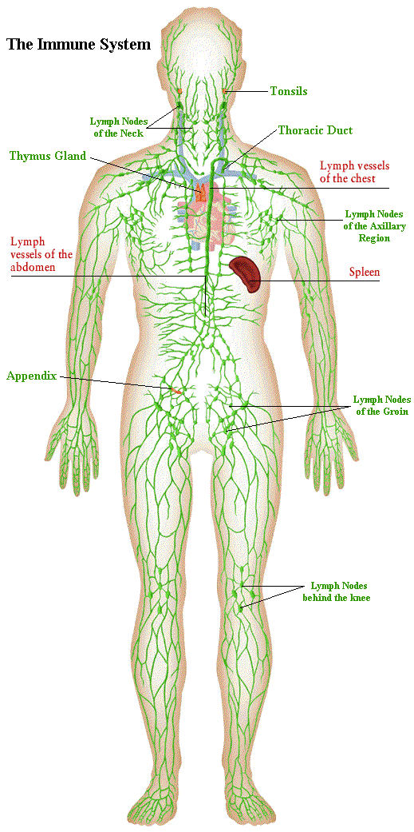
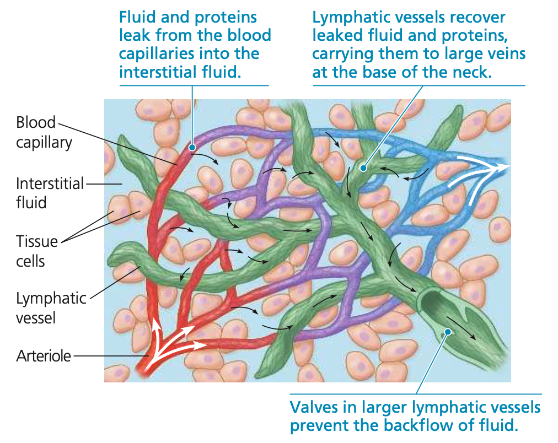
Lymphatic System
The fluid of the lymphatic system is called lymph.
  It has roughly the same composition as interstitial fluid.
Lymph capillaries are interspersed throughout the cardiovascular capillaries.
www.naturalhealthschool.com/ img/immune.gif
Notes:
x

Slide 15
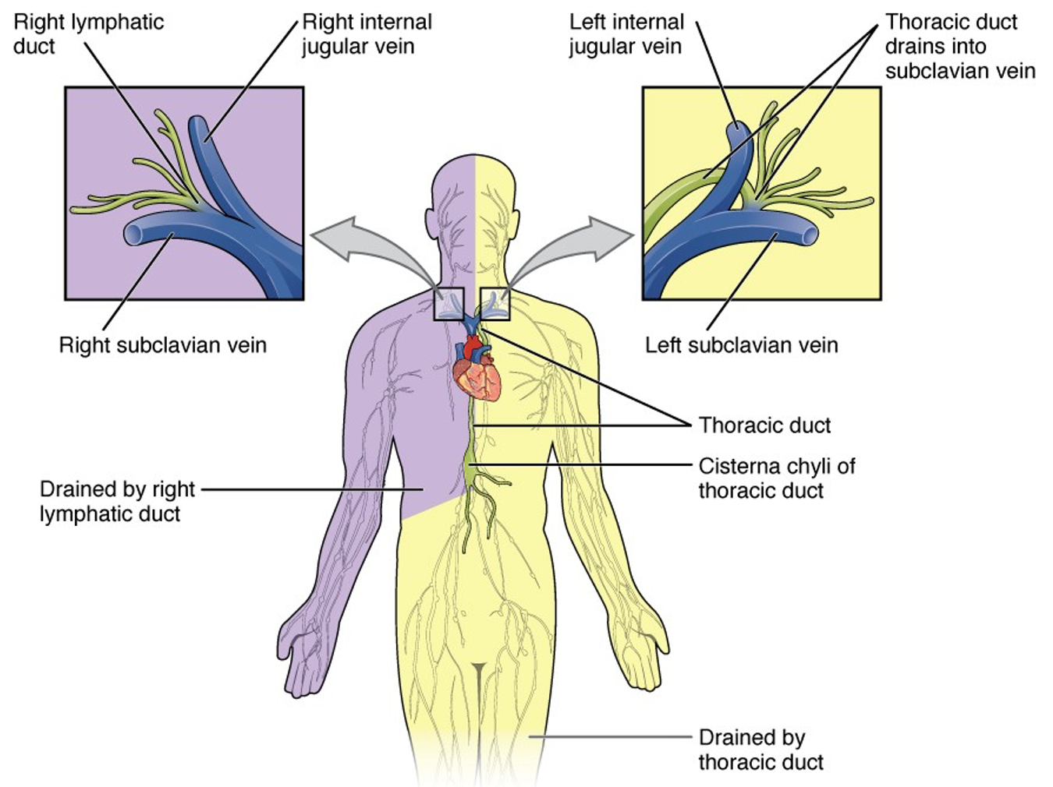
Lymphatic System
During normal circulation, fluid leaks from the blood capillaries into the tissues.
Lymph capillaries assist with the reabsorption of excess tissue fluid.
Lymph vessels collect fluid and return it to the bloodstream at the subclavian vein.
https://courses.lumenlearning.com/suny-ap2/chapter/anatomy-of-the-lymphatic-and-immune-systems/
Notes:
x

Slide 16
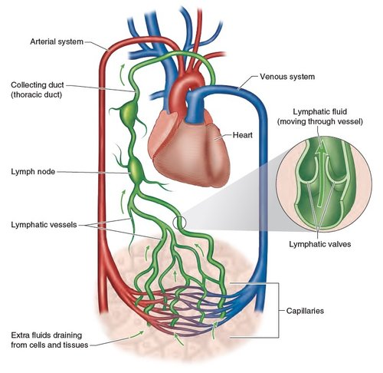
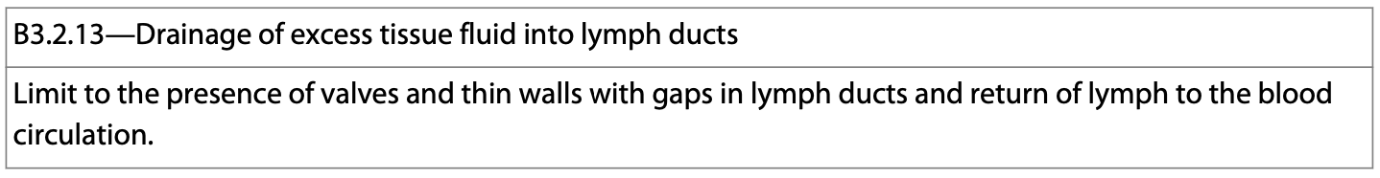
Lymphatic System
The lymph vessels are very similar to veins.
They have valves that prevent the backflow.
Rhythmic contractions of smooth muscle assist in lymph flow.
Skeletal muscle contractions are the main sources of lymph movement.
https://www.doctor-yogi.com/yoga-anatomy-blog/2022/7/1/what-impact-does-yoga-have-on-the-lymphatic-system
www.naturalhealthschool.com/ img/immune.gif
Notes:
x

Slide 17
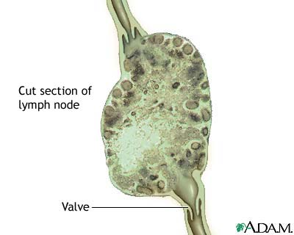
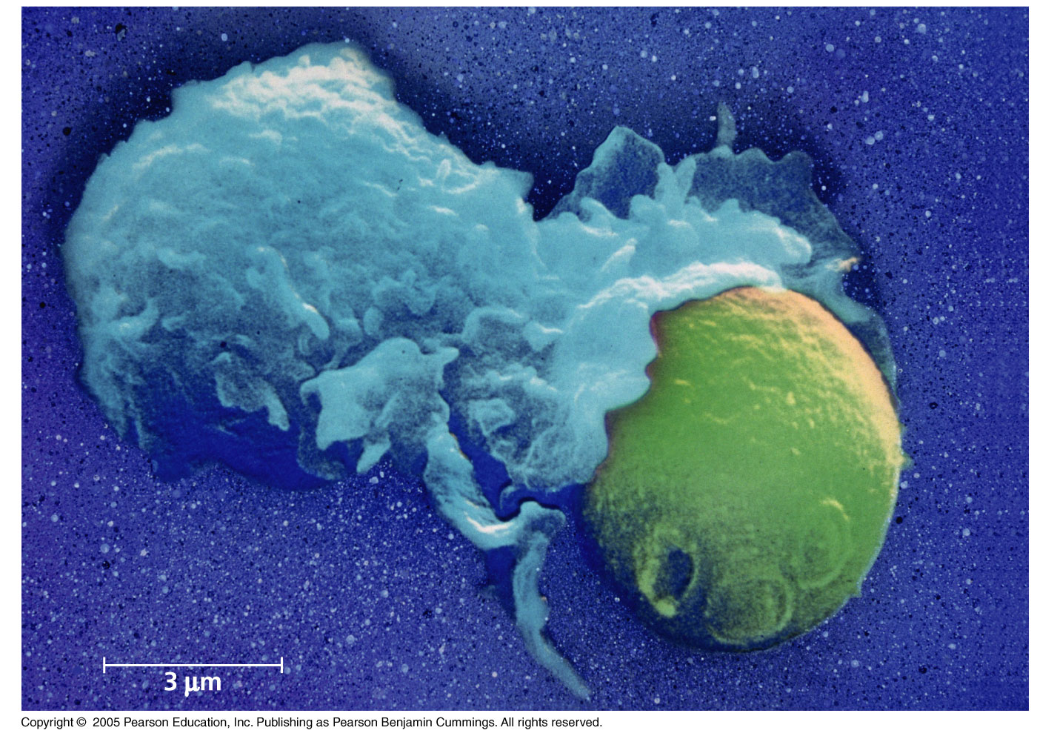
Lymphatic System
Lymph nodes are lymph vessel organs.
They contain WBC’s (lymphocytes) and cells specialized for defense (macrophages).
They filter the lymph and attack foreign invaders (antigens).
They often swell when we are ill.
Notes:
x

Slide 18
Blood Vessel Types
Arterioles are the sites where small vessels convey blood to the capillaries.
At the downstream end, capillaries converge into venules which converge into veins.
https://media.istockphoto.com/id/940502394/photo/bloody-inflammatory-capillaries-on-the-skin.jpg?s=612x612&w=0&k=20&c=i7Vx3PFcHAQaJEFS_L2zfdWbdESXL6C3e3vSW83dVUc=
https://blogger.googleusercontent.com/img/b/R29vZ2xl/AVvXsEhmPUSw_8ClPiA8CuXATn05dQd8moLZxItx9EmfPC0DQl0rxi6Ch-O8KhQ5Yb-a4Kv7YHdNqp4eOQmi6zz1AcOLh4bXjSYSsBdwiy70BVmtfetFbPOCSb9TRMm0MOuv9SONIRtMbpcdJFXE/s1600/capillary+3.jpg
Notes:
x

Slide 19
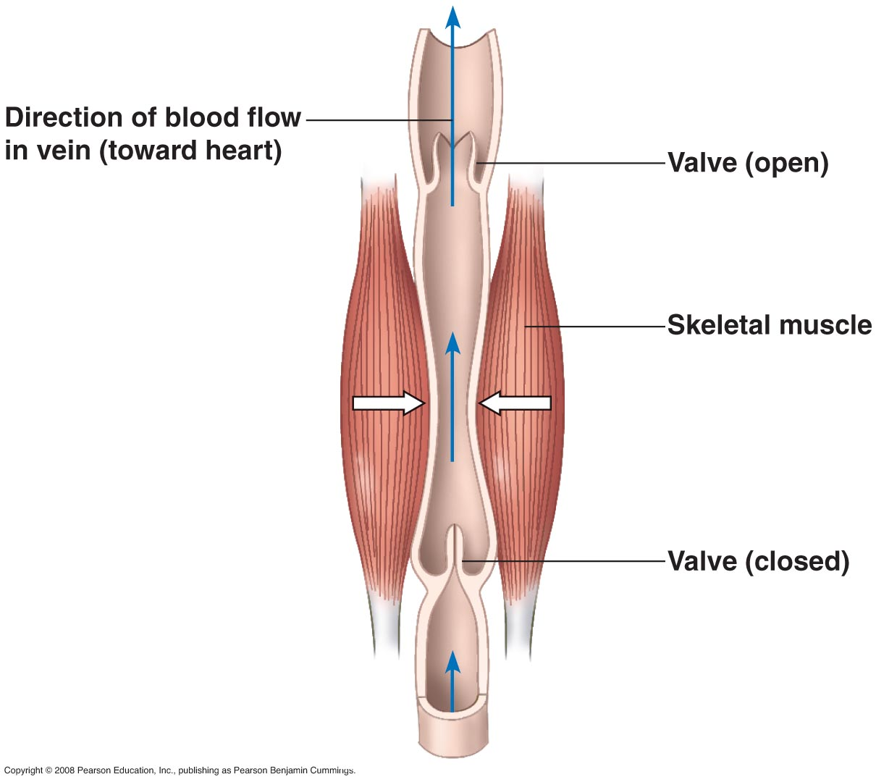
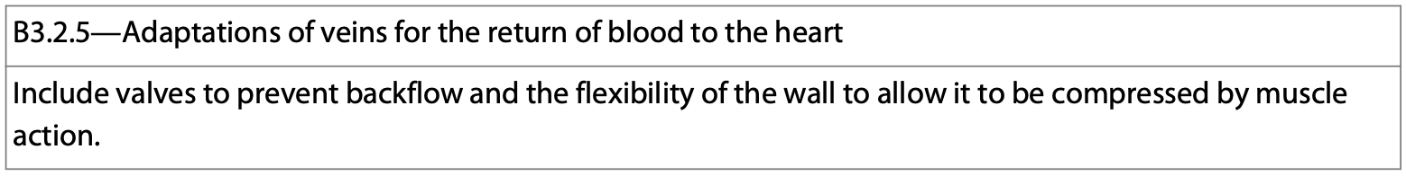
Veins
Veins are blood vessels that carry blood back to the heart.
Notes:
x

Slide 20
Veins
Veins have several adaptations that help them in this process:
  Thinner walls with lower pressure. This allows more blood flow with less resistance.
  Larger lumens for more blood flow.
  Valves that prevent the backflow of blood.
  The ability to dilate to allow more fluid flow.
Notes:
x

Slide 21
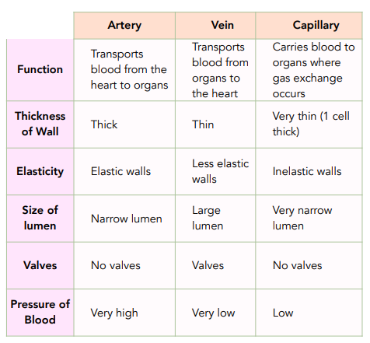
Summary of the Blood Vessels
https://studymind.co.uk/wp-content/uploads/2022/04/3-140.png
Notes:
x

Slide 22
Different Circulation Systems
There is a separate circulation system for the lungs.
Because of this, blood travels through the heart twice.
Double circulation is where blood passes through a chambered heart on its way back from the body, and then again on its way back from the lungs.
  The first time, as CO₂ rich blood.
  The second time as O₂ rich blood.
Notes:
x

Slide 23
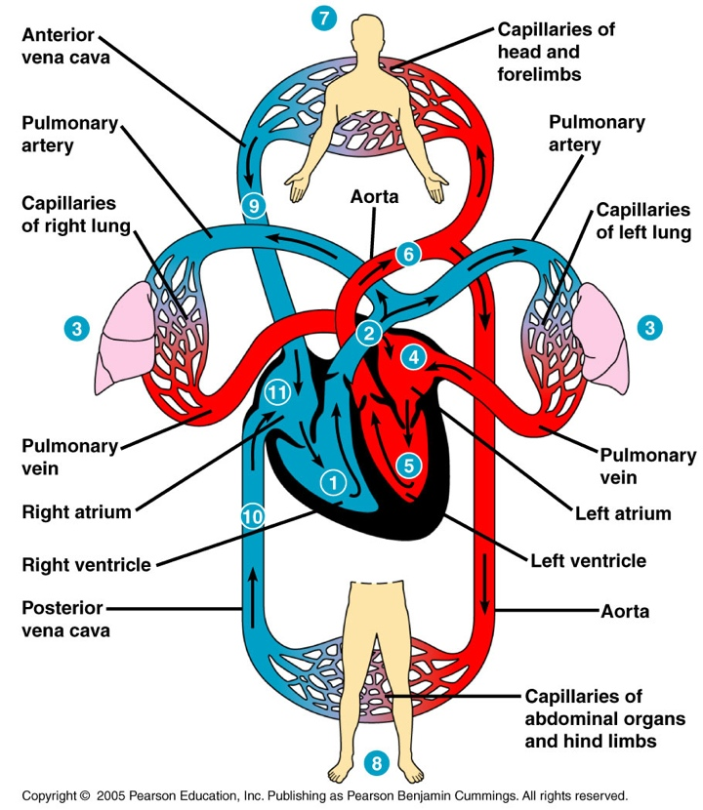
Double Circulation
The organization called double circulation provides for vigorous blood flow.
Blood gets pumped a second time after leaving the capillaries.
Reptiles, mammals and birds have double circulation.
Notes:
x

Slide 24
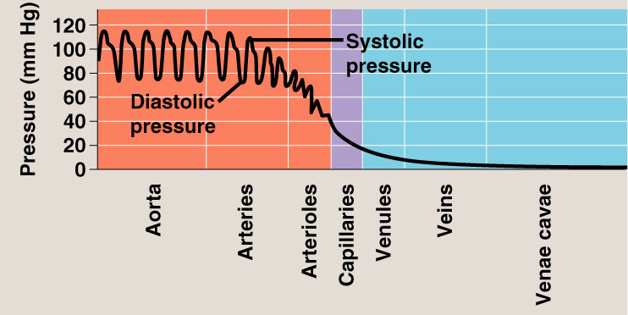
Double Circulation
In double circulation pressure is restored to the systemic circuit after blood has passed through the lung capillaries.
Notes:
x

Slide 25
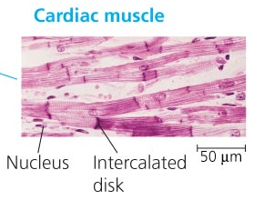
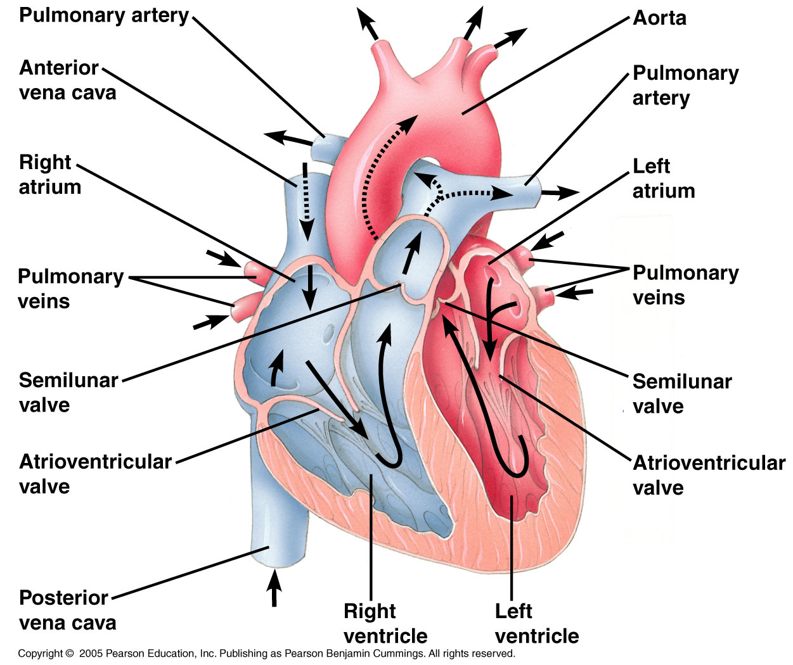
The 4 Chambered Heart
Consists mostly of cardiac muscle.
It goes through a series of rhythmic contractions and relaxations to move blood.
When the chambers relax they fill; when they contract, they empty.
  Systole-contraction
  Diastole-relaxation
Notes:
Copyright ©2005 Pearson Education, Inc. Publishing as Pearson Benjamin Cummings. All rights reserved.
x

Slide 26
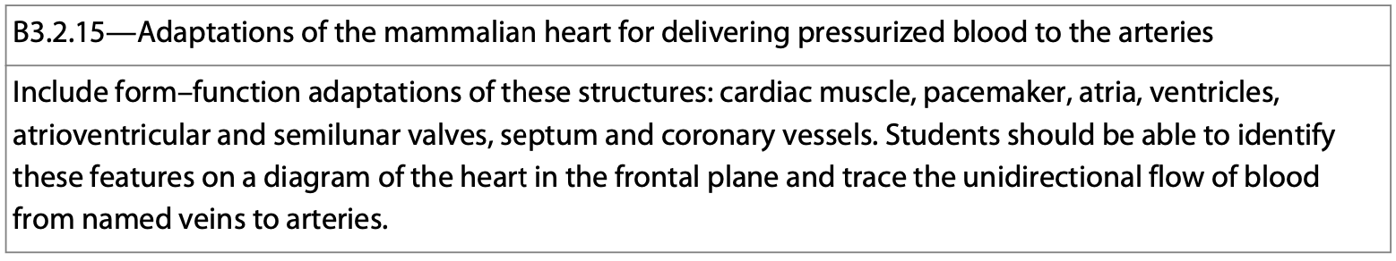
The 4 Chambered Heart
Ventricles are usually larger because they move more blood.
The AV valves are between the atria and ventricles.
  They prevent the back flow of blood during contraction.
Semilunar valves prevent back flow of blood while it’s in the aorta.
Notes:
x

Slide 27
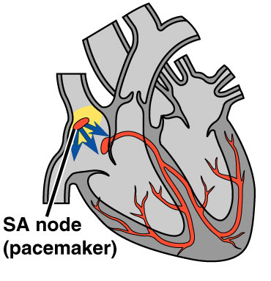
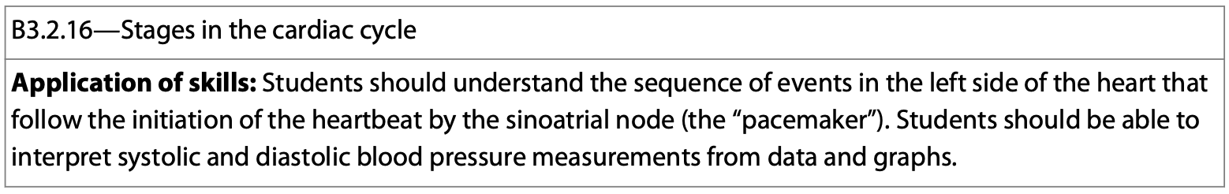
Heart Rhythm
Maintaining rhythm is important because O₂ is very important.
Some cardiac muscles are self-excitable and do not need any input from the nervous system to contract.
The heart’s pacemaker is the SA node.
Copyright ©2005 Pearson Education, Inc. Publishing as Pearson Benjamin Cummings. All rights reserved.
Notes:
x

Slide 28
The SA Node
It sets the rate and timing of heart contractions.
It is located in the wall of the right atrium and is made of specialized cells.
  Myogenic hearts have a pace making ability that originates in the heart.
  Neurogenic hearts have contractions that originate from motor nerves.
  The human heart is myogenic.
Copyright ©2005 Pearson Education, Inc. Publishing as Pearson Benjamin Cummings. All rights reserved.
Notes:
x

Slide 29
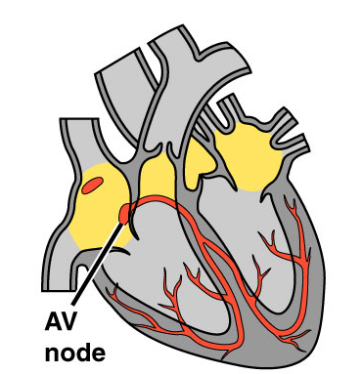
The SA Node
The SA node generates electrical impulses similar to those produced by nerve cells.
The cardiac muscle contains the SA node that sets the tempo for the entire heart.
The impulse is quickly passed through the muscles and passes a relay point called the AV node.
Copyright ©2005 Pearson Education, Inc. Publishing as Pearson Benjamin Cummings. All rights reserved.
Notes:
x

Slide 30
The AV Node
The AV node is located in the wall between the right atrium and right ventricle.
The AV node slightly delays the signal impulse.
The delay ensures that the atria empty before the ventricles contract.
Copyright ©2005 Pearson Education, Inc. Publishing as Pearson Benjamin Cummings. All rights reserved.
Notes:
x

Slide 31
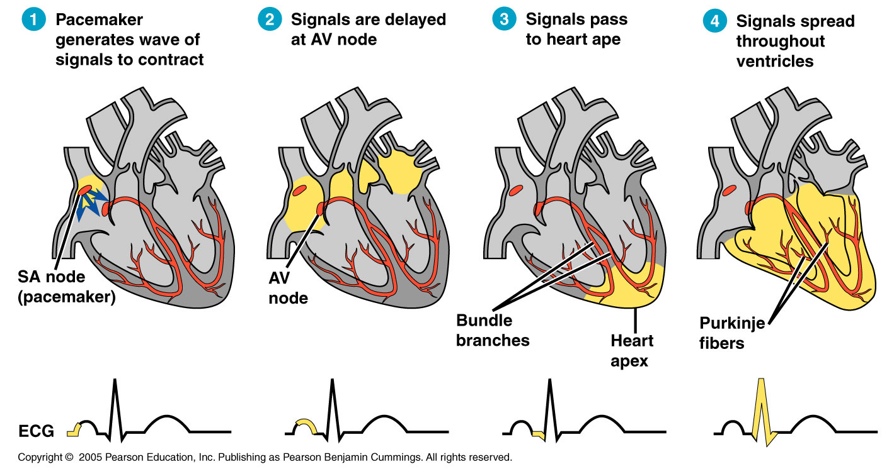
Purkinje Fibers
Purkinje fibers are specialized muscle fibers that conduct signals to the apex of the heart and throughout the ventricles.
Copyright ©2005 Pearson Education, Inc. Publishing as Pearson Benjamin Cummings. All rights reserved.
Notes:
x

Slide 32
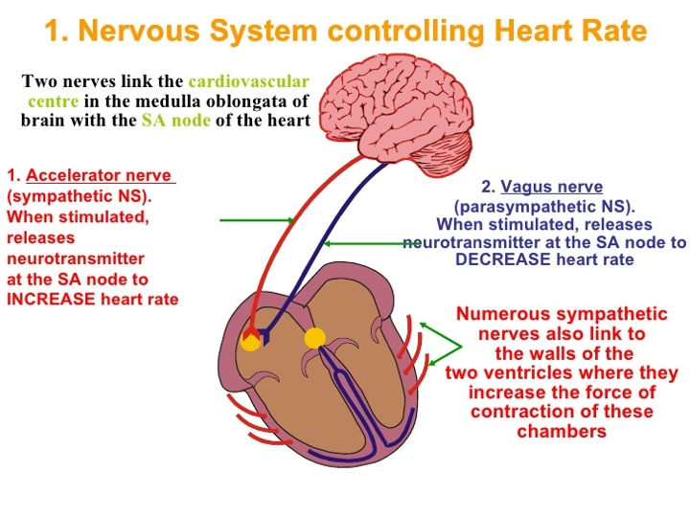
The Heart
Although the SA node sets the tempo for the heart, it is innervated by 2 nerves, the accelerans nerve and a pair of vagus nerves that run from the medulla of the brain and effect heart rate.
  The accelerans speeds the heart up (sympathetic).
  The vagus slows it down (parasympathetic).
http://www.slideshare.net/Traceywithane/control-of-heart-rate
Notes:
x

Slide 33
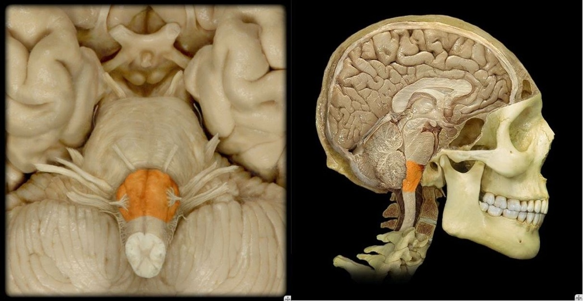
The Medulla
The medulla is located in the brainstem just above the spinal cord.
It contains two main divisions of the autonomic nervous system—sympathetic and parasympathetic.
These divisions oppose one another.
www.medullary.com

Slide 34
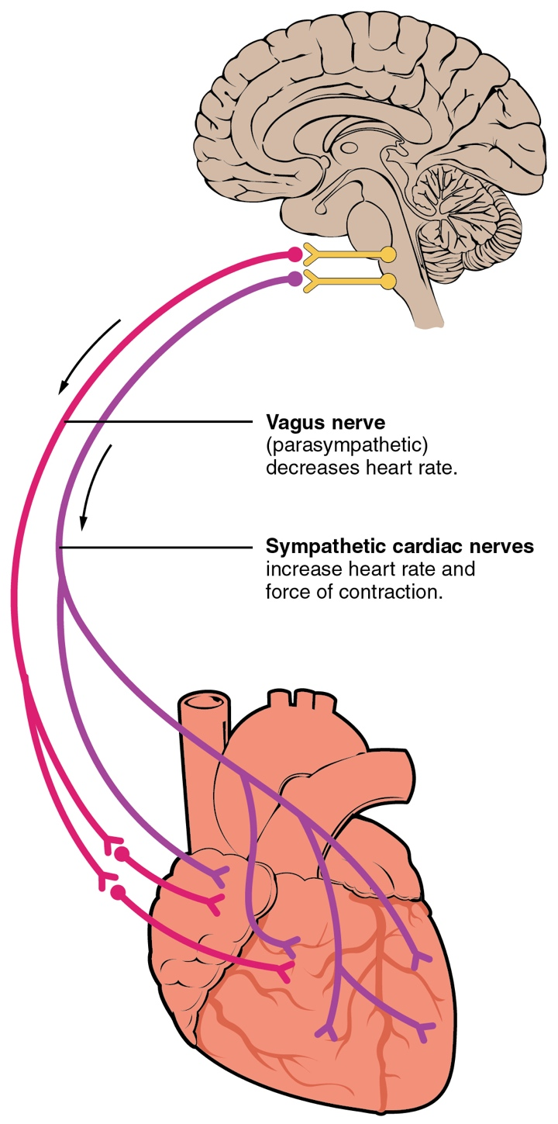
The Heart
The heart is innervated by sympathetic and parasympathetic fibers.
  Sympathetic stimulation of the heart increases the heart rate (running from the accelerans nerve).
  Parasympathetic stimulation has the opposite effect (from the vagus nerve).
https://en.wikipedia.org/wiki/Heart_rate

Slide 35
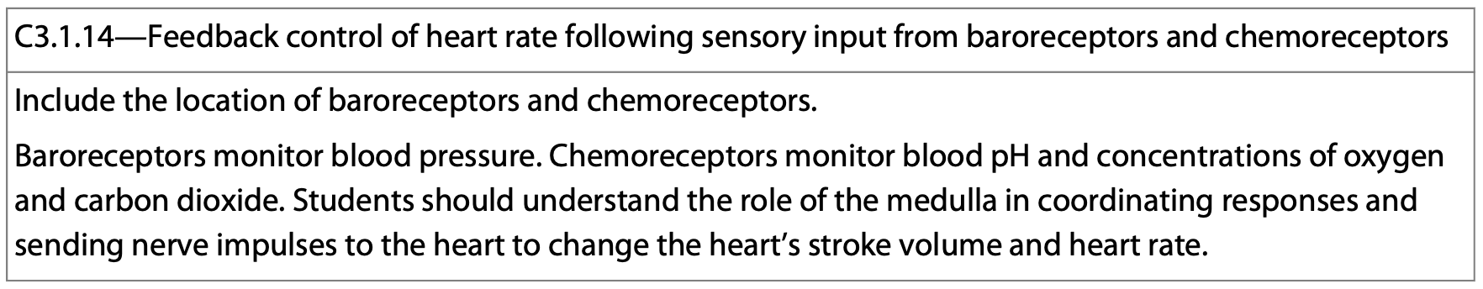
The Heart
When the accelerans nerve releases epinephrine/noradrenaline, the strength and rate of heartbeat increase.
  In short, epinephrine release prepares the body for vigorous physical activity—fight or flight.
  The release is in response to exercise, increased CO2 levels, low blood pressure, etc.
Baro- and chemoreceptors in the aorta and carotid arteries sense changes in pH and blood pressure.

Slide 36
The Heart
When the vagus nerves releases acetylcholine, the strength and rate of heartbeat decreases.
The release has the effect of slowing the heart rate, decreasing the strength of contractions, and lowering blood pressure, etc.

Slide 37
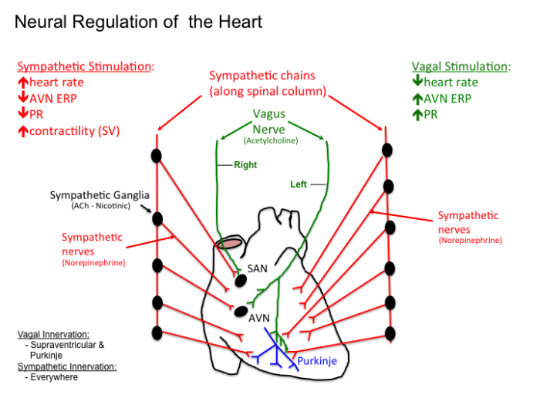
The Heart
The right vagus nerve innervates the SA node, while the left vagus nerve innervates the AV node.
http://tmedweb.tulane.edu/pharmwiki/lib/exe/detail.php/ans_heart.png?id=introduction_to_cardiac_physiology_electrophysiology

Slide 38
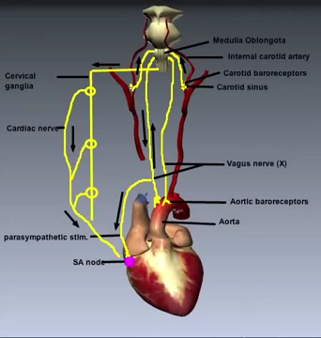
The Heart
The following video explains the nervous control of the heart rate.

Slide 39
The Heart
Hormones, body temperature, and physical activity also have an effect on heart rate.

Slide 40
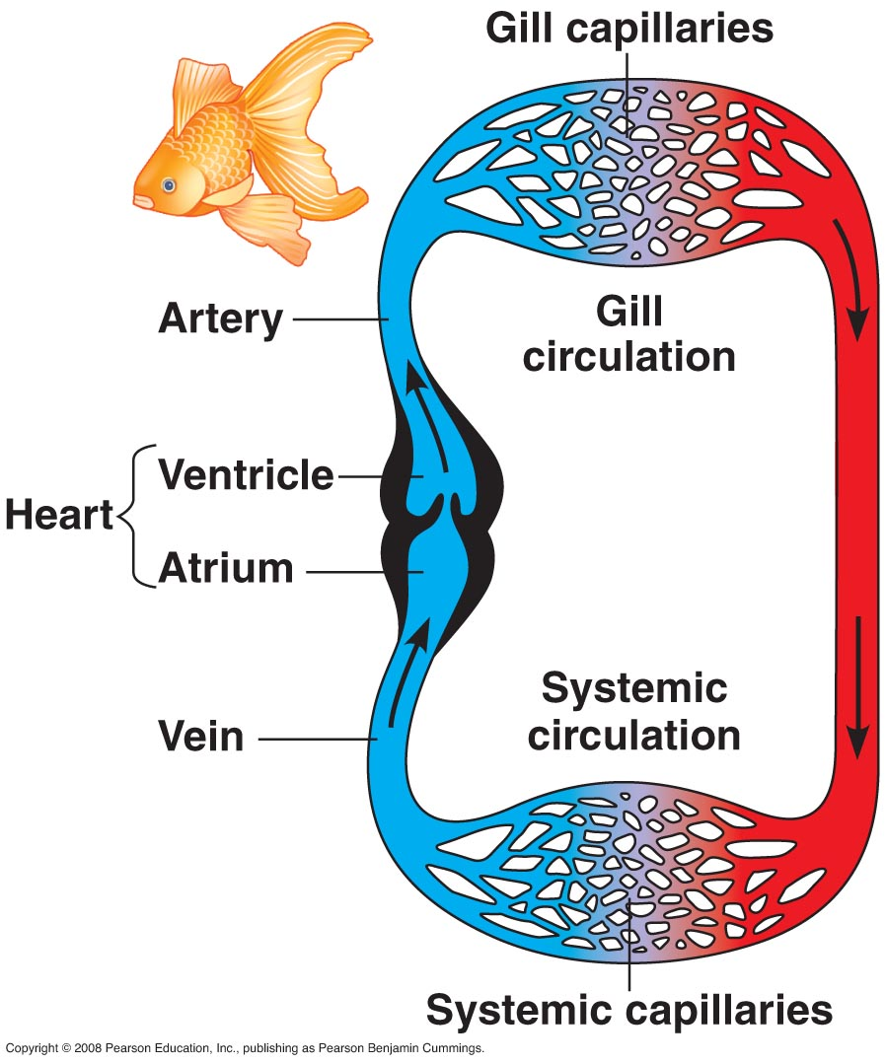
Single Circulation-Bony Fish
The blood passing through a fish heart only does so once.
The heart is acting like a simple, one-way pump.

Slide 41
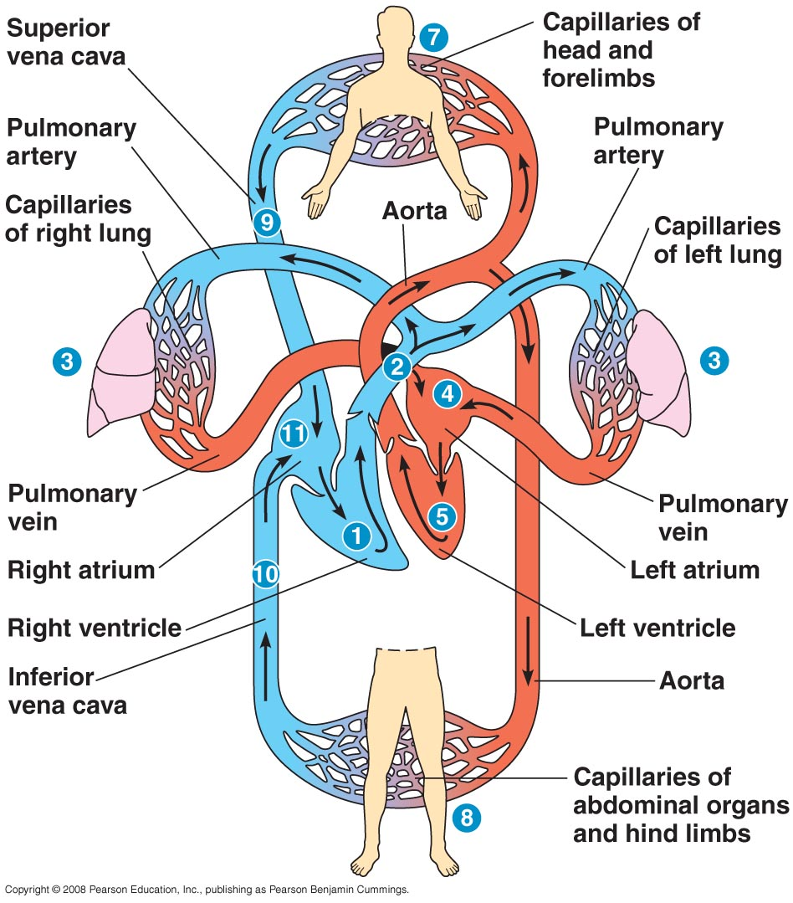
Double Circulation-Mammals
Recall the blood passes through a mammalian heart twice, once as deoxygenated blood, and once as oxygenated blood.

Slide 42
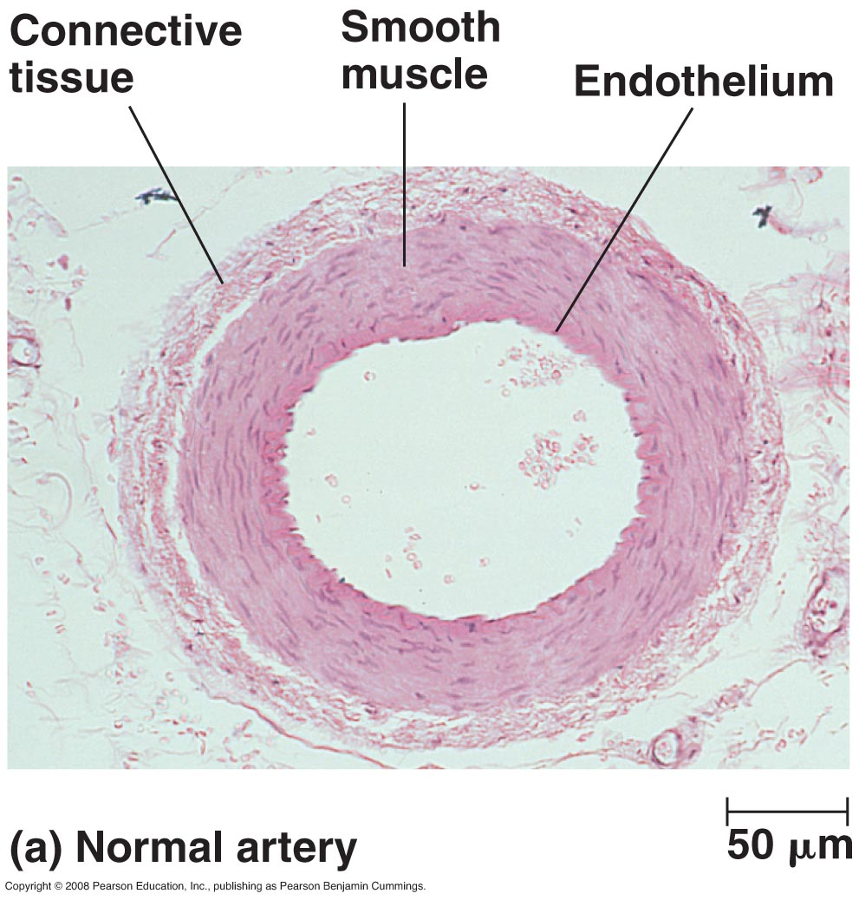
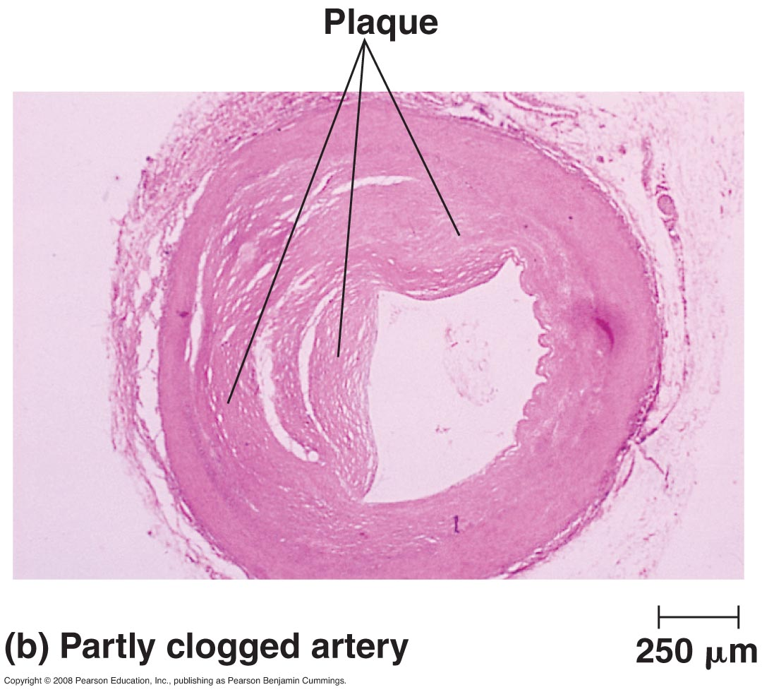
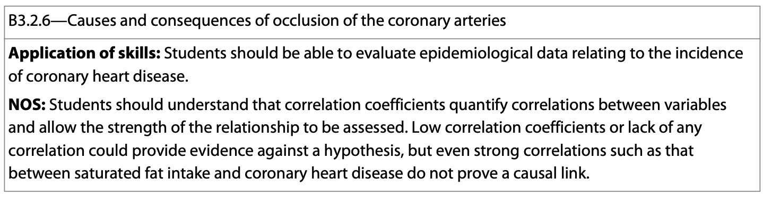
Coronary Arteries
Coronary arteries supply the heart muscle with blood and oxygen.
When they become blocked, heart muscle becomes stressed, and a heart attack can occur.

