Slide 1
Forces and Physical Properties
Essential Idea: One of the strengths of scientific thinking is that a limited number of fundamental concepts can be used to explain a wide range of phenomena. In this reductionist approach four fundamental forces (strong nuclear, weak nuclear, electromagnetic and gravitational) can be used to explain the way in which fundamental particles interact to produce the amazing variety of properties that we observe in the matter that comprises the universe.

Slide 2
Properties of Materials
Physical-density, conductivity, acoustical, optical, combustibility
Mechanical-Strength, stiffness, elasticity, plasticity, ductility, brittleness, hardness, malleability
Dimensional-Size, shape
Chemical-Composition, acidity, alkalinity, weatherability, corrosion

Slide 3
Types of Bonds
There are three types of chemical bonds:
  Ionic
  Covalent
  Metallic
http://classof2018physicalscience.weebly.com/uploads/5/1/8/2/51820345/7562538_orig.jpg

Slide 4

Molecular Structures vs. Lattices
The type of bond the atom has contributes to the type of material that exists.
In terms of bond strength, metallic, ionic, and covalent bonds are strong, whereas molecular interactions are much weaker.
https://slideplayer.com/slide/13397892/80/images/84/Bond+Strengths+Bond+Type+Strength+%28kJ+mol+%E2%80%931%29+Metallic+80+to+600+Ionic.jpg

Slide 5
Molecular Structures vs. Lattices
The consequence is that almost all liquids and gases have molecular structures, whereas many solids have a repeating lattice structure based on bond formation.
These bonds give rise to materials with different properties.
https://images.slideplayer.com/14/4341216/slides/slide_5.jpg

Slide 6
Bond Strength
The bond strengths determine the physical properties of the compounds involved.
https://sparror.cubecinema.com/cube/cola/chemistry/figures/hydrocar.gif
http://www.schoolscience.co.uk/site/scho/uploadedresources/boilingpoints-table.jpg

Slide 7
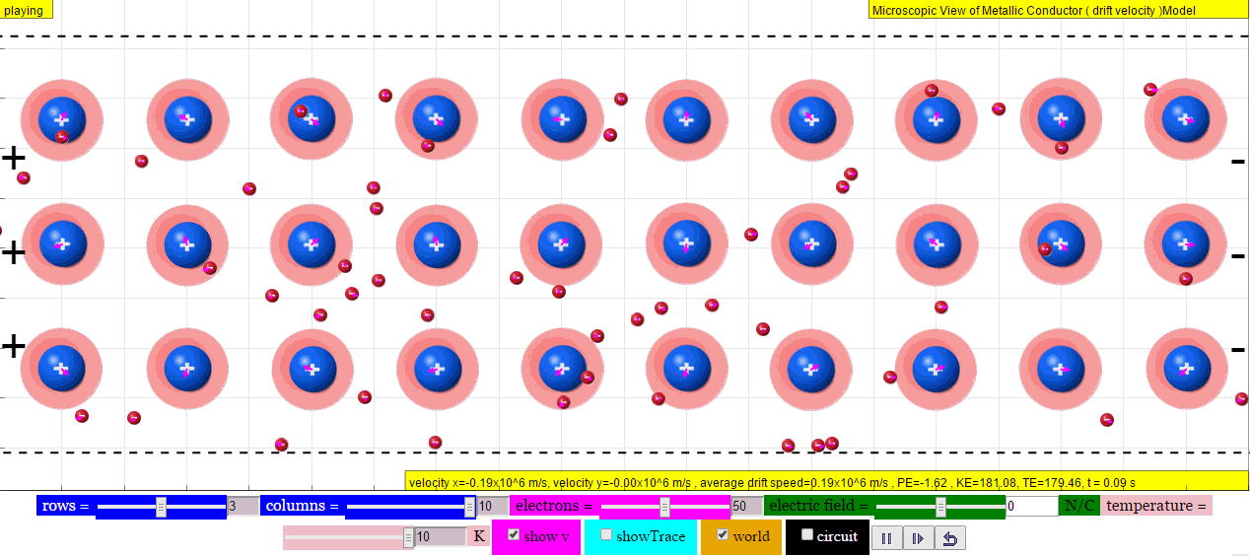
Metallic Bonds
With metals, we have cations existing in a sea of electrons. Atoms can roll over one another. Electrons are free to move and carry charge.
https://1.bp.blogspot.com/-Yk1IT1ZECDg/VW05WZWdZoI/AAAAAAAAuG0/u_pLMtIm7Ak/s1600/Step+4.gif

Slide 8
Ionic Bonds
Ionic bonds form as atoms give and receive electrons from one another.
Opposite charges attract and are held in place by forces of attraction between oppositely charged particles.
https://cnx.org/resources/40e153b2250b362c5de6a615b7c8e2eec29e3625/CNX_UPhysics_42_03_NaClCryst.jpg

Slide 9
Covalent Bonds
Covalent bonds form when atoms share electrons.
https://i.ytimg.com/vi/LkAykOv1foc/maxresdefault.jpg

Slide 10
https://i.ytimg.com/vi/CndrRd4cZ9Q/maxresdefault.jpg

Slide 11
http://pediaa.com/wp-content/uploads/2017/02/Difference-Between-Ductility-and-Malleability-infographic.png

Slide 12
https://pediaa.com/wp-content/uploads/2018/01/Difference-Between-Ductile-and-Brittle-Comparison-Summary.png

Slide 13
Bonds and Mechanical Properties
The position of the particles within the material, and the type of bonds they form determines the properties of the materials in question.
https://cdn.britannica.com/72/105672-050-82E5A58D/types-bonding-crystals.jpg

Slide 14
Brittle Compounds
Ionic compounds have ions fixed in place due to their opposite charges.
They have a very strong structure, and it takes a lot of energy to break the bonds.
These compounds are hard and brittle. The breaking of the structure is due to the like charges interacting.
http://saintschemistry10.weebly.com/uploads/5/1/9/3/51932861/brittleness-on-ionic-compounds_orig.png
https://igcseandialchemistry.com/giant-chemical-structures/

Slide 15
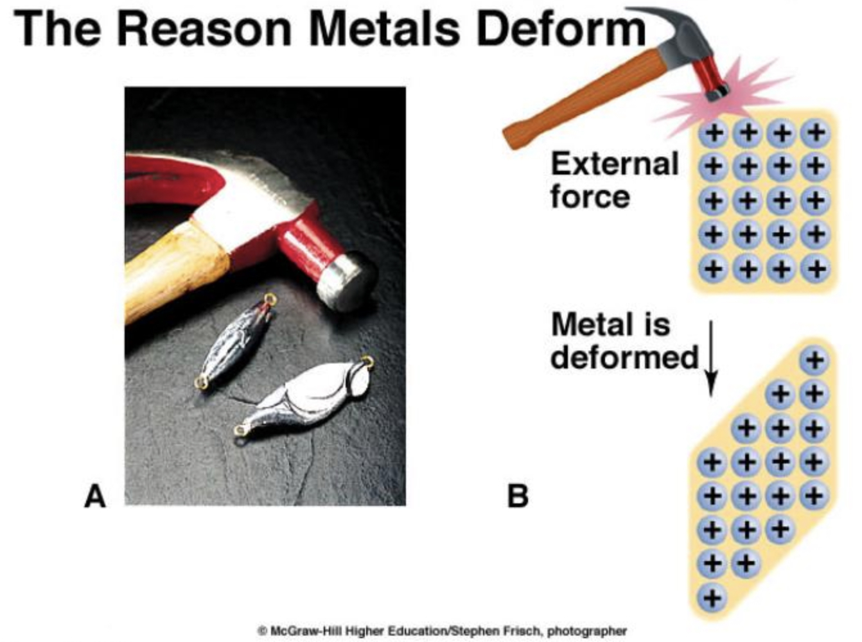
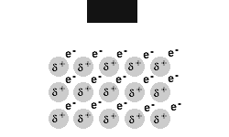
Metal Compounds
Metals can become deformed because the electrons allow for the atoms to get pushed around the sea of electrons.
https://kaiserscience.wordpress.com/chemistry/the-periodic-table/metals-and-non-metals/

Slide 16
Ductile
Ductlie means it can be drawn into wires. In the picture below, the reddish substance is copper. It is pushed through the hole using a tremendous amount of pressure. Once started, a tool grabs it and slowly pulls more and more copper through the hole, drawing it into wire.
https://kaiserscience.wordpress.com/chemistry/the-periodic-table/metals-and-non-metals/

