Slide 1
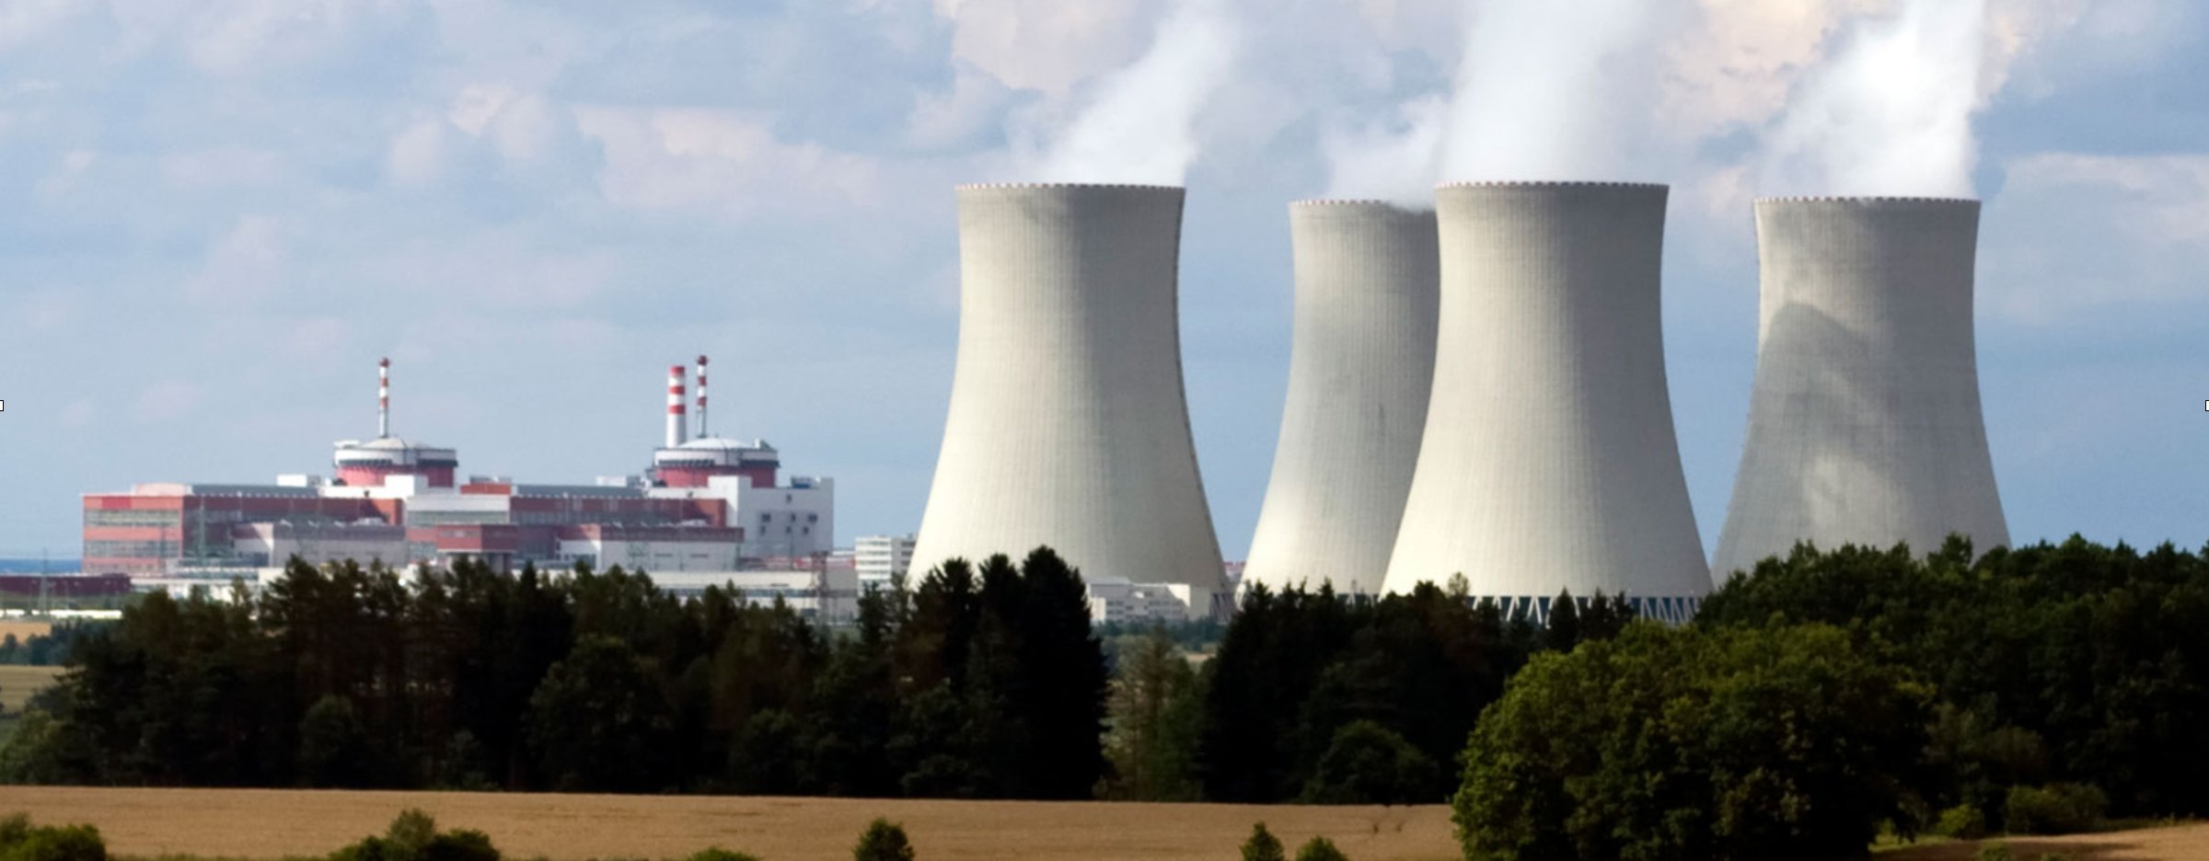
Nuclear Power
https://www.britannica.com/technology/nuclear-reactor

Slide 2
In the U.S.
Nuclear Power

Slide 3
Nuclear Output of Various Nations:
Meeting Energy Demands
Nuclear Generation by Country, 2018
As of 2018, the United States generates a lot of energy from nuclear reactors, but it represents only 19% of the country’s energy needs.
France, by contrast, meets 71% of its energy needs from nuclear reactors.
https://www.world-nuclear.org/information-library/current-and-future-generation/nuclear-power-in-the-world-today.aspx

Slide 4
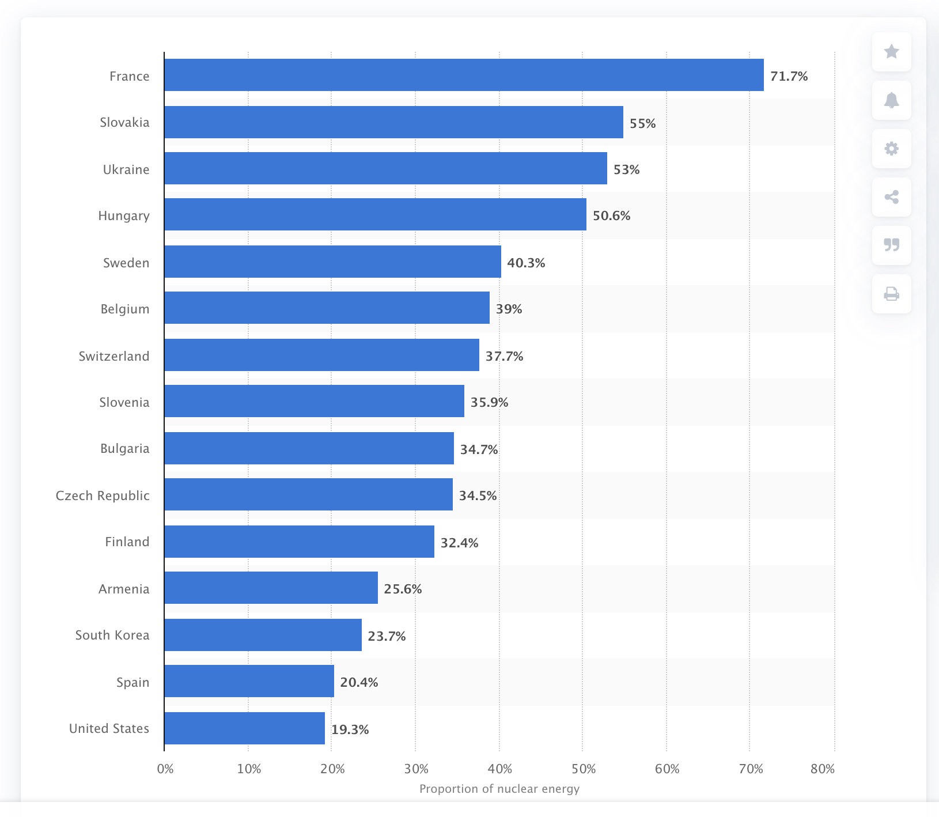
Nuclear Output of Various Nations:
Meeting Energy Demands
Nuclear Power as a Share of Electricity Supply, 2018
As of 2018, the United States generates a lot of energy from nuclear reactors, but it represents only 19% of the country’s energy needs.
France, by contrast, meets 71% of its energy needs from nuclear reactors.
https://www.statista.com/statistics/270367/share-of-nuclear-power-in-the-power-supply-of-selected-countries/

Slide 5
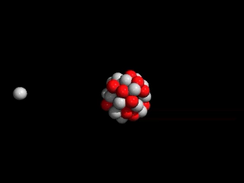
Nuclear Fission
The Nuclear Reaction
With nuclear fission, often a uranium atom is struck by a neutron which adds to the atom’s mass making it unstable and causing it to break apart.
The products of this reaction are two lighter atoms, Kr and Ba, 3 neutrons, and a release of energy.
https://www.xataka.com/energia/fusion-nuclear-asi-funciona-la-tecnologia-que-aspira-a-resolver-nuestras-necesidades-energeticas
https://gfycat.com/discover/fission-gifs

Slide 6
Controlled vs. Uncontrolled Nuclear Reactions
Nuclear Reactions
Nuclear power plants operate by controlling the rate of the reaction inside the reactor core.
Control is maintained by using materials to absorb neutrons.
Control is also maintained by using uranium with a low enrichment level (3-5%) making a nuclear explosion impossible.
Overheating of the reactor can, however, lead to a meltdown and a large release of radiation.

Slide 7
Controlled vs. Uncontrolled Nuclear Reactions
Nuclear Reactions
Nuclear weapons, use highly enriched uranium to produce a fast, intense, uncontrolled reaction that results in a massive release of energy.

Slide 8
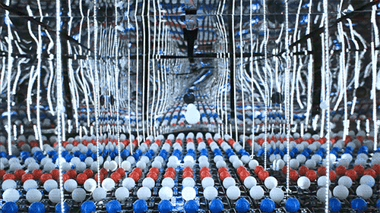
Controlled vs. Uncontrolled Nuclear Reactions
Nuclear Reactions
Nuclear fission in a power plant uses uranium in a controlled chain reaction.
Fission releases two neutrons which strike two more uranium atoms.
As the chain reaction grows with each split of an atom, control rods must be used to slow the reaction before it overheats causing a meltdown.
https://www.aplustopper.com/nuclear-energy/

Slide 9
Control Rods
Nuclear Reactions
Control rods are made of cadmium boron, carbon, or other materials, and absorb neutrons as they are released from the splitting of uranium atoms.
As more neutrons are absorbed, they are unable to strike other uranium atoms, and thus slow/stop the reaction.
https://www.pinterest.com/pin/411797959670187978/

Slide 10
Nuclear Reactor
How it works
Energy released from the fission reactions is used to heat water in the primary loop.
The heated water in the primary loop is used to heat water in a secondary loop, generating steam which turns a turbine and generates electricity.
https://www.inquirer.com/news/nuclear-industry-bets-future-small-modular-reactors-nuscale-holtec-20190316.html

Slide 11
Nuclear Reactions
https://chem.libretexts.org/Courses/Furman_University/CHM101%3A_Chemistry_and_Global_Awareness_(Gordon)/07%3A_Nuclear_Energy/7.04%3A_Generating_Electricity_by_Using_Fission
The fission reaction in the reactor core heats water producing steam that turns a turbine generating electricity.

Slide 12
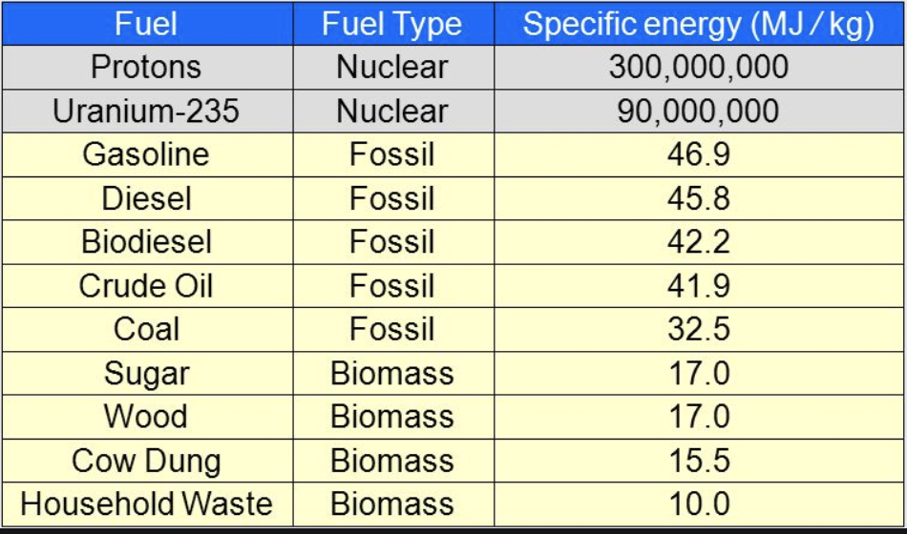
Fuel Density
Nuclear Energy
Nuclear power is desirable because of the extremely high energy density of uranium-235.
Fission Fuel = 3.0 x 10⁸ MJ/kg
Coal = 32.5 MJ/kg
https://slideplayer.com/slide/10457731/

Slide 13
Rod module
Fuel assembly
The fuel assemblies consist of a variety of parts designed to control the fission reaction.
The fuel pellets are purified uranium-235.
Control rods are neutron absorbing and used to slow/stop the reaction.
The reaction is started with a primary source of neutrons, for instance, Plutonium-238.

Slide 14
URanium Enrichment
The Uranium fuel cycle
The enrichment of uranium requires taking the ore, and purifying it.
The purified uranium is made into fuel pellets, and then used in a reactor.
A third of the fuel pellets are usually replaced every 12-18 months to keep the reactor continually generating electricity.
https://www.e-education.psu.edu/eme444/node/238

Slide 15
Uranium mining
The Uranium fuel cycle
https://theohiostar.com/2018/11/07/supreme-court-weighs-bid-to-open-nations-largest-uranium-mine/
First, ore is removed from the ground.
Then it is ground into a fine powder and treated with a chemical to remove the uranium ore.
The ore is then turned into a gas and centrifuged to remove the desired U-235.

Slide 16
Text
http://infographic.statista.com/normal/chartoftheday_12304_countries_with_the_biggest_production_volume_of_uranium_n.jpg

Slide 17
Uranium Enrichment
The uranium fuel cycle
The enrichment process actually involves the production of a gas, which is fed into repeated centrifuges resulting in a higher and higher concentration of U-235.

Slide 18
Nuclear accidents
Meltdowns and explosions
Nuclear accidents are rare compared to other forms of energy production.
The problem with the accidents is they are catastrophic.

Slide 19
Disaster Statistics
Chernobyl
200,000 km² were contaminated as a result of the accident.
4,000+ deaths.
Many plants and animals within 20-30 km of the site were severely effected initially, but have recovered.
350,000 people were relocated.
785,000 hectares of agriculture was lost.
695,000 hectares of timber was lost.
https://www.timesofisrael.com/when-hubris-meets-nuclear-fission-a-chernobyl-liquidators-warning-to-humanity/

Slide 20
Disaster statistics
Fukushima
13,000 km² were contaminated.
160,000 people were relocated.
No fatalities due to the accident.

