Slide 1
Introduction to Communication
Essential Idea: Modern developments in science have allowed continuous communication and information exchange at large volumes and high speeds, over long distances. This has transformed our everyday lives.

Slide 2
1800 BC
Smoke Signals
Smoke Signals: In a matter of hours, Chinese soldiers stationed on the Great Wall could warn their comrades 500 miles away of an impending enemy attack via tower to tower smoke signals.
https://www.conferencecallsunlimited.com/history-of-communication-technology/

Slide 3
150 BC
The Greek Way
The Greek Way: Polybius, a Greek historian, invented a system of converting Greek alphabetic characters into numeric characters. The enabled messages to be easily sent by coded torch smoke signals.
https://www.conferencecallsunlimited.com/history-of-communication-technology/

Slide 4
1844
Telegram
Telegram. The first telegraph message trailed 40 miles and read, “What Hath God Wrought?”
https://www.conferencecallsunlimited.com/history-of-communication-technology/

Slide 5
1876
“Mr. Watson…
“Mr. Watson come here, I want to see you,” were the first words spoken on a successful telephone call by Alexander Graham Bell.
https://www.conferencecallsunlimited.com/history-of-communication-technology/

Slide 6
1877
Ahoy?
Ahoy? Alexander Graham bell originally wanted the greeting for the telephone to be “Ahoy,” but Thomas Edison voted for “Hello,” a word he coined himself.
https://www.conferencecallsunlimited.com/history-of-communication-technology/

Slide 7
1920s
Crystal Clear
The most common type of radio used a crystal as one of its main components. Radio waves powered the crystal instead of batteries.
The first record was of “Mary Had a Little Lamb”. Thomas edison, who invented the phonograph, recited and recorded it.
https://www.conferencecallsunlimited.com/history-of-communication-technology/

Slide 8
1920s
Optic Fiber
One thread of optic fiber is slightly thicker than a human hair. One million threads of optic fiber can fit in a tube 1/2” in diameter.
https://www.conferencecallsunlimited.com/history-of-communication-technology/

Slide 9
1946
How Practical
The Swedish police used the first cell phone. It could only make 6 phone calls before the car’s battery died.
https://www.conferencecallsunlimited.com/history-of-communication-technology/

Slide 10
1973
First Cell Phone
Martin Cooper invented the first official cell phone. The 2 pound “Brick” was called Motorola Dyna-Tac. Its dimensions measured 9”x 5”x 1.75”
https://www.conferencecallsunlimited.com/history-of-communication-technology/

Slide 11
1978
SPAM! SPAM!
The first span email was sent to the 393 users on ARPANET by Gary Thurek to advertise a new kind of computer.
https://www.conferencecallsunlimited.com/history-of-communication-technology/

Slide 12
2006
We Are Googling
To “google” became an officially recognized verb in 2006 when both Merriam-Webster Collegiate Dictionary as well as the Oxford English Dictionary recognized it.
https://www.conferencecallsunlimited.com/history-of-communication-technology/

Slide 13
2009
Old vs. New
A carrier pigeon transported 4GB 60 miles in South Africa faster than it took to transfer 4GB over broadband.
https://www.conferencecallsunlimited.com/history-of-communication-technology/

Slide 14
Explosion of Communication
With the rapid invention and adoption of new technology, the medium of communication has dramatically changed—especially in recent years. Internet modalities have largely replaced paper and earlier wire-based communications. Internet communications continue to evolve in ways that its founders could never imagine or envision.

Slide 15
Future
We can now communicate across long distances to large groups of people almost instantaneously with international conference calls and webinars. What new developments in technology will make communication even more instant? Will our screens and webcams become obsolete? Where will our blossoming inner abilities and outer technologies take us and which of today’s cutting edge communication tools will survive? The future is exciting and unpredictable.
https://www.conferencecallsunlimited.com/history-of-communication-technology/

Slide 16
Future
In 2012 migrant workers sent $12 billion home through mobile money transfer services.
In 2016 it was $55 billion.
https://www.conferencecallsunlimited.com/history-of-communication-technology/

Slide 17

Microphones
Microphones convert energy from one form into another.
They convert sound waves into electrical signals.
https://www.mediacollege.com/audio/microphones/dynamic.html

Slide 18
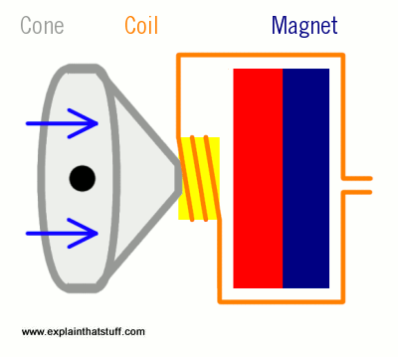
The Speaker
When a fluctuating electric current flows through the coil (orange), it becomes a temporary electromagnet, attracted and repelled by the permanent magnet (blue/red). As the coil moves, it moves the cone (gray) back and forth, pumping sound waves into the air.
https://www.explainthatstuff.com/loudspeakers.html

Slide 19
Generation of the Signal
Once the signal has been generated, it gets transmitted to the antenna and sent out.

Slide 20
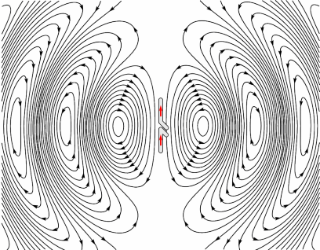
Electromagnetic Wave Transmission
Whenever an alternating current flows through a conductor (antennae), electromagnetic waves are produced.
The frequency of the waves equals the frequency of the alternating current.
https://en.wikipedia.org/wiki/Radio_wave#/media/File:Dipole_xmting_antenna_animation_4_408x318x150ms.gif

Slide 21
Electromagnetic Waves
Electromagnetic waves are produced whenever electric charges are accelerated.
Oscillations of current in an electrical conductor emit electromagnetic waves that mirror the oscillations.
https://media.cdn.lexipol.com/signalgraph.jpg

Slide 22
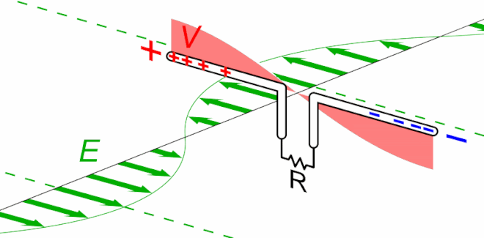
Receiving Antenna
These waves may be detected by a conductor at some distance from the source, without there being any physical connection between the two.
https://en.wikipedia.org/wiki/Radio_wave#/media/File:Dipole_xmting_antenna_animation_4_408x318x150ms.gif

Slide 23
An Aside
Light emitted by light bulb is caused by the thermal motion that accelerates the electrons in the hot filament sufficiently to produce visible light.
http://galileo.phys.virginia.edu/classes/241L/emwaves/img00005.gif

Slide 24
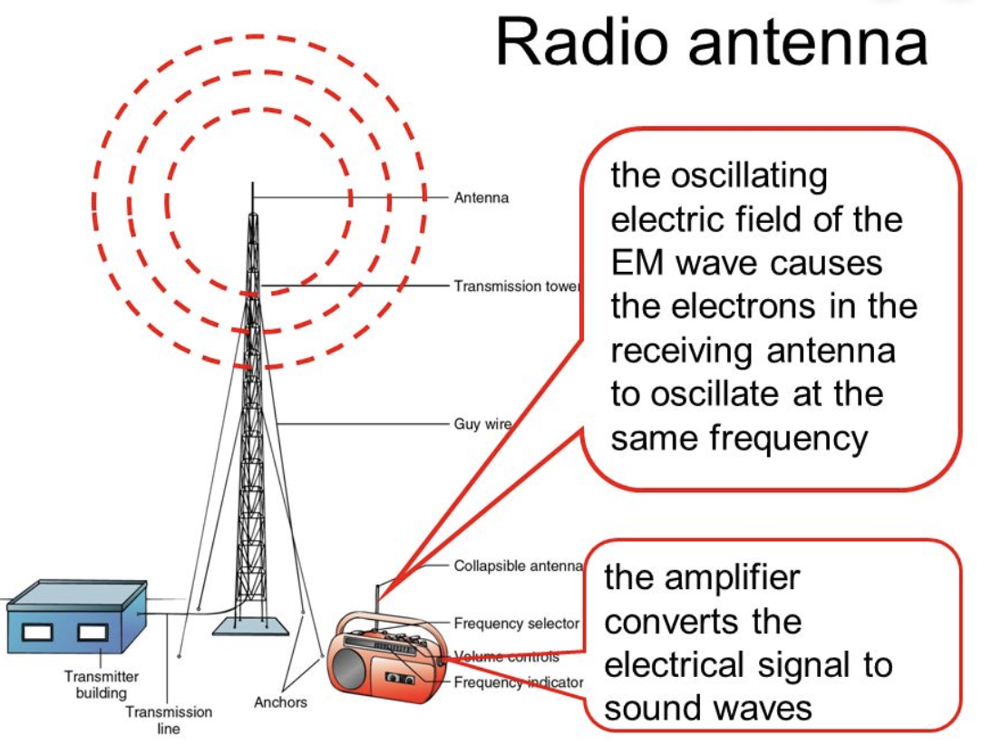
Electromagnetic Waves
The opposite is also true: that is, if an electromagnetic wave strikes a wire, it induces an alternating current of the same frequency in the wire.
This is how the receiving antennas of radios (and older TVs) work.
Antennas work best when their length is similar to that of the wavelength of the waves emitted or received.
https://images.slideplayer.com/36/10659384/slides/slide_20.jpg

Slide 25
Crossing Borders
Broadcasting techniques using electromagnetic waves allow a signal to be received at many stations. This has brought nations into closer contact and helped to overcome cultural differences.
https://www.nexus.org/wp-content/uploads/2017/11/xafrican-radio-listener-c.jpg.pagespeed.ic.5WiiY-ogOX.jpg

Slide 26
Sending Signals
Electromagnetic induction can be used to generate and transmit an audio signal across great distances.

Slide 27
Invention of Radio
The application of the principle of electromagnetic induction to the transmission of audio signals is a wonderful example of the creative, imaginative way that scientists have adapted basic discoveries to make possible things that had previously been considered impossible.
https://upload.wikimedia.org/wikipedia/commons/1/12/FFU_trx_Stiff_1904.JPG

